Slide 1
Asking the right questions from your methylation data
Anders Berglund
Moffitt Cancer Center

Slide 2
Conflict of Interest None

Slide 3
Different types of questions with increasing complexity and difficulty
Is my gene of interest regulated by methylation?
Is my list of genes regulated by methylation?
Is my outcome of interest driven by methylation?
Hey, I have a methylation dataset…

Slide 4
“Epigenetics is the study of heritable phenotype changes that do not involve alterations in the DNA sequence[1].”
“As such, the term ‘epigenetics’ has solid roots in describing how a cell retains memory of past states and perturbations[2].”
xkcd.com/2298/
Dupont C, Armant DR, Brenner CA (2009). "Epigenetics: definition, mechanisms and clinical perspective". Seminars in Reproductive Medicine. 27 (5): 351–57
Henikoff, S., & Greally, J. M. (2016). Epigenetics, cellular memory and gene regulation. Current biology, 26(14), R644-R648.

Slide 5
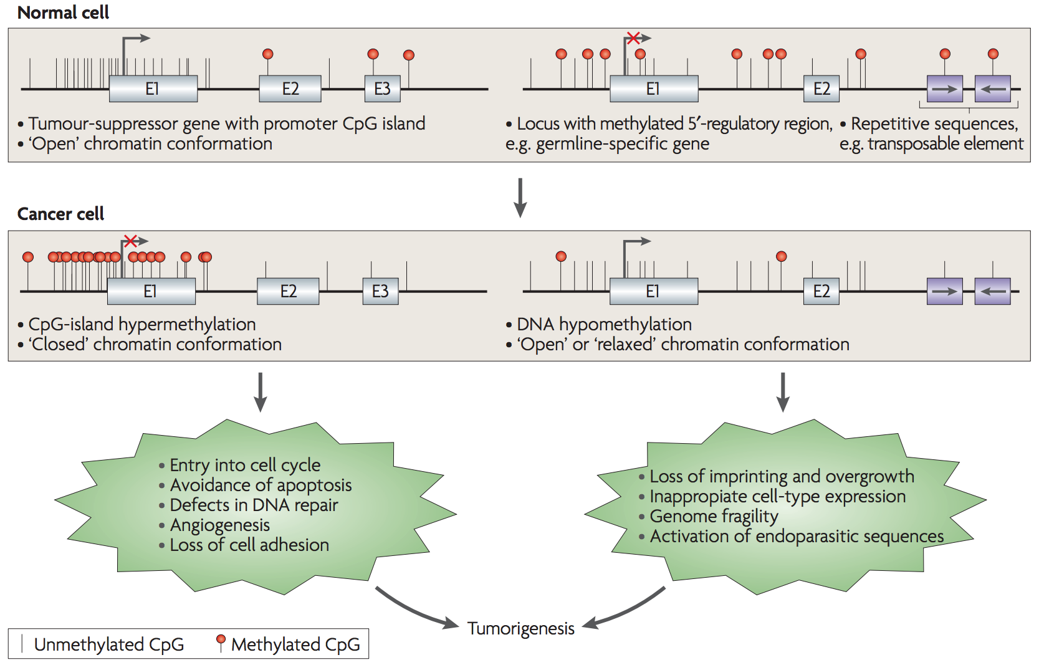
CpG island
Methylation
Multiple CpG-sites for each gene
Different parts of the gene structure
Both hyper and hypo methylation are important
Esteller M. Cancer epigenomics: DNA methylomes and histone-modification maps. Nat Rev Genet. 2007;8(4):286-98.

Slide 6
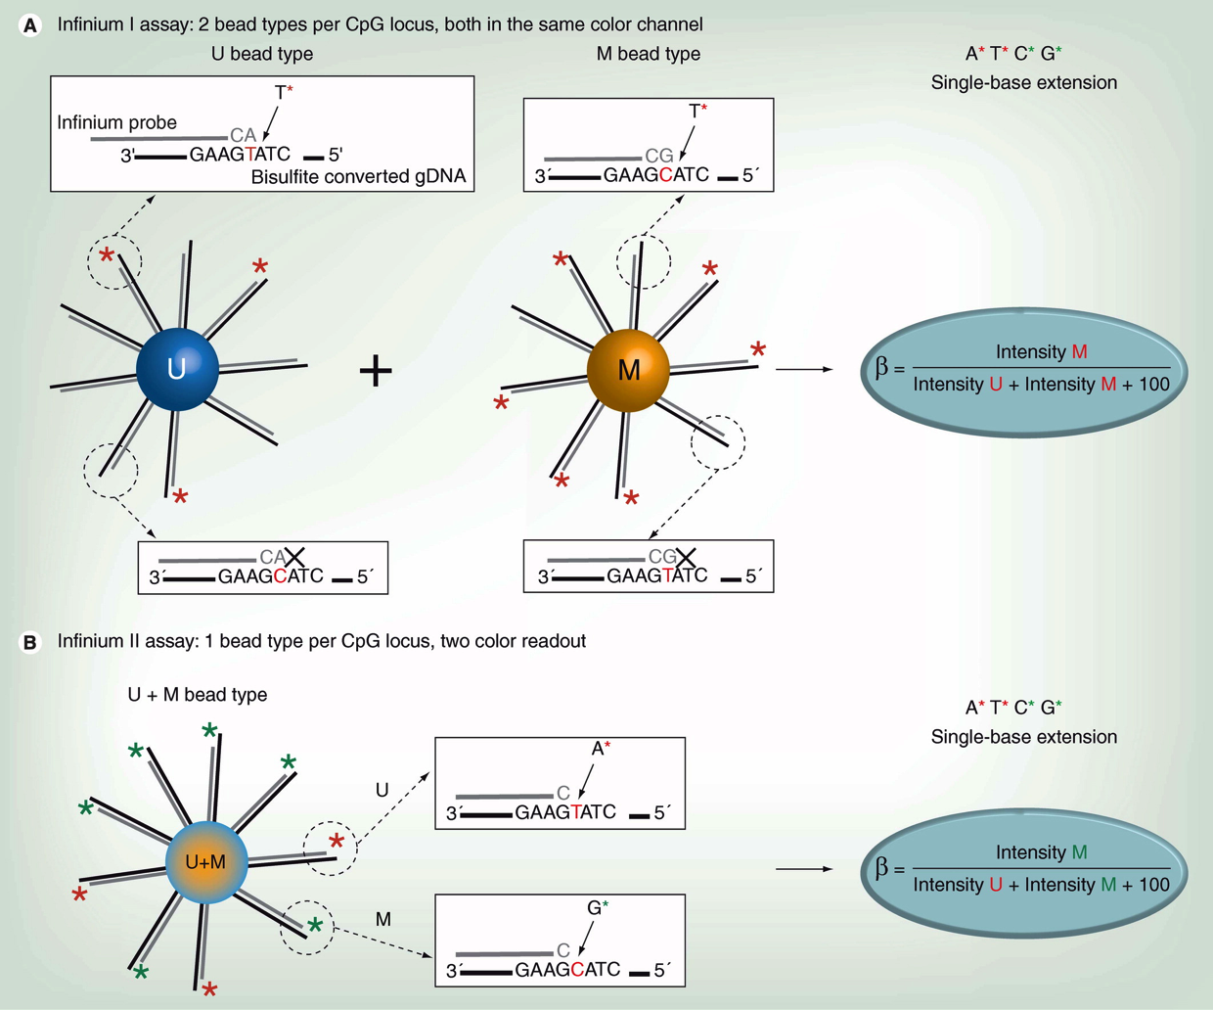
Illumina's Infinium 27K/450K / EPIC/EPICv2 HumanMethylation Array
Illumina methylation array
Two assays¹
SNP probes, rs-probes
450K: 480K CpG-probes², TCGA
EPIC: 850K CpG-probes
EPICv2: 920K CpG-probes, somatic mutations, multiple CpG-probes for the same position, cg00017461_BC12
β–value
Degree of methylation
M-value M=log₂(β /(1− β))
Annotation of the probes
Cross hybridization, SNP sites and other issues^{3,4}
Normalization
Many methods available
Usual problems⁵
Batch effects
How to interpret the results
Dedeurwaerder S, et al: Evaluation of the Infinium Methylation 450K technology. Epigenomics 2011, 3:771-784.
Bibikova M, et al: High density DNA methylation array with single CpG site resolution. Genomics 2011, 98:288-295.
Chen Y-a, et al: Discovery of cross-reactive probes and polymorphic CpGs in the Illumina Infinium HumanMethylation450 microarray. Epigenetics 2013, 8:203-209.
Price EM, et al: Additional annotation enhances potential for biologically-relevant analysis of the Illumina Infinium HumanMethylation450 BeadChip array. Epigenetics & Chromatin 2013, 6:4.
Harper KN, et al: Batch Effects and Pathway Analysis: Two Potential Perils in Cancer Studies Involving DNA Methylation Array Analysis. Cancer Epidemiology Biomarkers & Prevention 2013, 22:1052-1060.
Taken from Dedeurwaerder S, et al. Epigenomics 2011, 3:771-784.

Slide 7
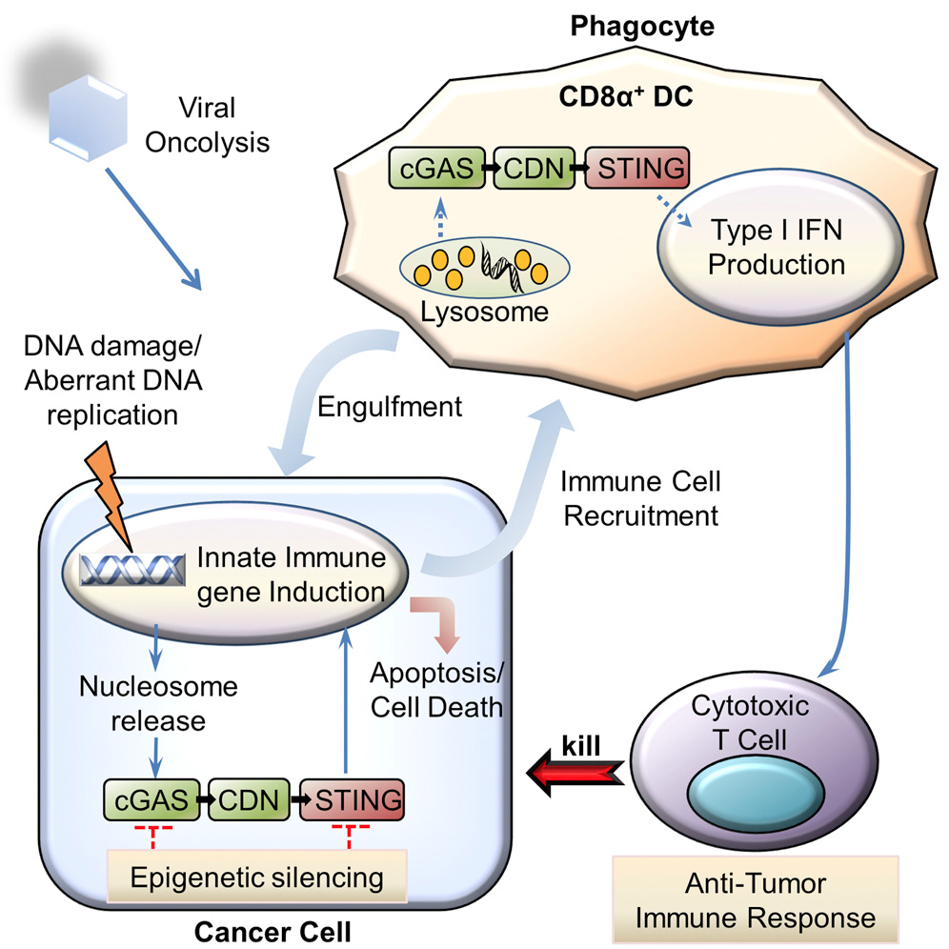
Are STING and cGAS epigenetically regulated across different tumor types?
Xia T, et al. Deregulation of STING Signaling in Colorectal Carcinoma Constrains DNA Damage Responses and Correlates With Tumorigenesis. Cell reports 2016;14:282-97

Slide 8
How do we visualize methylation data?
One gene is represented by many CpG-probes
Probe Id
Location
CpG-Islands
Where in the gene-body
5 – 10,000 samples
Group comparison
Additional questions
Correlation between probes
Correlation to gene-expression levels
Gene Structure Methylation (GSM) plot¹⁻⁶
Siegel EM, Eschrich S, Winter K, Riggs B, Berglund A, et al. Epigenomic Characterization of Locally Advanced Anal Cancer: A Radiation Therapy Oncology Group 98-11 Specimen Study. Dis Colon Rectum. 2014 Aug;57(8):941-57. PMCID: PMC4100249
Konno H, Yamauchi S, Berglund A, Putney RM, Mulé JJ, Barber GN. Suppression of STING signaling through epigenetic silencing and missense mutation impedes DNA damage mediated cytokine production. Oncogene. 2018 Apr;37(15):2037-2051. PMCID: PMC6029885.
Wu Q, Berglund AE, Wang D, MacAulay RJ, Mulé JJ, Etame AB. Paradoxical epigenetic regulation of XAF1 mediates plasticity towards adaptive resistance evolution in MGMT-methylated glioblastoma. Sci Rep. 2019 Oct 1;9(1):14072. PMCID: PMC6773736.
Berglund A, Mills M, Putney RM, Hamaidi I, Mulé J, Kim S. Methylation of immune synapse genes modulates tumor immunogenicity. J Clin Invest. 2020 Feb 3;130(2):974-980. PMCID: PMC6994116.
Berglund, A. E. et al. Accessible Pipeline for Translational Research Using TCGA: Examples of Relating Gene Mechanism to Disease-Specific Outcomes. Methods Mol. Biol. 2194, 127–142 (2021).
Berglund A, Putney RM, Hamaidi I, Kim S. Epigenetic dysregulation of immune-related pathways in cancer: bioinformatics tools and visualization. Exp Mol Med 2021;53:761–71

Slide 9
cGAS
CpG-island
Gene
Body
16 CpG-probes for cGAS
Box-plots
Probe Ids
Genomic
location
Distance dependent (log)
β-value
0% methylation
100% methylation
Konno H, Yamauchi S, Berglund A, Putney RM, Mulé JJ, Barber GN. Suppression of STING signaling through epigenetic silencing and missense mutation impedes DNA damage mediated cytokine production. Oncogene. 2018 Apr;37(15):2037-2051

Slide 10
13(16) probes show a r<-0.3
cg09931909 is highly correlated but show high degree of methylation in most samples opposite to most other probes
Using these three graphs we can in an informed way summarize the methylation level of a gene
β-value

Slide 11
cGAS is silenced in many tumors across different tumor types
Bartlett’s test (* p < 0.05) and Fisher’s exact test for enrichment of tumors in the 75th percentile ( + p < 0.05)
Konno H, Yamauchi S, Berglund A, Putney RM, Mulé JJ, Barber GN. Suppression of STING signaling through epigenetic silencing and missense mutation impedes DNA damage mediated cytokine production. Oncogene. 2018 Apr;37(15):2037-2051. PMCID: PMC6029885.

Slide 12
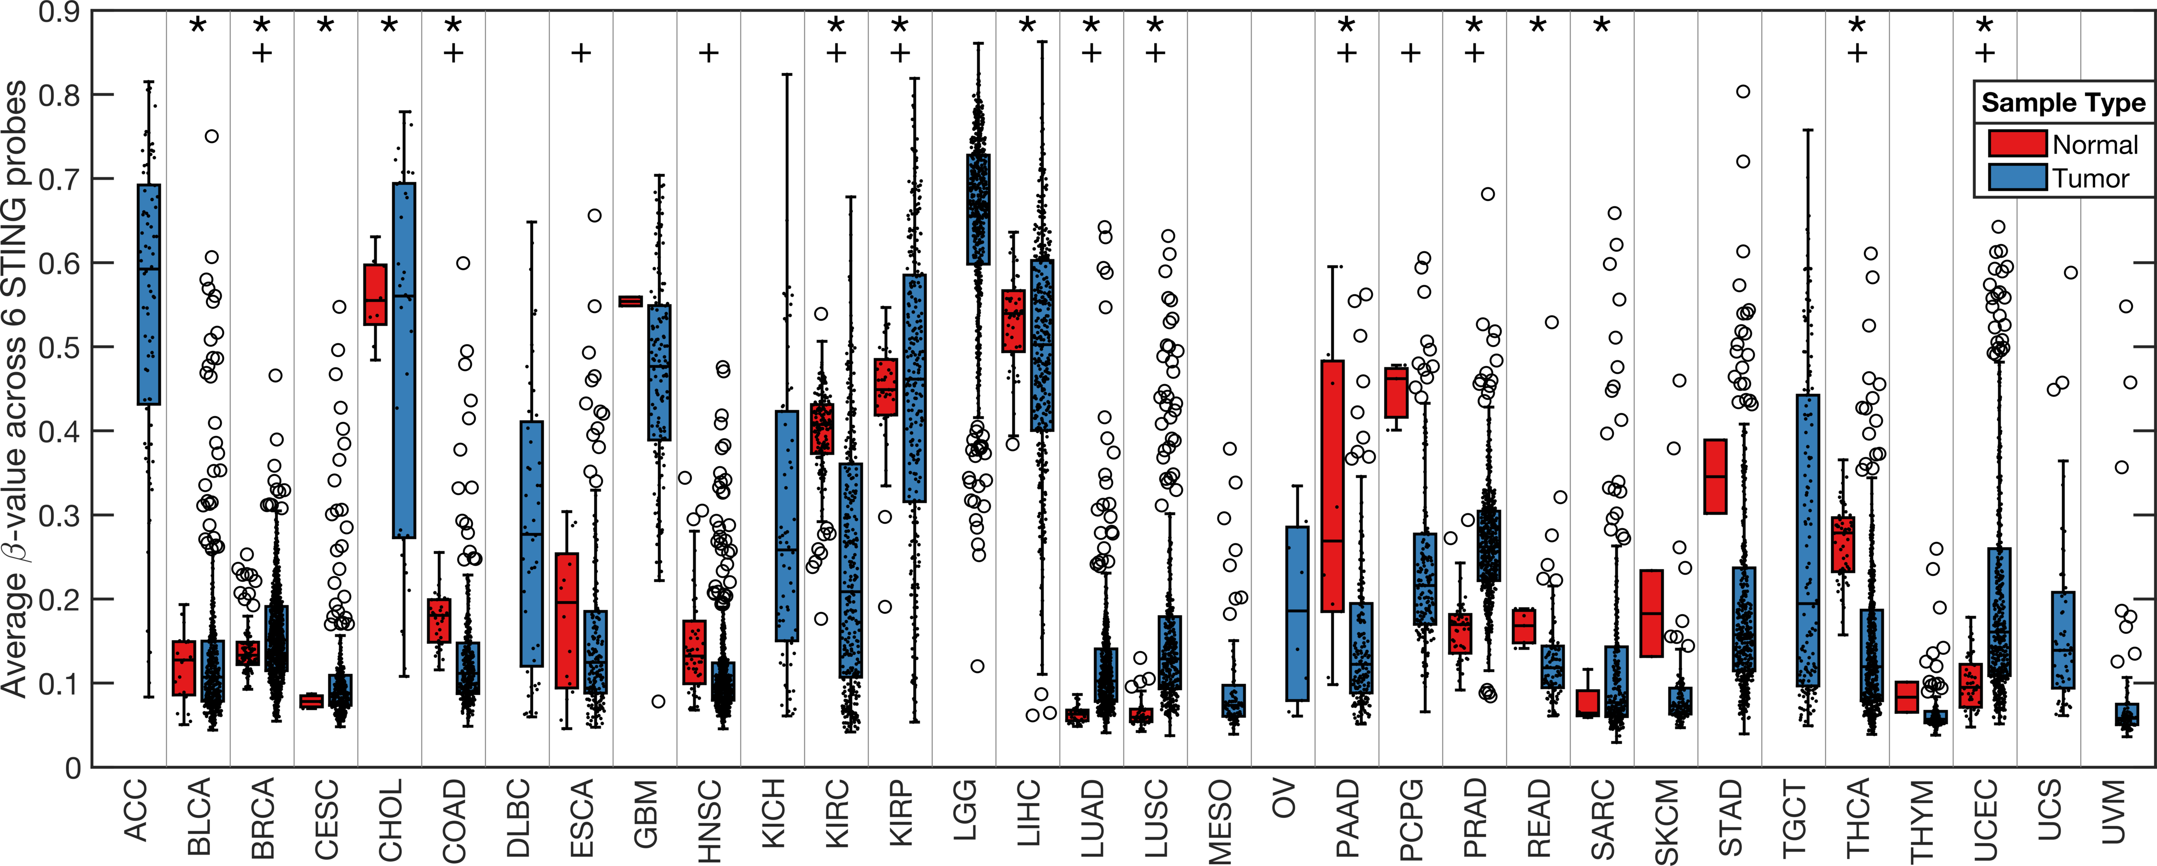
STING is silenced in many tumors across different tumor types
Bartlett’s test (* p < 0.05) and Fisher’s exact test for enrichment of tumors in the 75th percentile ( + p < 0.05)
Konno H, Yamauchi S, Berglund A, Putney RM, Mulé JJ, Barber GN. Suppression of STING signaling through epigenetic silencing and missense mutation impedes DNA damage mediated cytokine production. Oncogene. 2018 Apr;37(15):2037-2051. PMCID: PMC6029885.

Slide 13
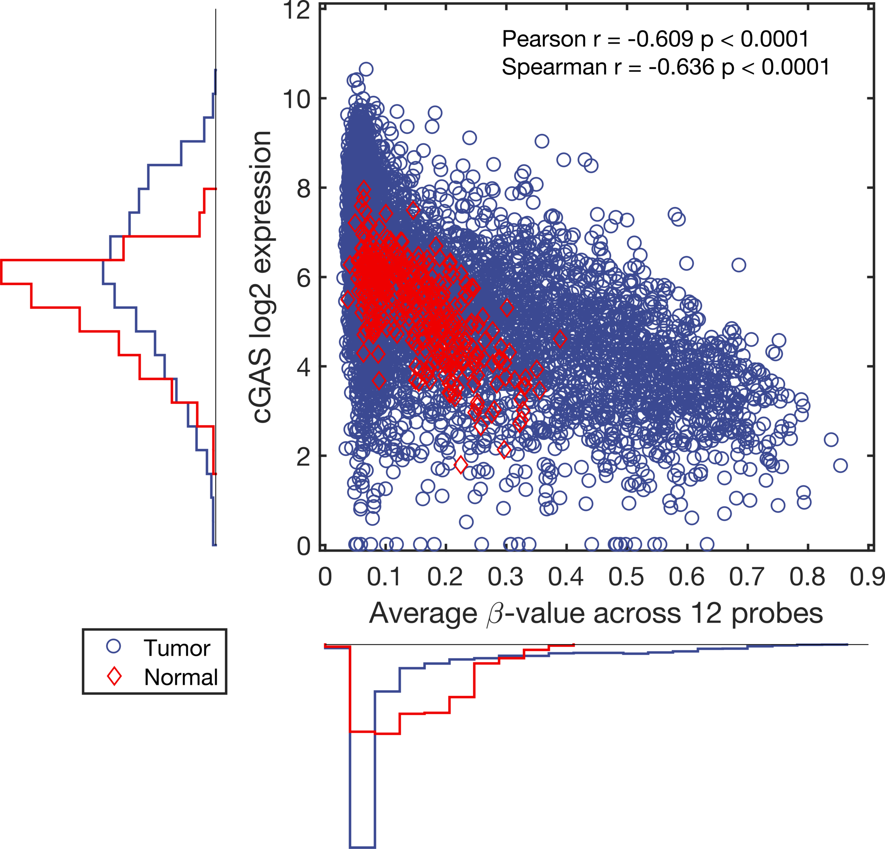
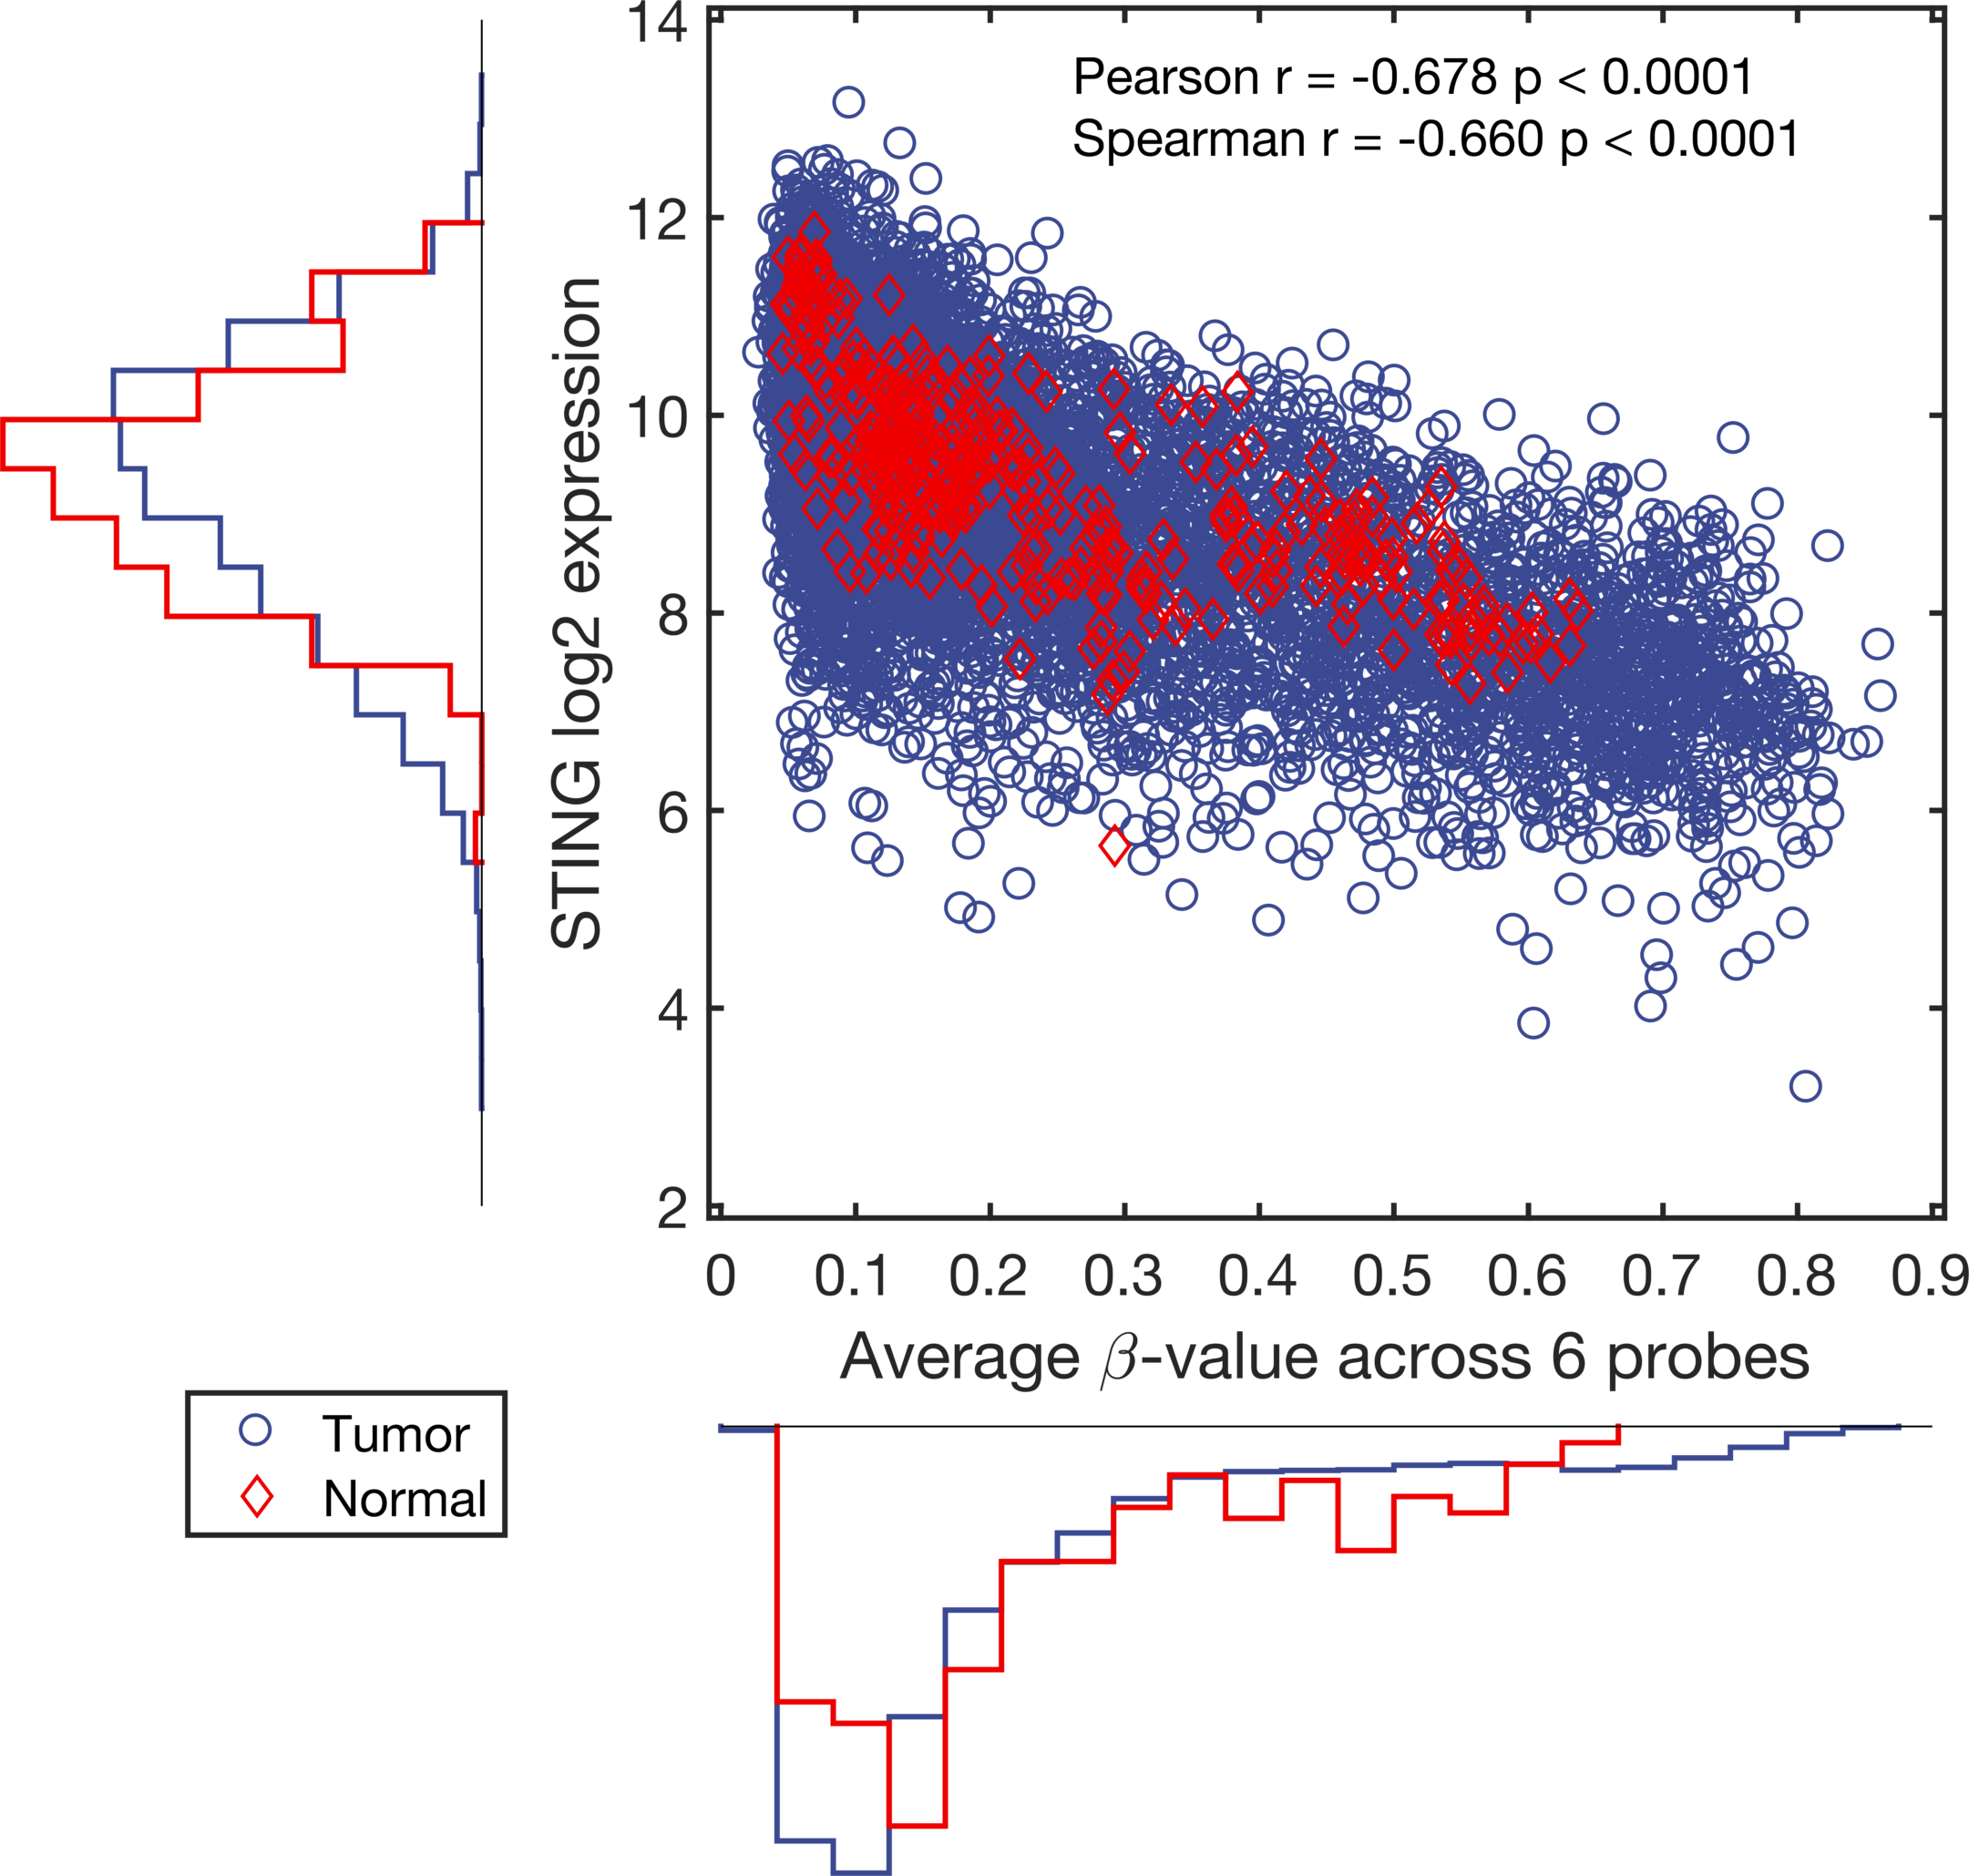
The average methylation level for the 12 selected probes is negatively correlated to cGAS gene expression level
High degree of methylation results in low expression of cGAS
Sample with low degree of methylation still show a full range of expression, indicating the cGAS expression is also regulated by other means
Is it always this neat?

Slide 14
Nice!
Nothing here
What?
TDRD1 is regulated by methylation in prostate samples
TTP/ZFP36 is not regulated by methylation in cancer
SEPT9(SEPTIN9) is not just a problem in Excel but also when it comes to methylation…
Berglund AE, et al. Tristetraprolin disables prostate cancer maintenance by impairing proliferation and metabolic function. Oncotarget 2016;7:83462–75.
Berglund AE, et al. Distinct transcriptional repertoire of the androgen receptor in ETS fusion-negative prostate cancer. Prostate Cancer Prostatic Dis 2019;22:292–302.

Slide 15
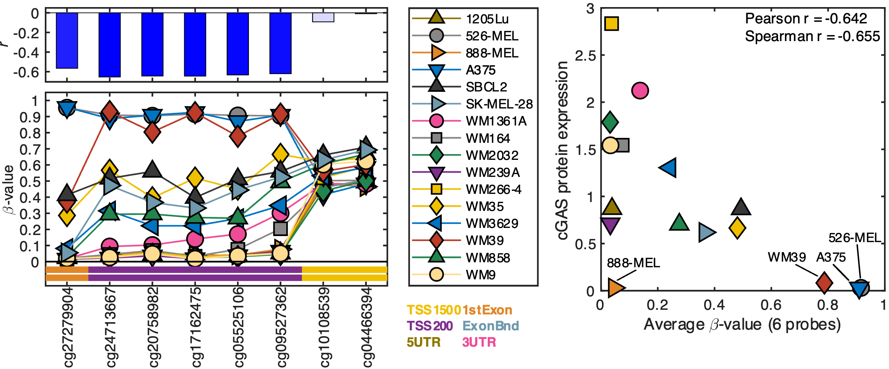
cGAS
Falahat R, Berglund A, Putney RM, Perez-Villarroel P, Aoyama S, Pilon-Thomas S, et al. Epigenetic reprogramming of tumor cell–intrinsic STING function sculpts antigenicity and T cell recognition of melanoma. PNAS 2021;118
Falahat R, Berglund A, Perez-Villarroel P, Putney RM, Hamaidi I, Kim S, et al. Epigenetic state determines the in vivo efficacy of STING agonist therapy. Nat Commun 2023;14:1573

Slide 16
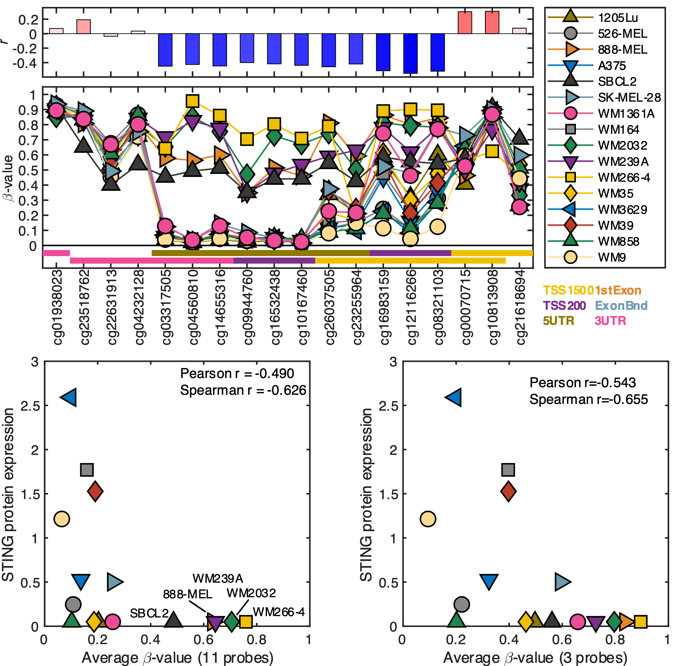
STING
The model is a bit more complicated for STING
Not all probes are showing the same behavior
Falahat R, Berglund A, Putney RM, Perez-Villarroel P, Aoyama S, Pilon-Thomas S, et al. Epigenetic reprogramming of tumor cell–intrinsic STING function sculpts antigenicity and T cell recognition of melanoma. PNAS 2021;118
Falahat R, Berglund A, Perez-Villarroel P, Putney RM, Hamaidi I, Kim S, et al. Epigenetic state determines the in vivo efficacy of STING agonist therapy. Nat Commun 2023;14:1573
Notes:
Expand on the pink triangles, maybe add plot using these 3 probes

Slide 17
Does methylation of immune synapse genes modulate tumor immunogenicity?
Select genes to use
Investigate methylation pattern across tumor types using all genes and probes
Summarize methylation state
Immune checkpoint genes vs. Co-stimulatory genes
Investigate clinical relevance
Validate findings
Berglund A, Mills M, Putney RM, Hamaidi I, Mulé J, Kim S. Methylation of immune synapse genes modulates tumor immunogenicity. J Clin Invest. 2020 Feb 3;130(2):974-980

Slide 18
CSG
ICG
Berglund A, Mills M, Putney RM, Hamaidi I, Mulé J, Kim S. Methylation of immune synapse genes modulates tumor immunogenicity. J Clin Invest. 2020 Feb 3;130(2):974-980

Slide 19
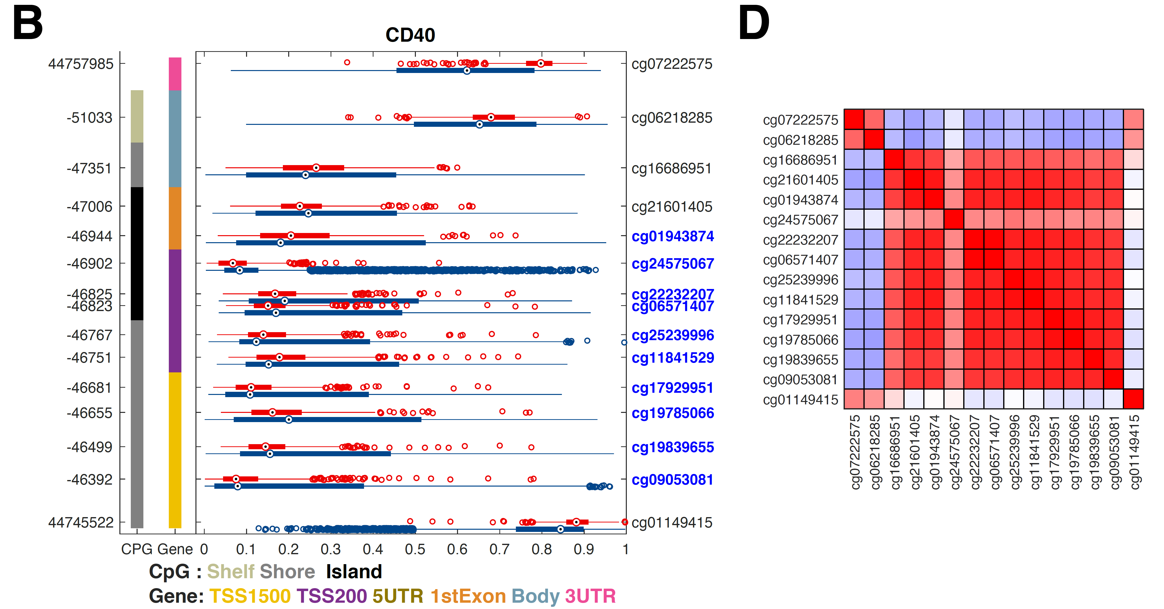
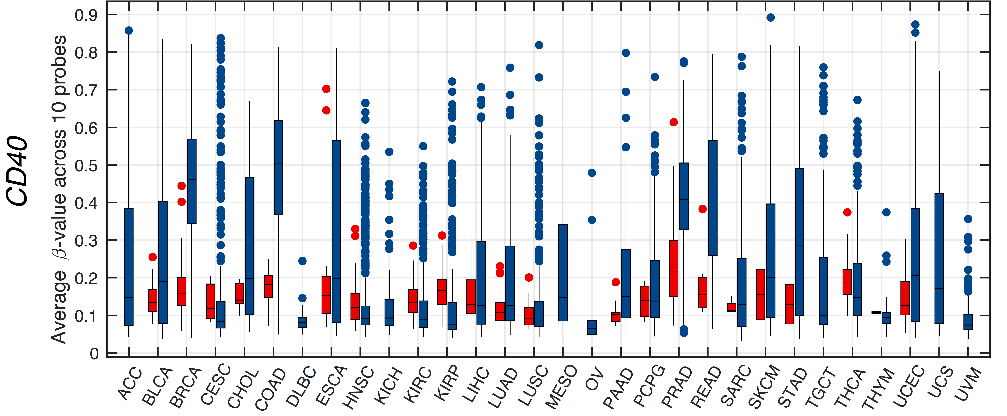
CSGs are Hypermethylated

Slide 20
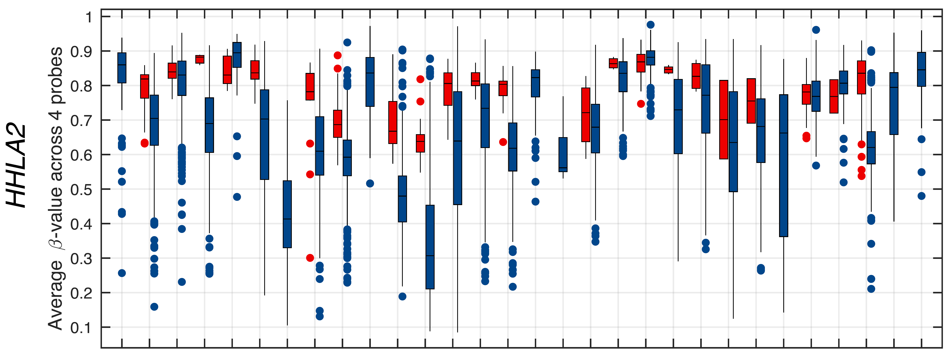
ICGs are Hypomethylated

Slide 21
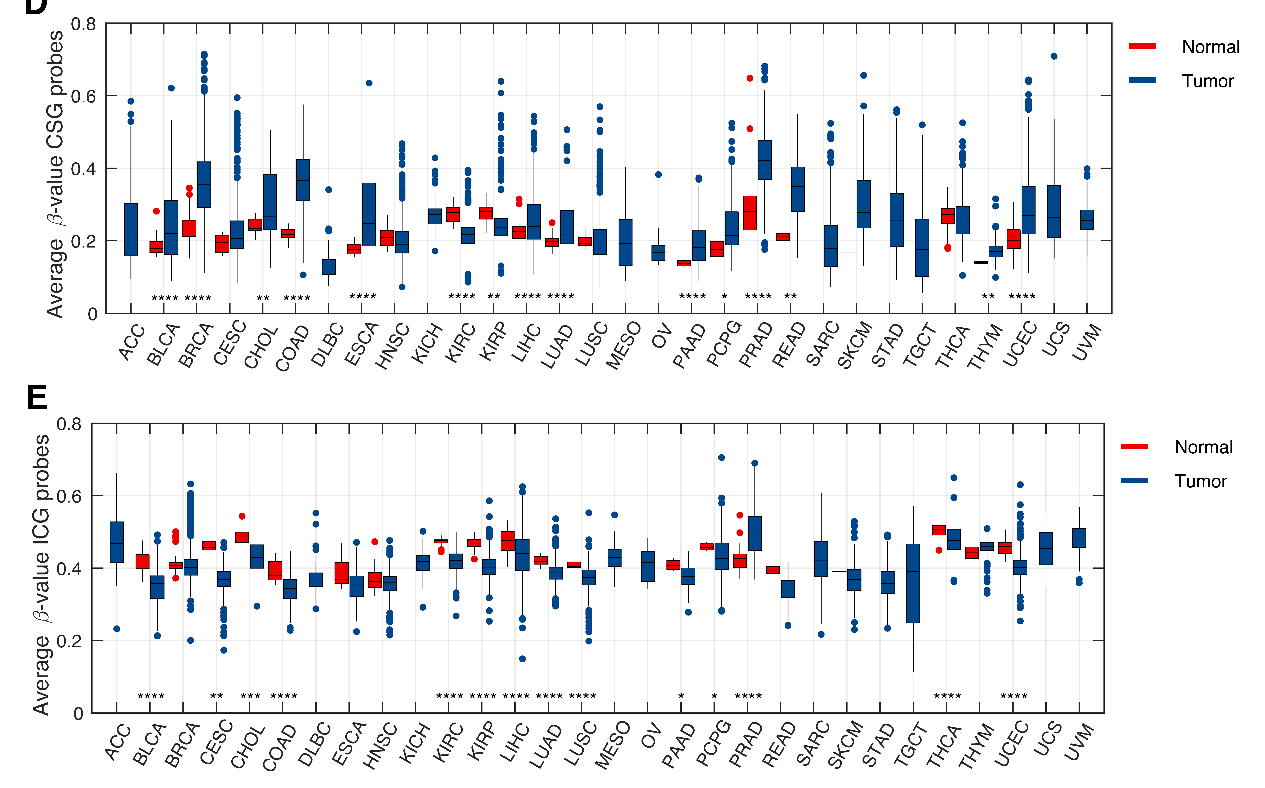
Dichotomous methylation of ICG and CSG

Slide 22
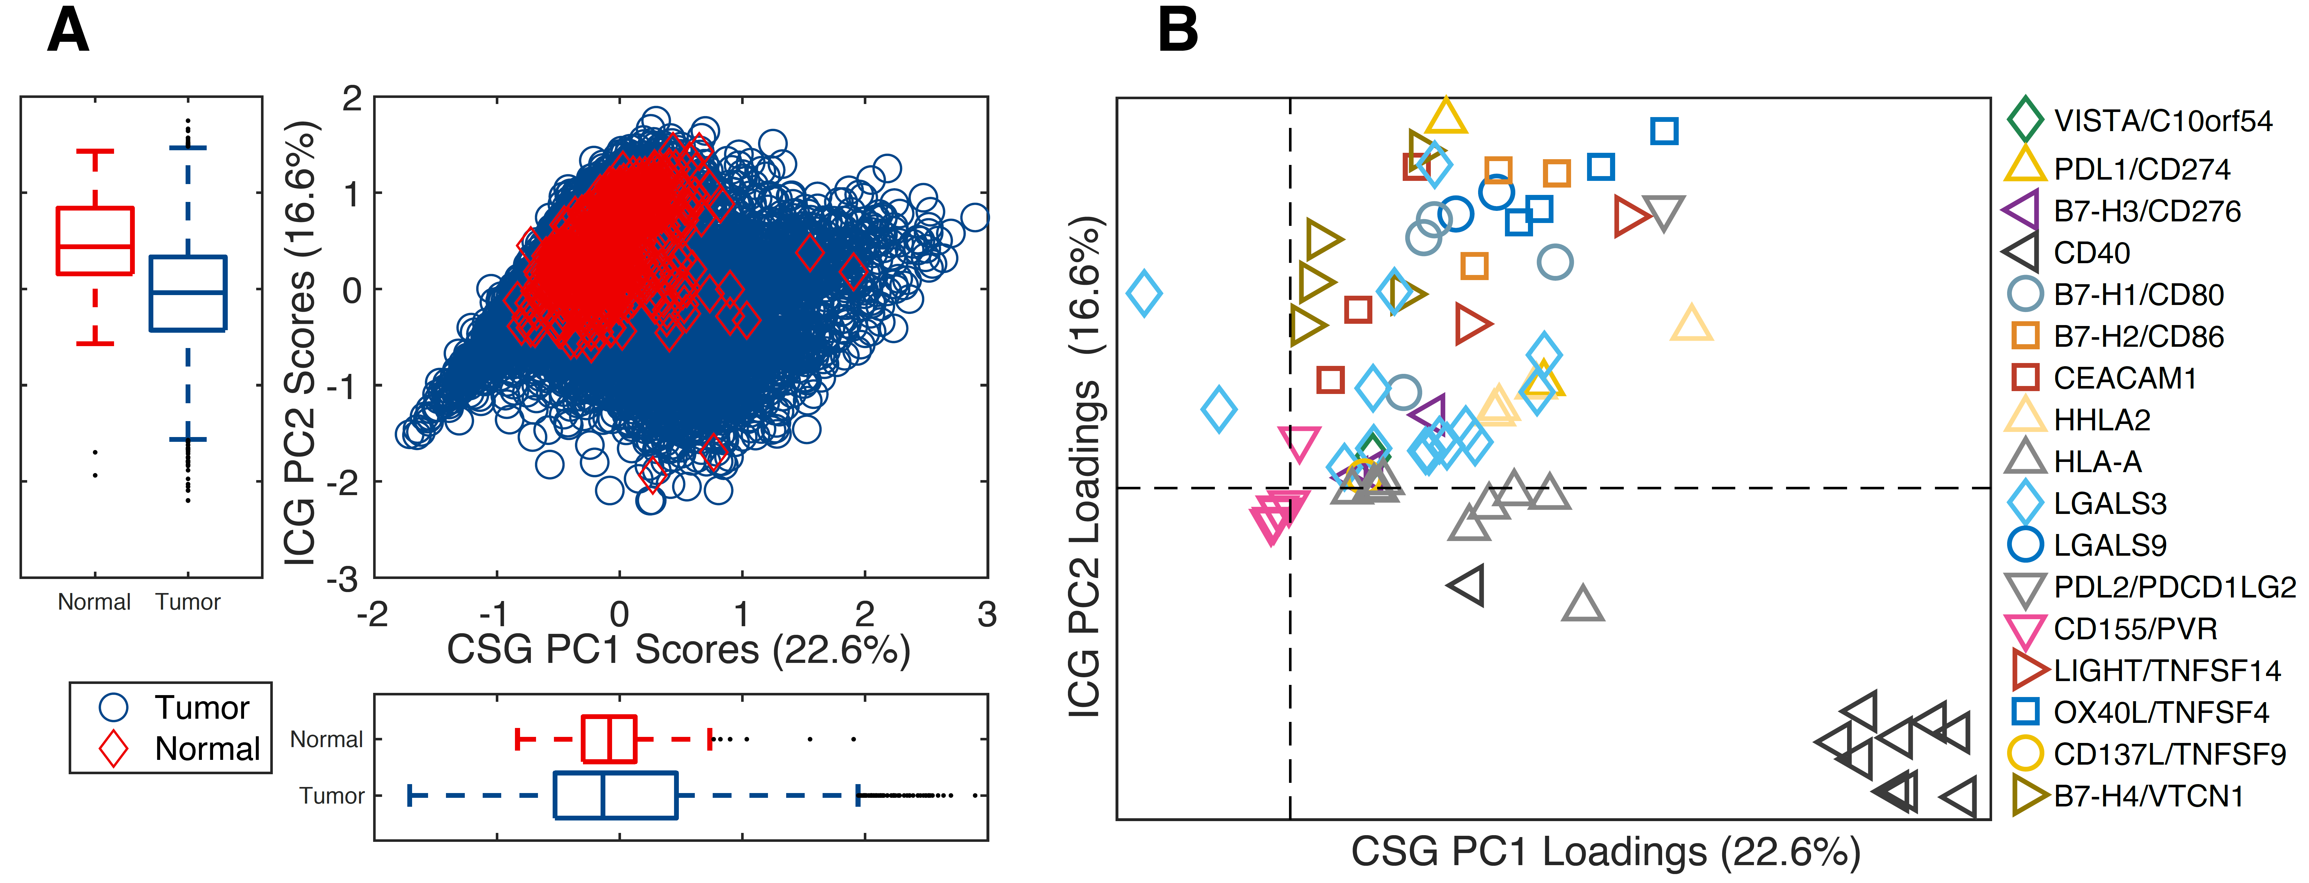
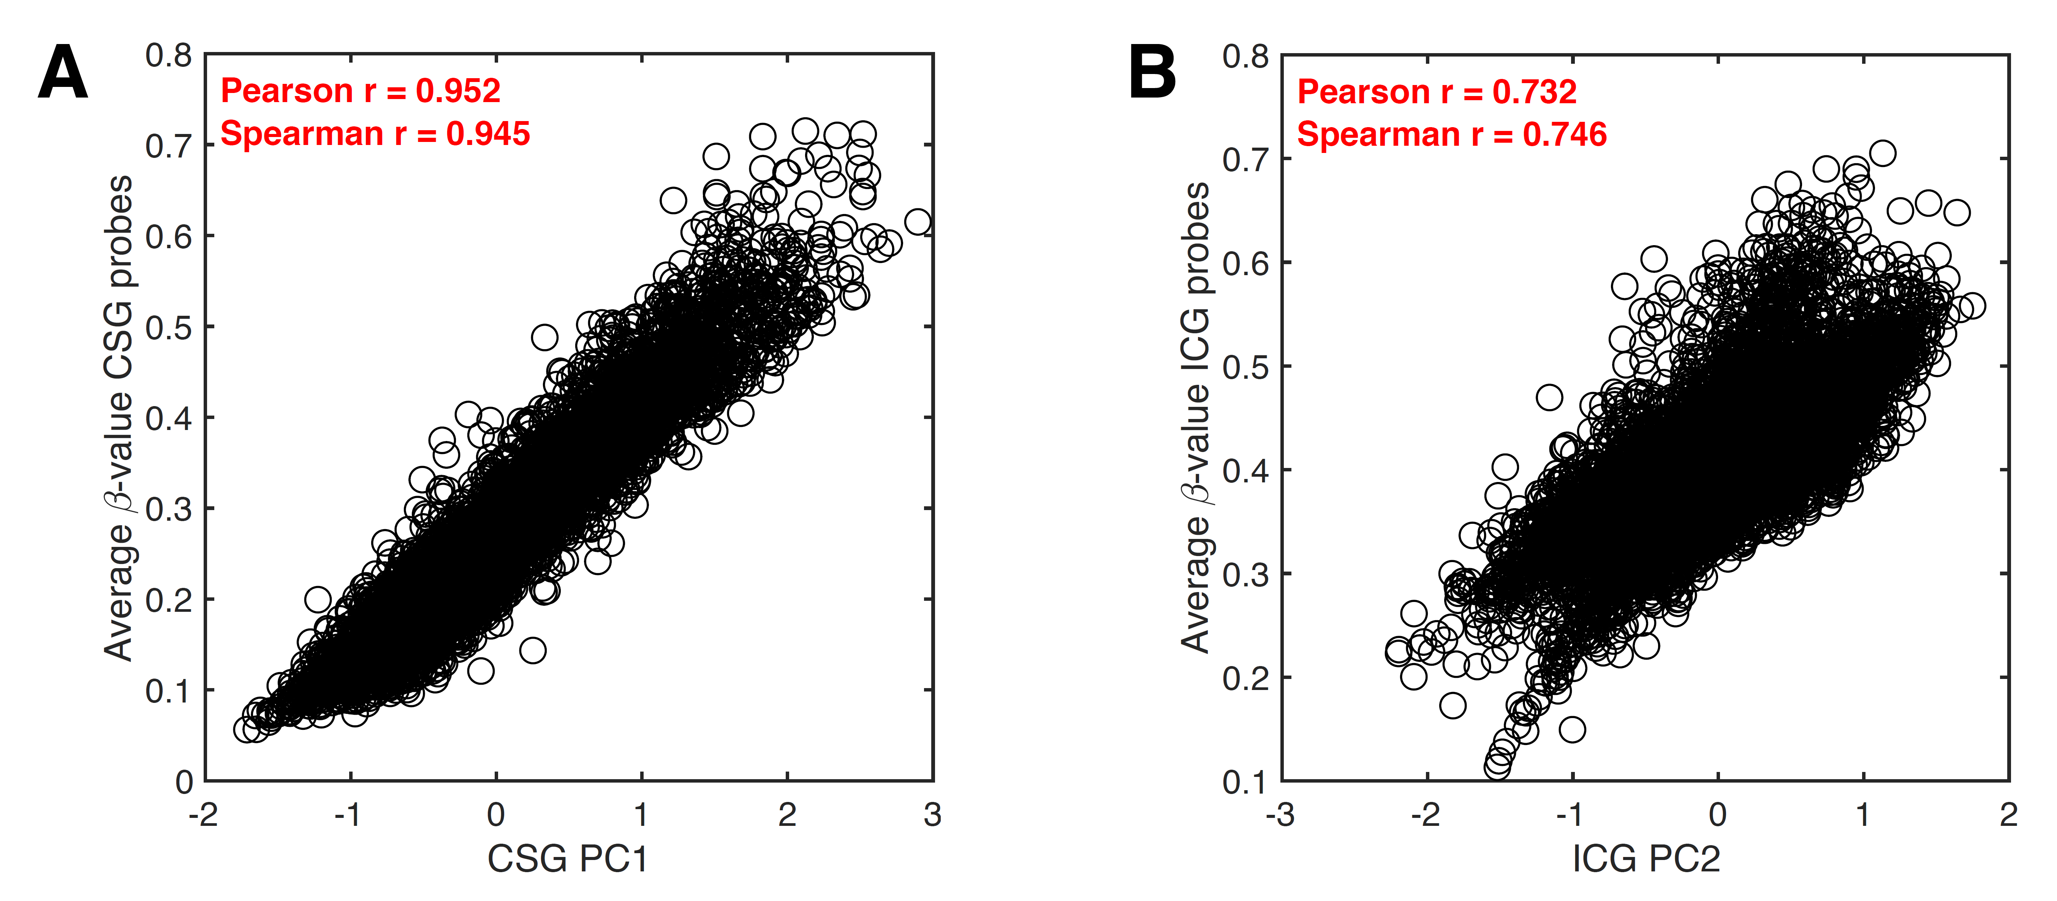
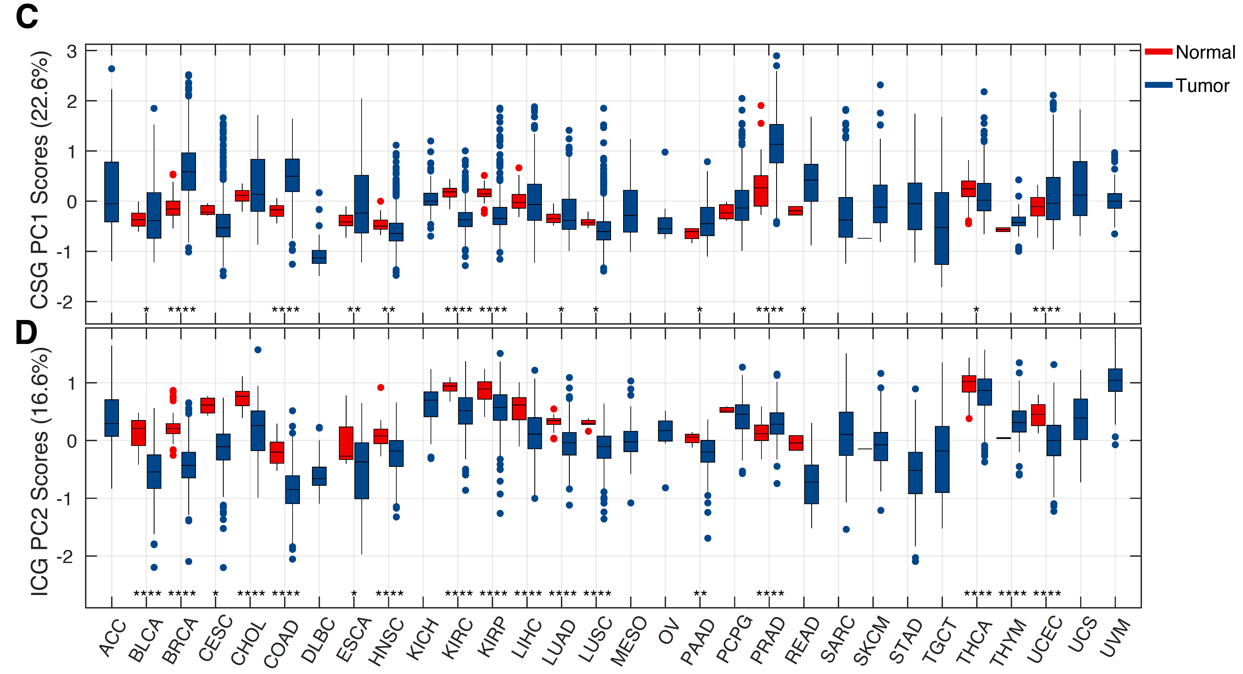
A
B
C
D
PCA segregates CSGs and ICGs
E
F

Slide 23
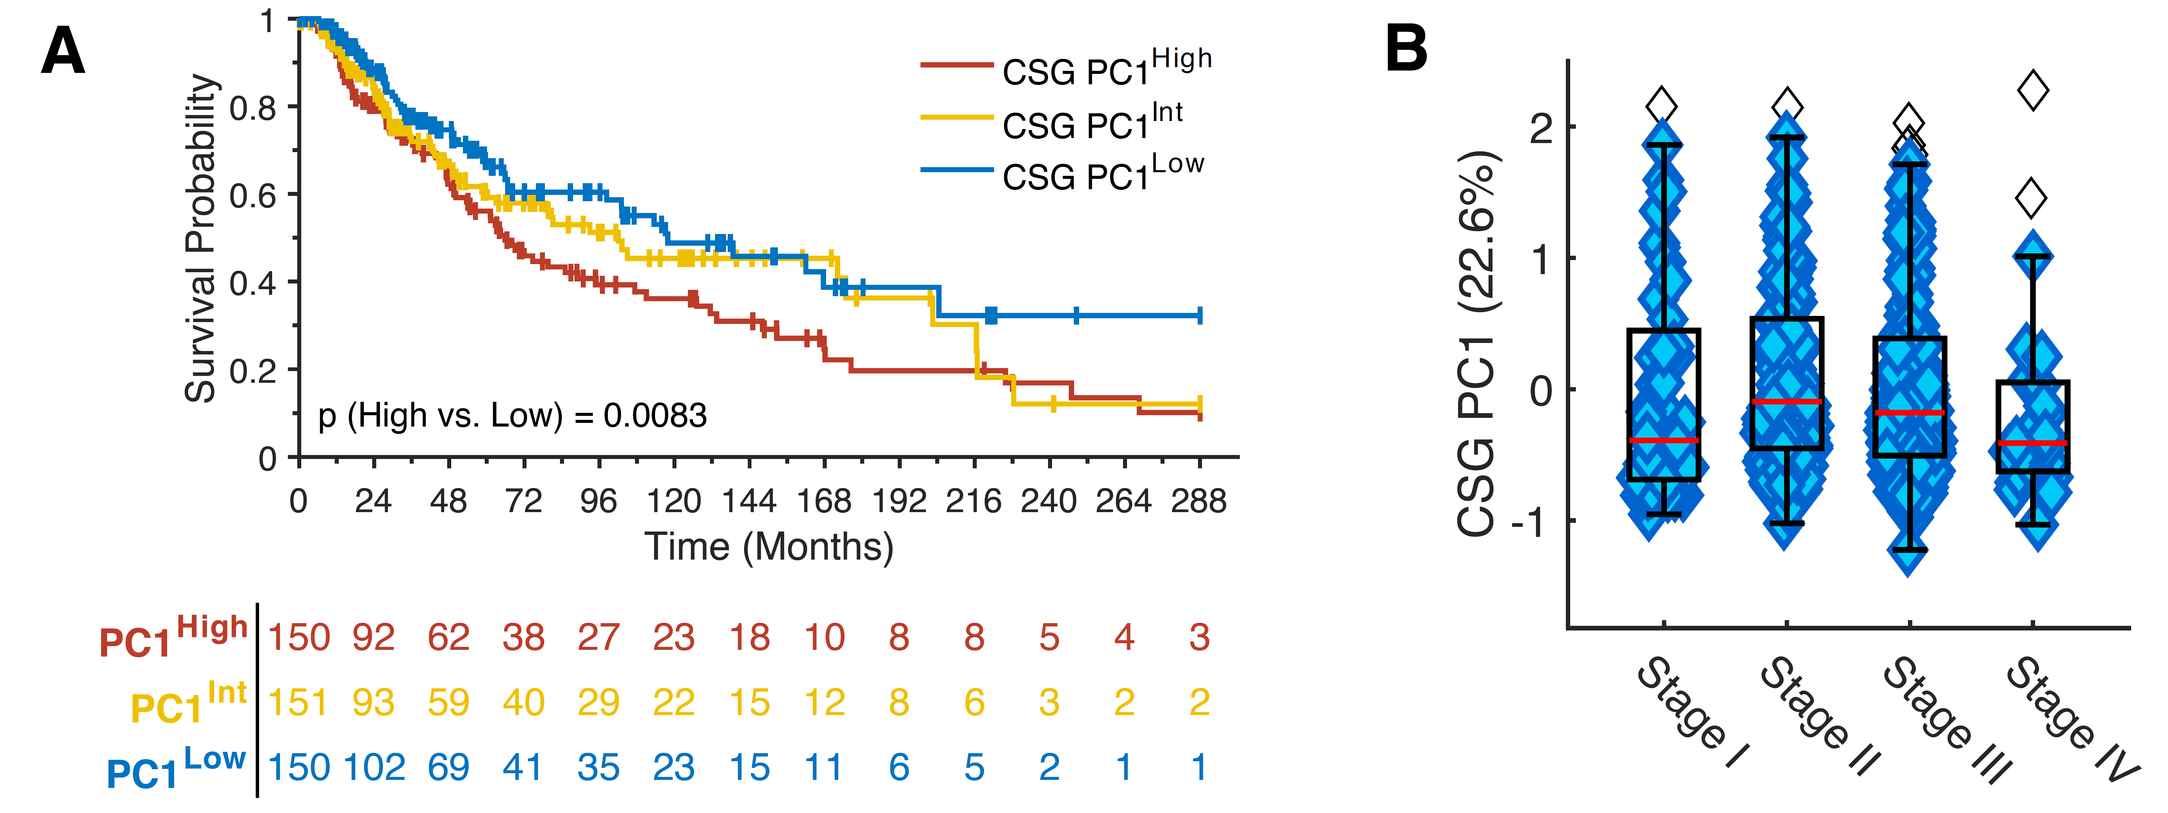
PC1 is Prognostic in Melanoma

Slide 24
AZA (5-azacytidine) is DNA methyltransferase inhibitor, causing hypomethylation of DNA and can reverse the methylation of CD40
Li H, Chiappinelli KB, Guzzetta AA, Easwaran H, Yen RW, et al. Oncotarget. 2014;5(3):587-98.

Slide 25
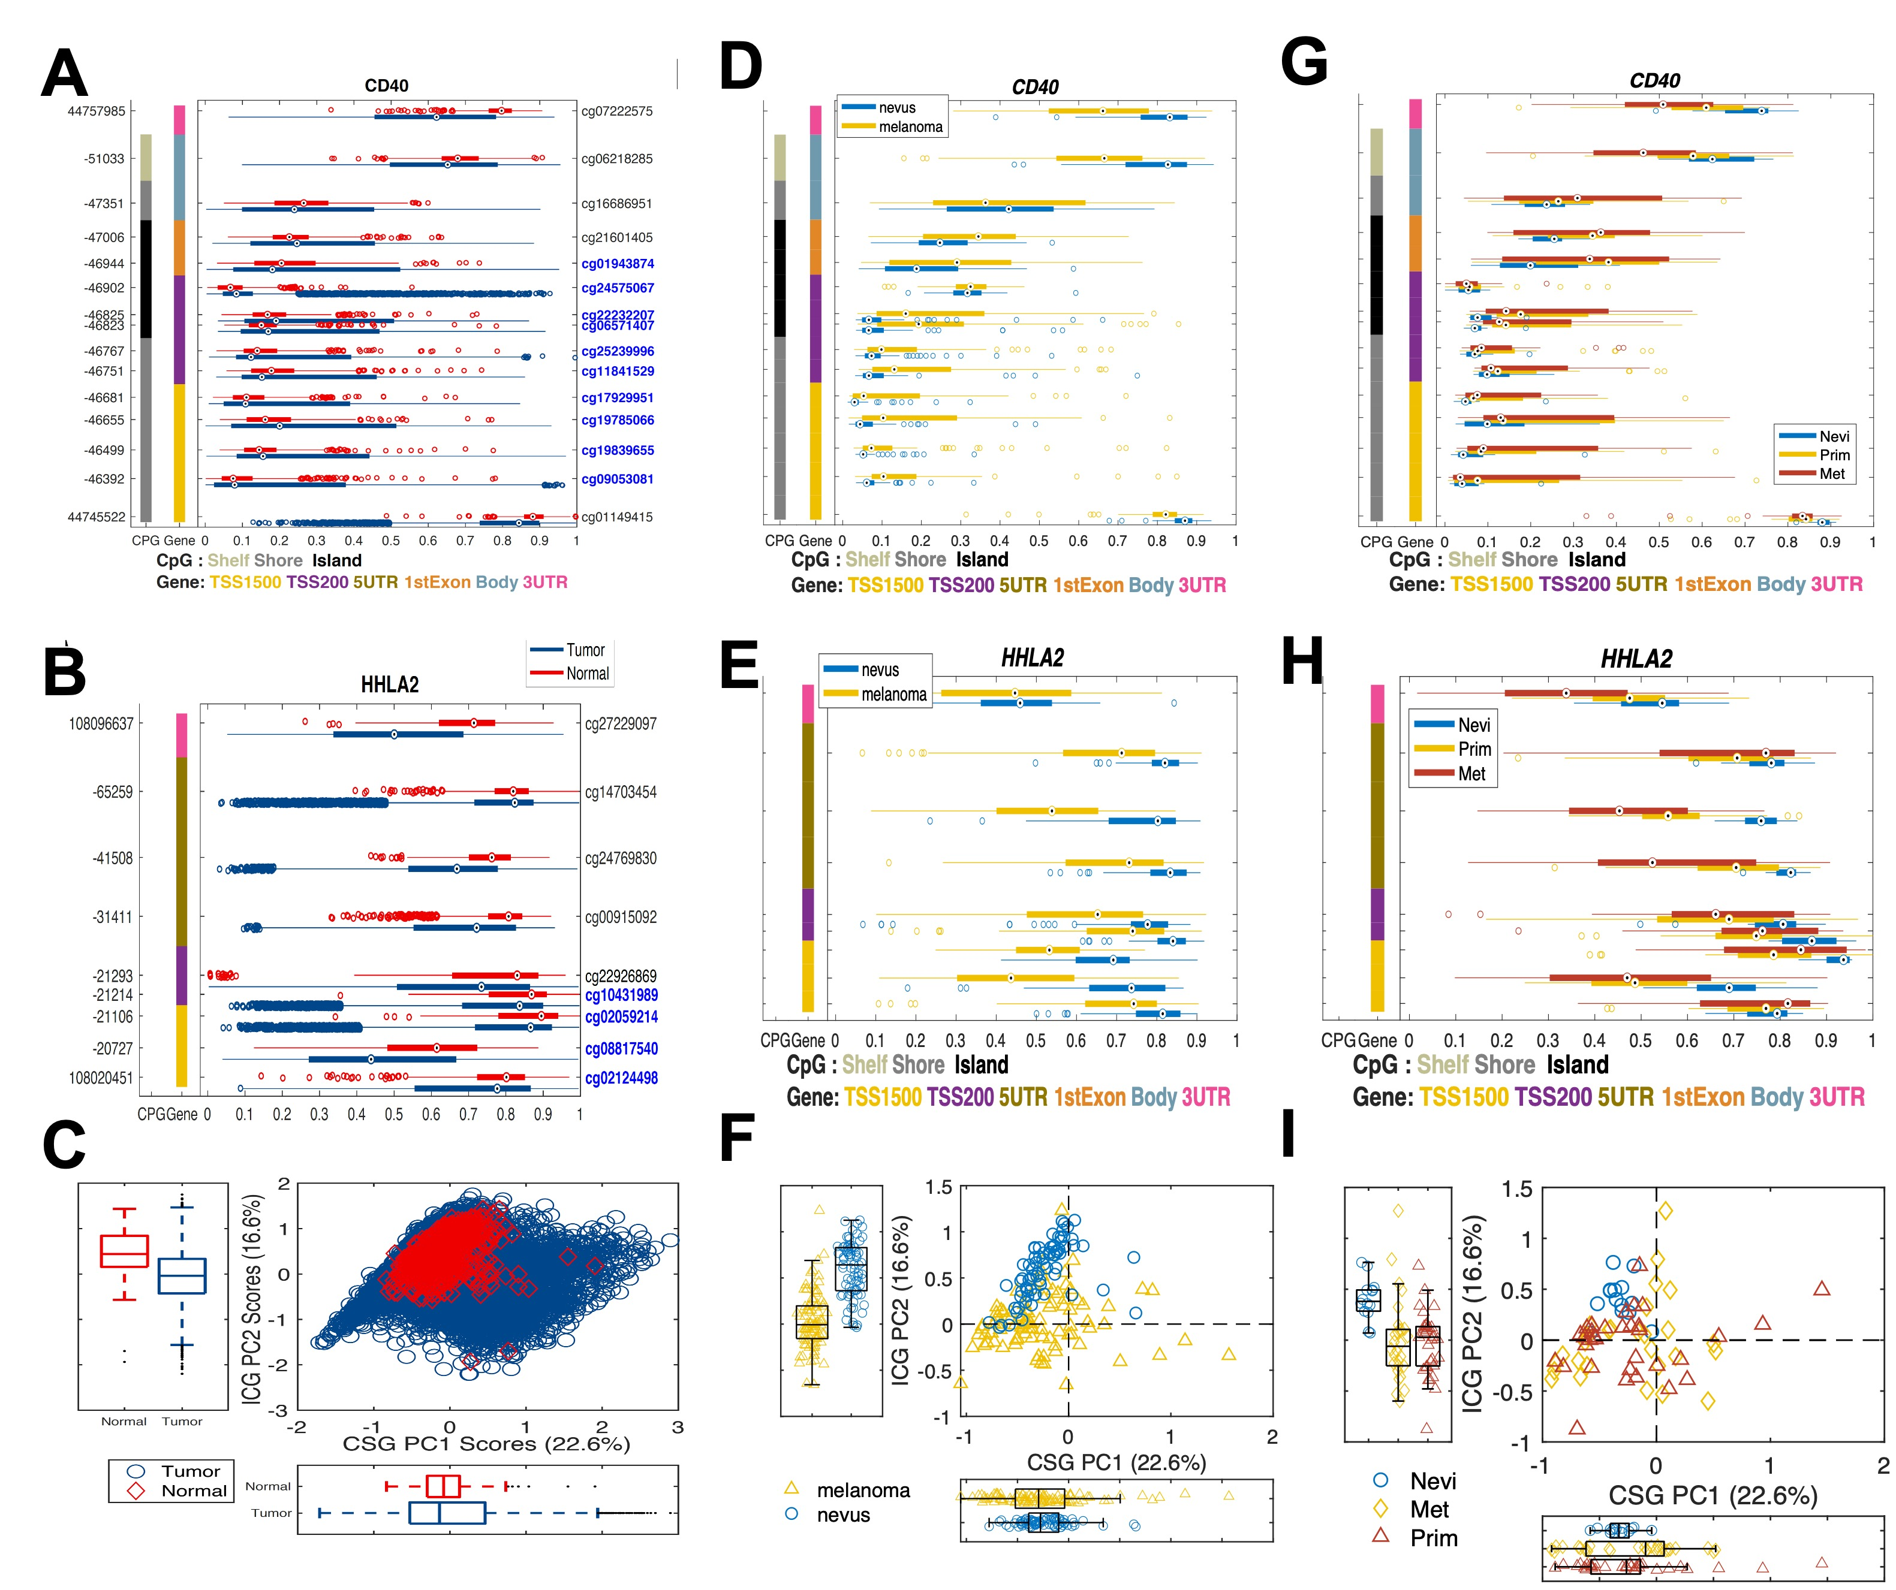
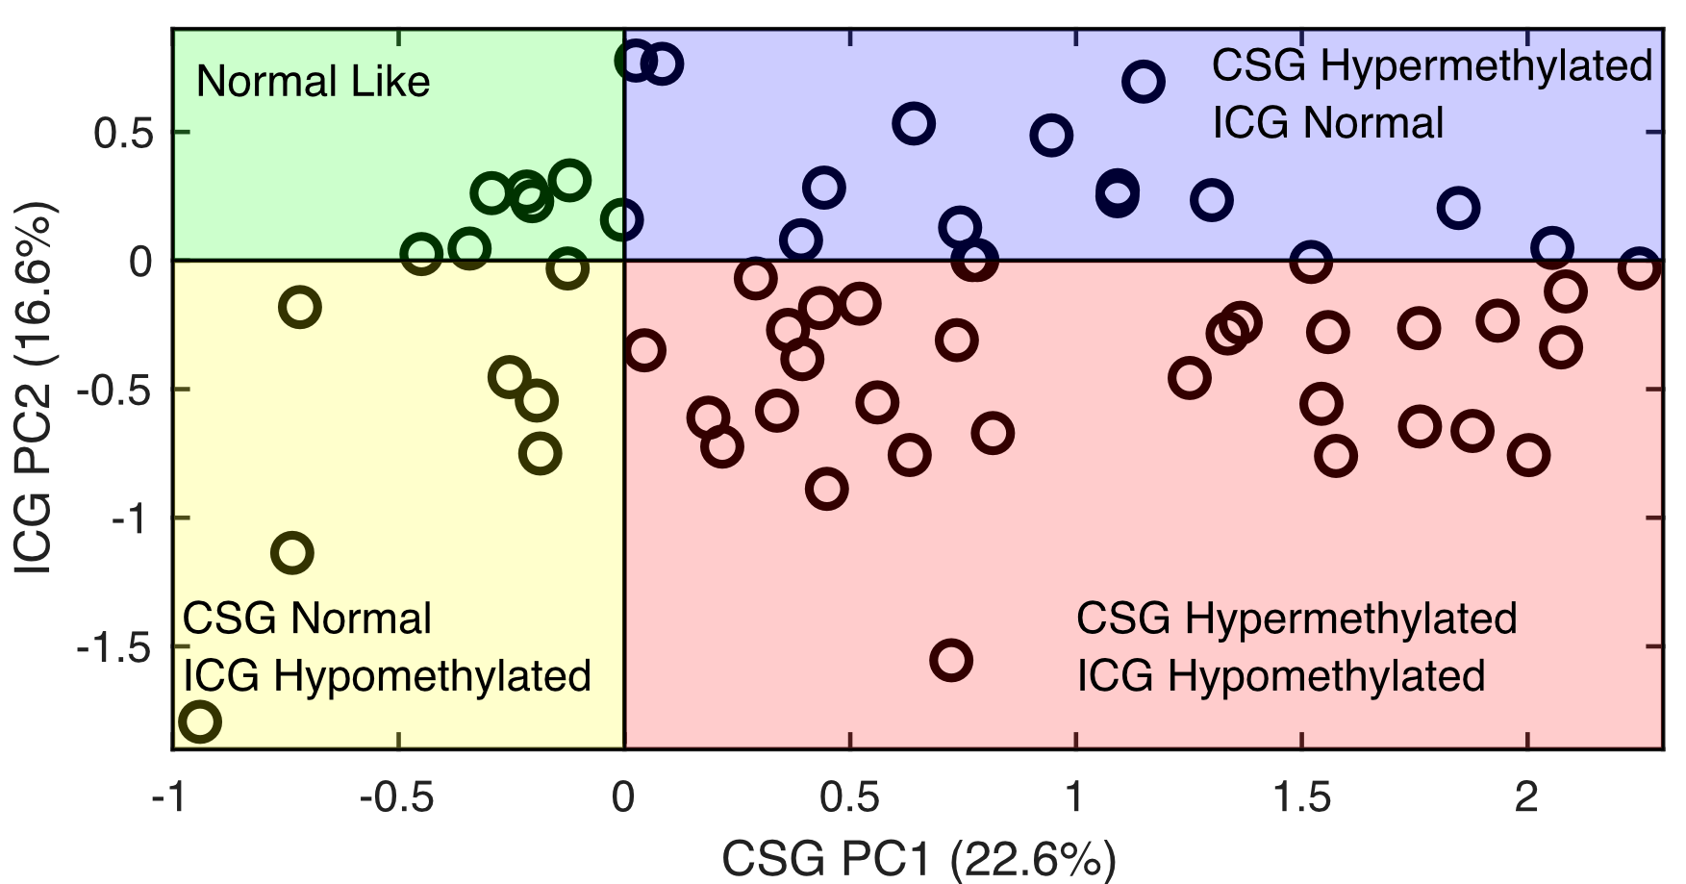
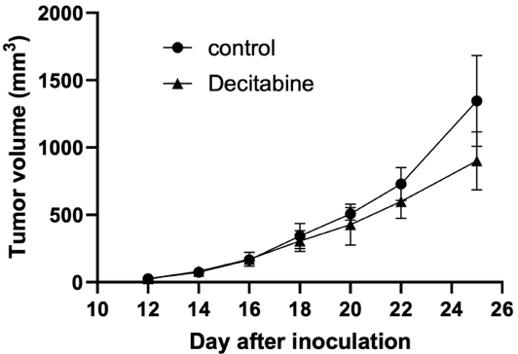
Account: W81XWH-22-1-0861
Name of PI: Berglund, A./Kim, S.
Funding Source: CDMRP/MRP
Dates: 09/30/2022-09/29/2025
Title: Epigenetic regulation of the immune synapse in melanoma
CCLE melanoma cell lines

Slide 26
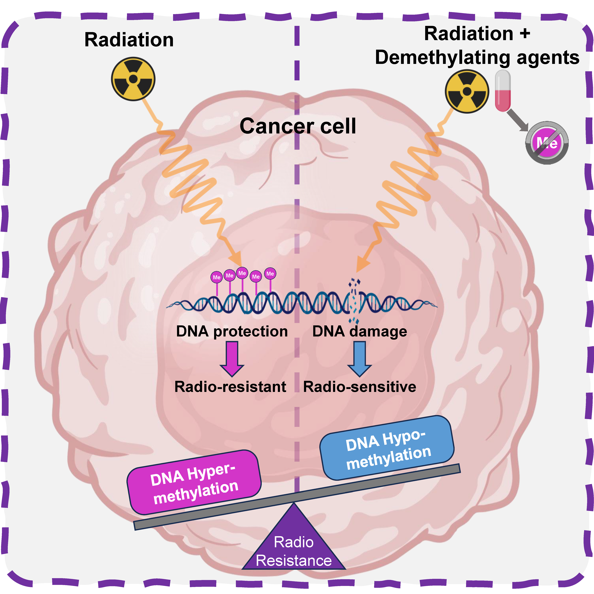
Does a dysregulated methylome modulate the radiosensitivity of different cancer types? [1]
Similar to previous work we have done with HPV16 in HNSC [2]
Berglund A, Cheng P, Putney R, Wang MH, Hamaidi I, Yamoah Y, …, Kim S, A dysregulated methylome modulates the radiosensitivity of cancer, In revision.
Berglund A, Muenyi C, Siegel EM, Ajidahun A, Eschrich SA, Wong D, et al. Characterization of epigenomic alterations in HPV16+ head and neck squamous cell carcinomas. Cancer Epidemiol Biomarkers Prev 2022
Imene Hamaidi

Slide 27
Processing steps for TCGA M450
RAW IDATS
From GDC
Normalized using NOOB [1]
Remove duplicate samples
Keep sample with higher tumor purity
Add Clinical annotation
PANCAN publication [2]
HPV status [3]
Add Survival information [4]
DSS & PFI
Remove masked CpG-probes [5]
Add Radiation data
Manually curated by Dr. Kim
Divide samples into RT and NoRT
Calculate Survival
M-Values
Cox regression
Volcano plots
Total amount of hyper methylation
Fortin, J.-P. et al. Functional normalization of 450k methylation array data improves replication in large cancer studies. Genome Biology 15, 503 (2014).
https://gdc.cancer.gov/about-data/publications/pancanatlas
Campbell, J. D. et al. Genomic, Pathway Network, and Immunologic Features Distinguishing Squamous Carcinomas. Cell Rep 23, 194-212.e6 (2018).
Liu, J. et al. An Integrated TCGA Pan-Cancer Clinical Data Resource to Drive High-Quality Survival Outcome Analytics. Cell 173, 400-416.e11 (2018).
Zhou, W., Laird, P. W. & Shen, H. Comprehensive characterization, annotation and innovative use of Infinium DNA methylation BeadChip probes. Nucleic Acids Res 45 (2017).

Slide 28
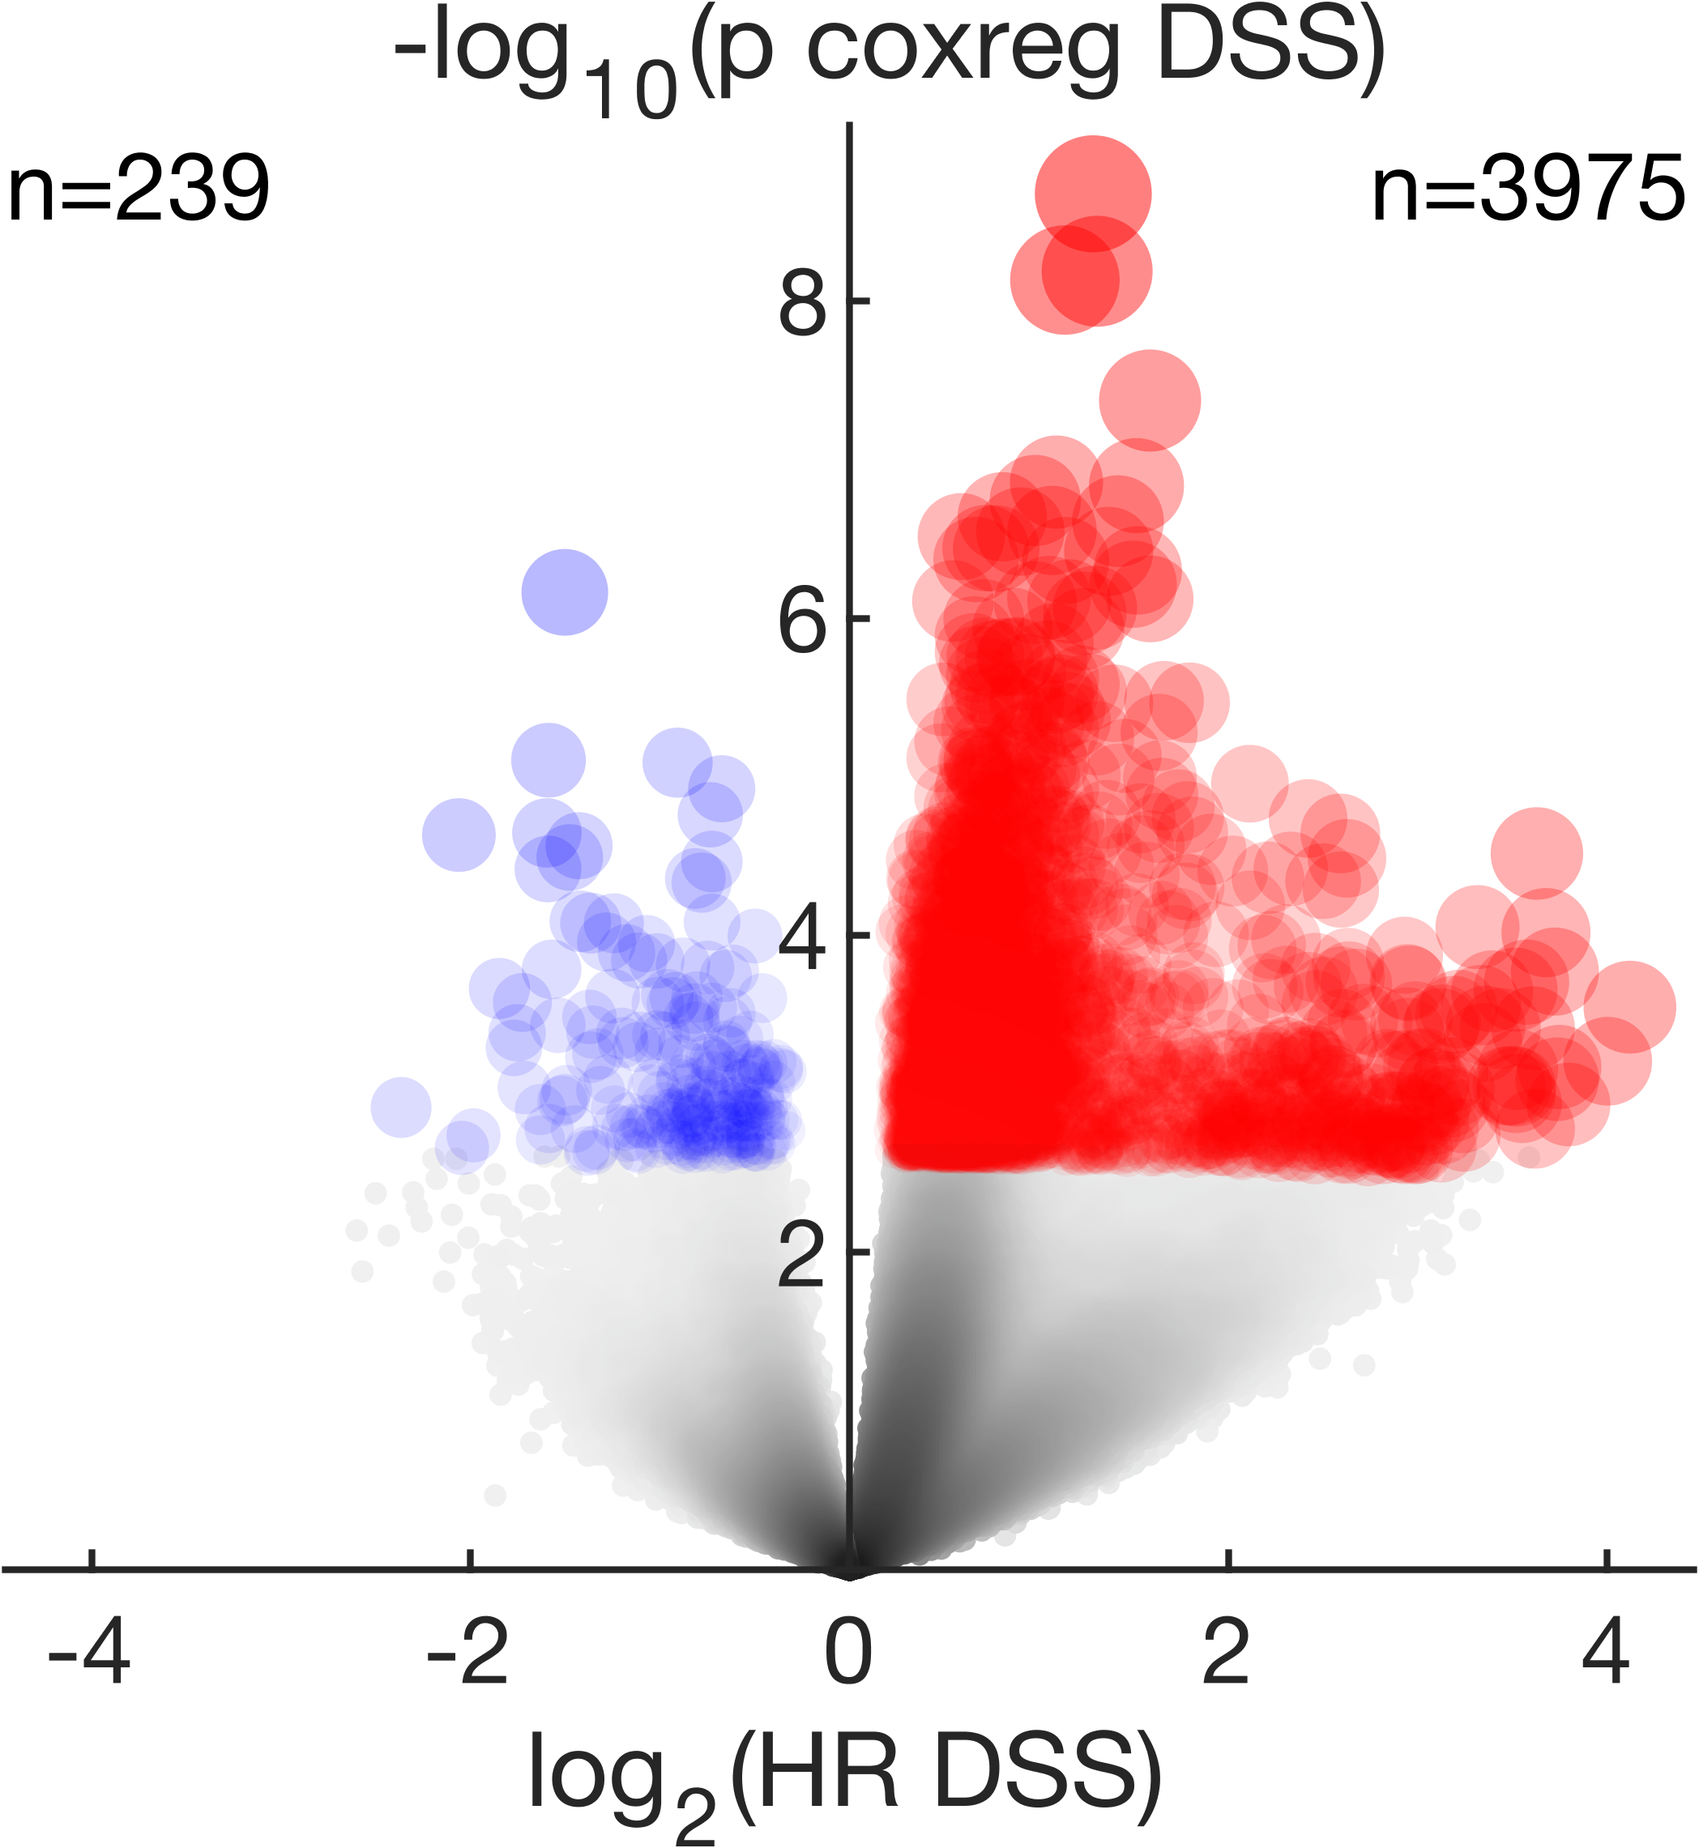
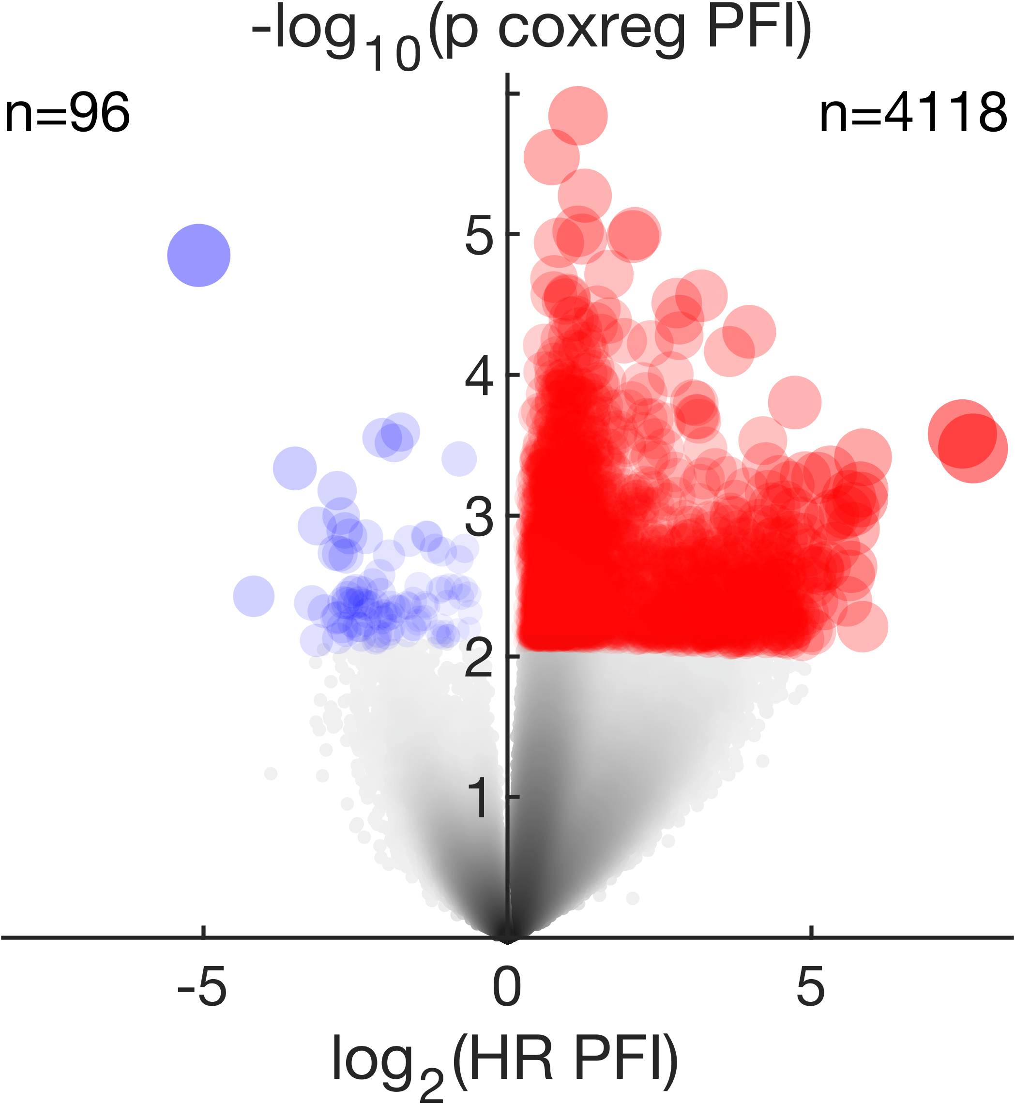
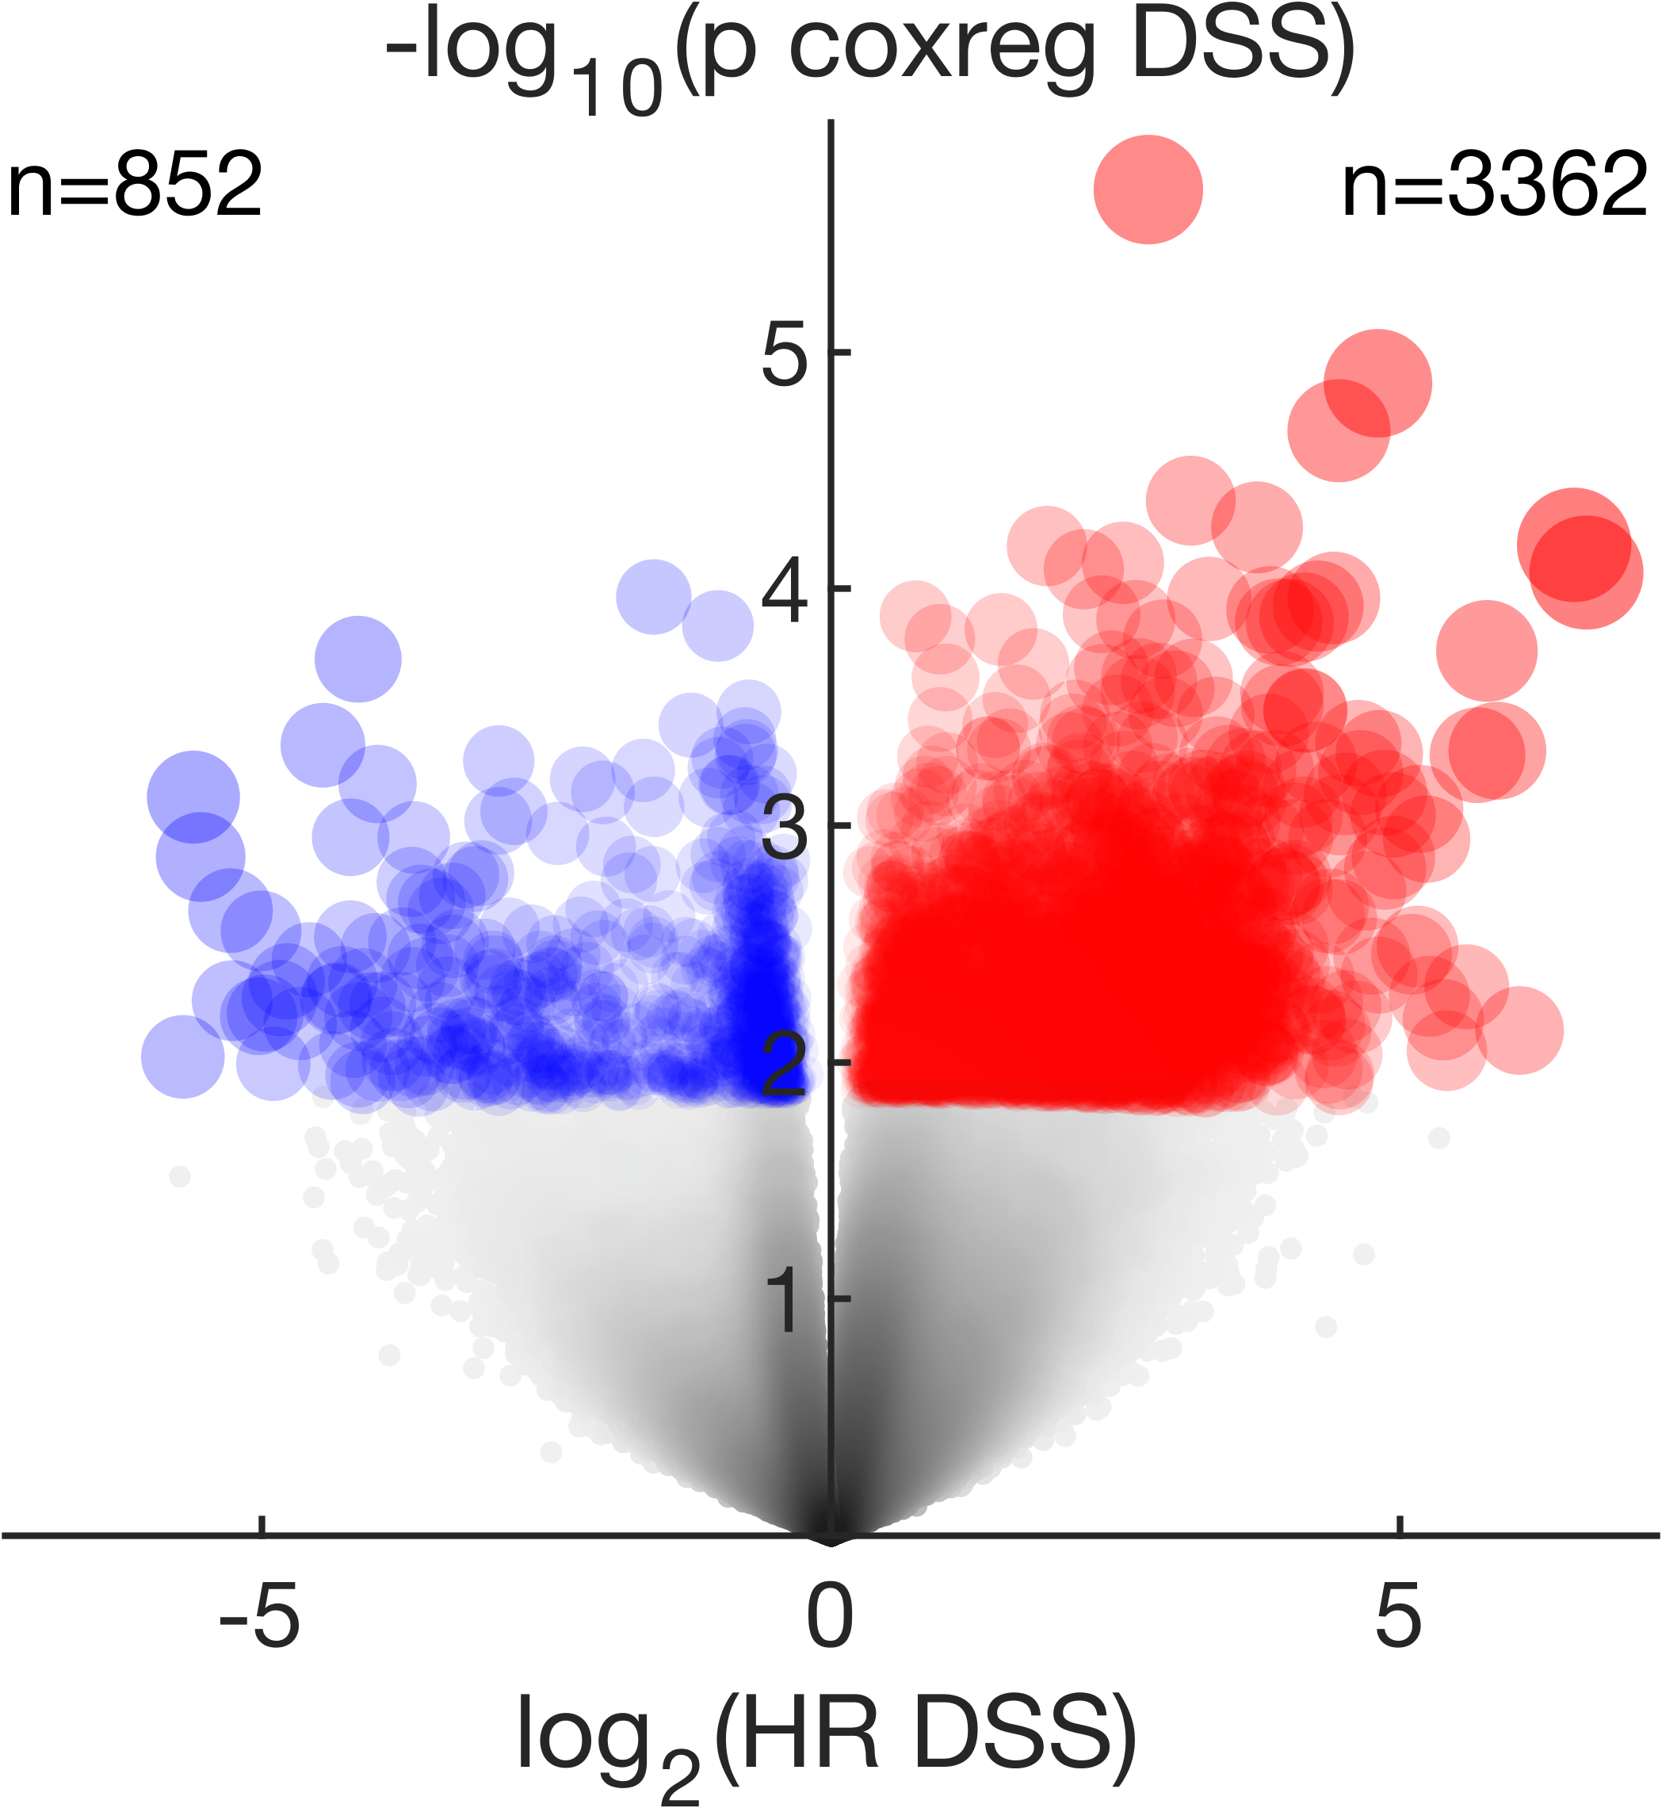
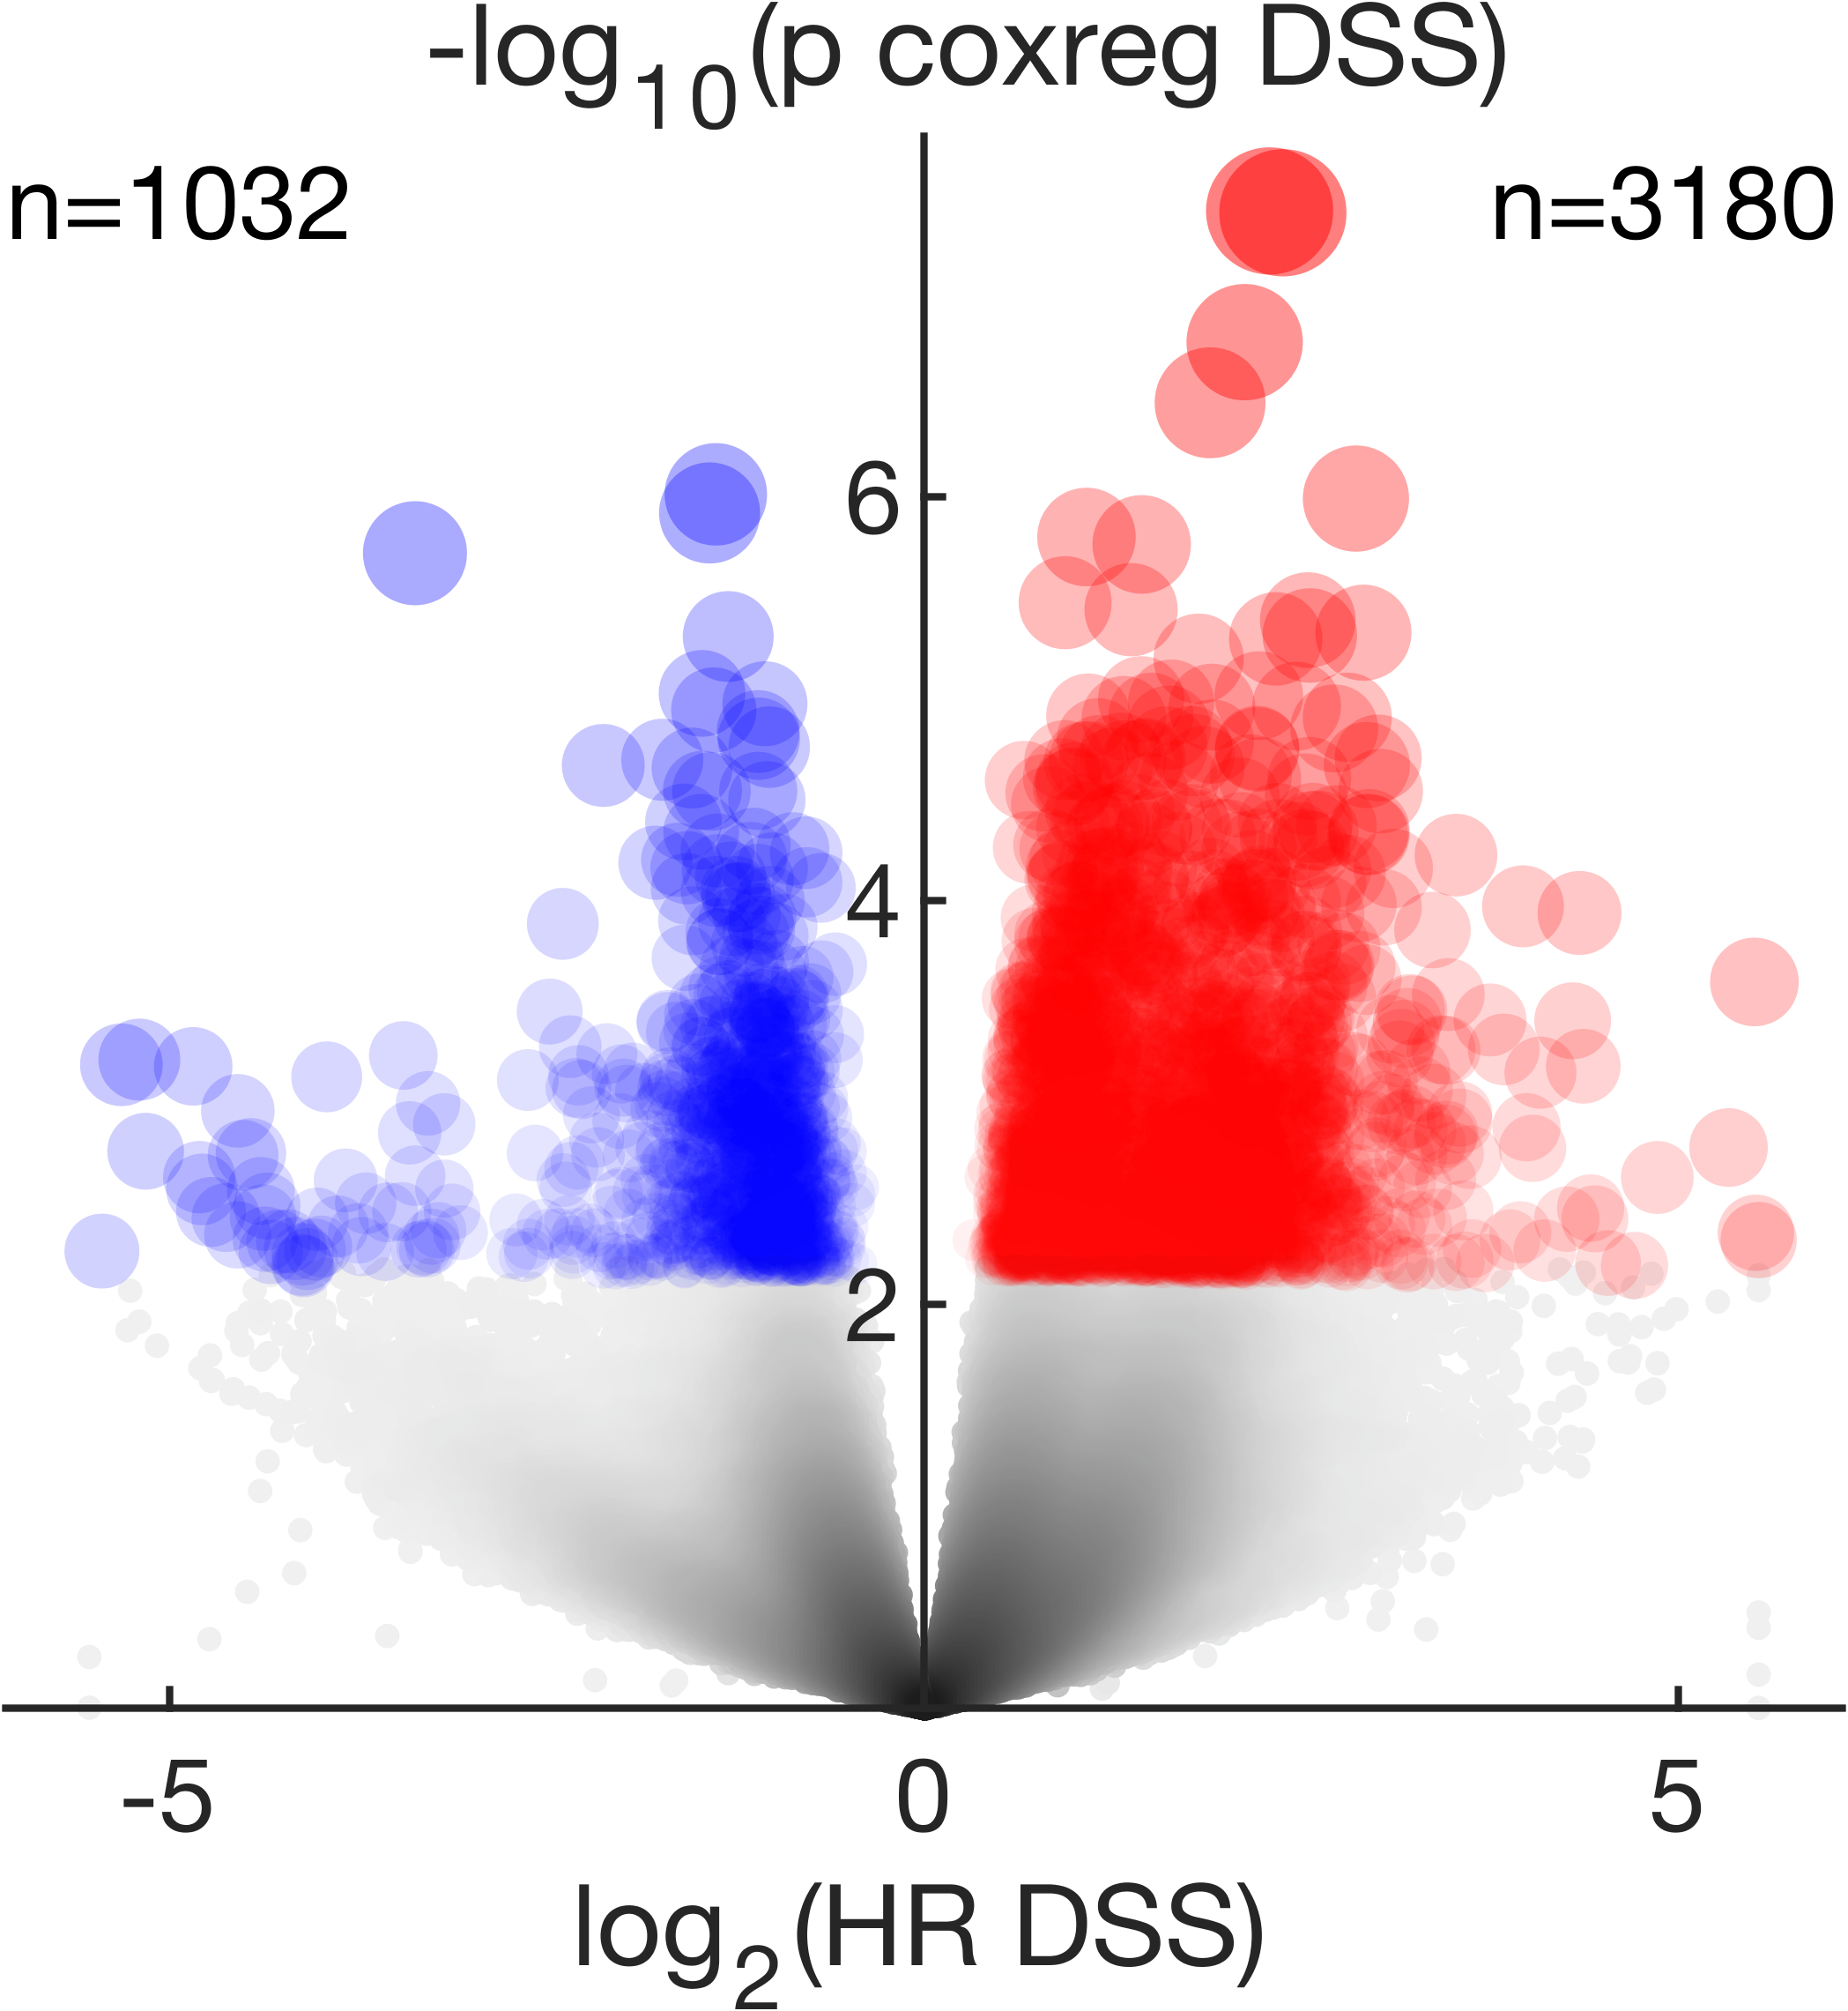
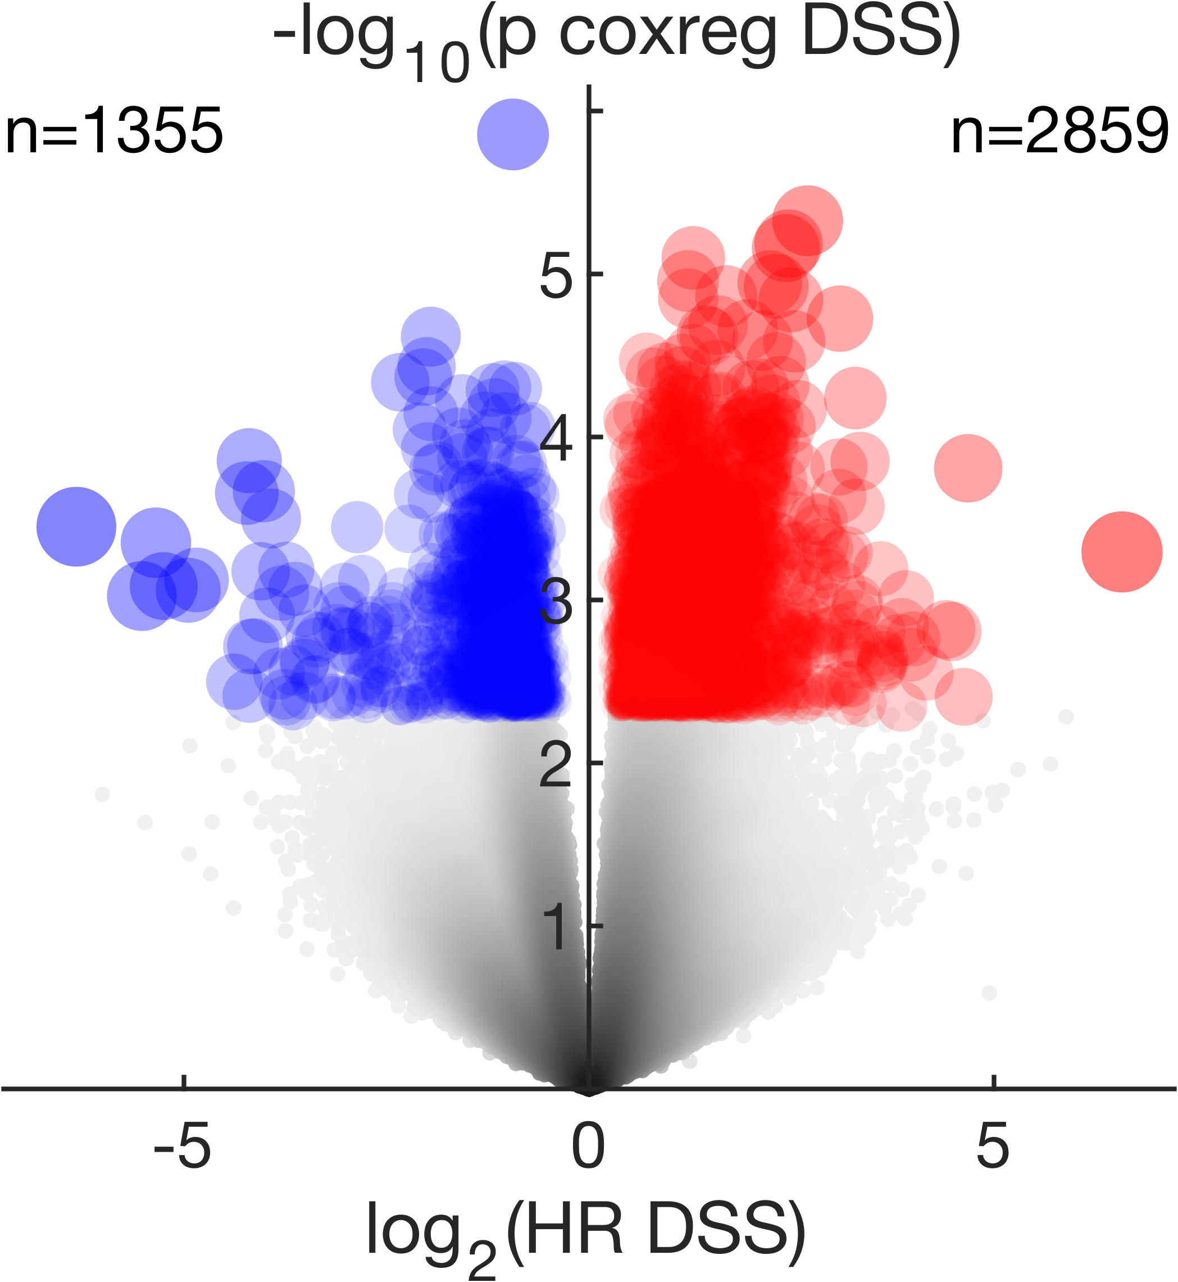
HPV(-)HNSCC
PRAD
SKCM
BRCA
SARC
RT
Top 1% CpG-probes are highlighted
Poor clinical response following adjuvant RT was associated with a significantly higher number of hypermethylated probes within the epigenome, most notably in HPV(-)HNSCC with 3975 hypermethylated CpG-probes vs. 239 hypomethylated CpG-probes among the top 1% CpG-probes

Slide 29
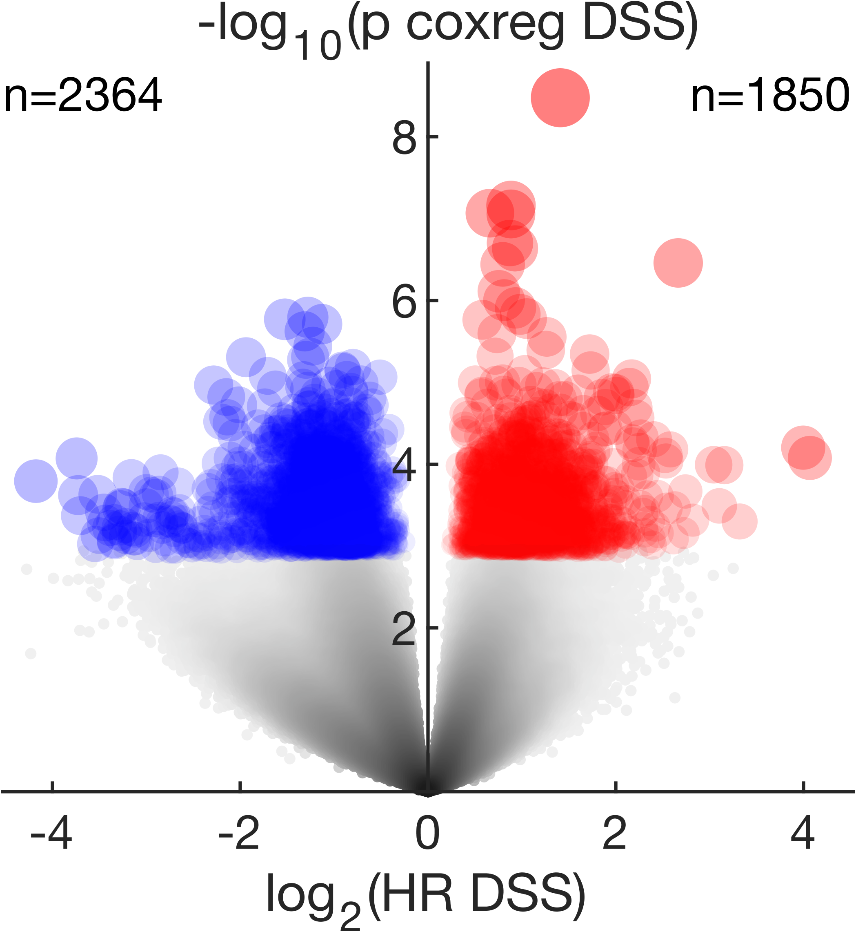
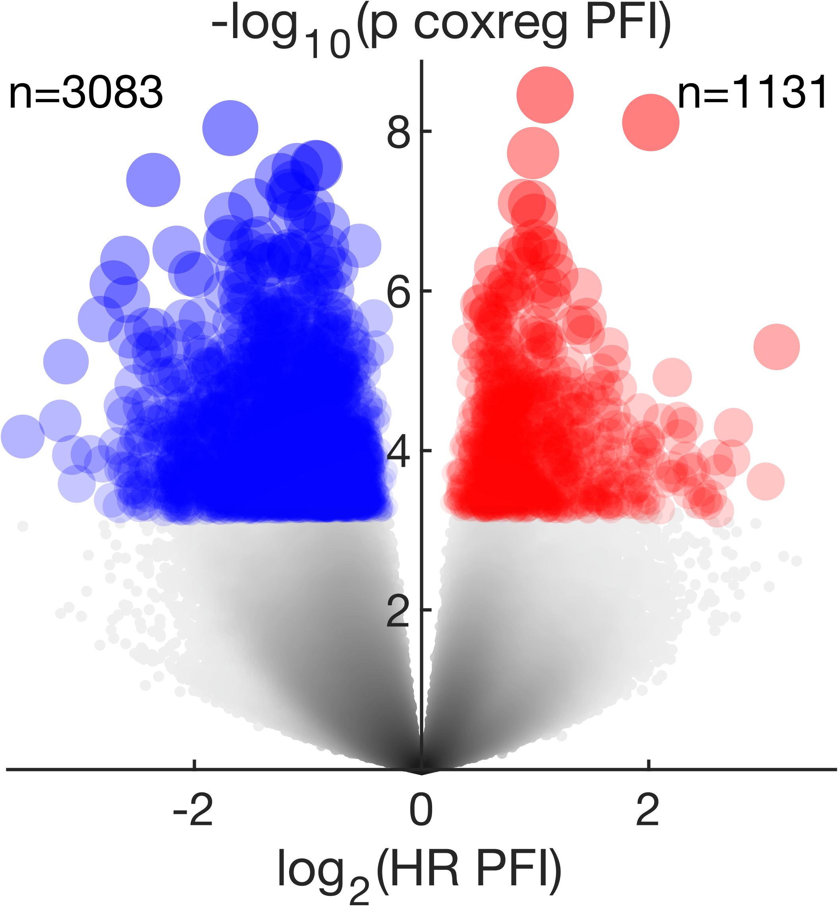
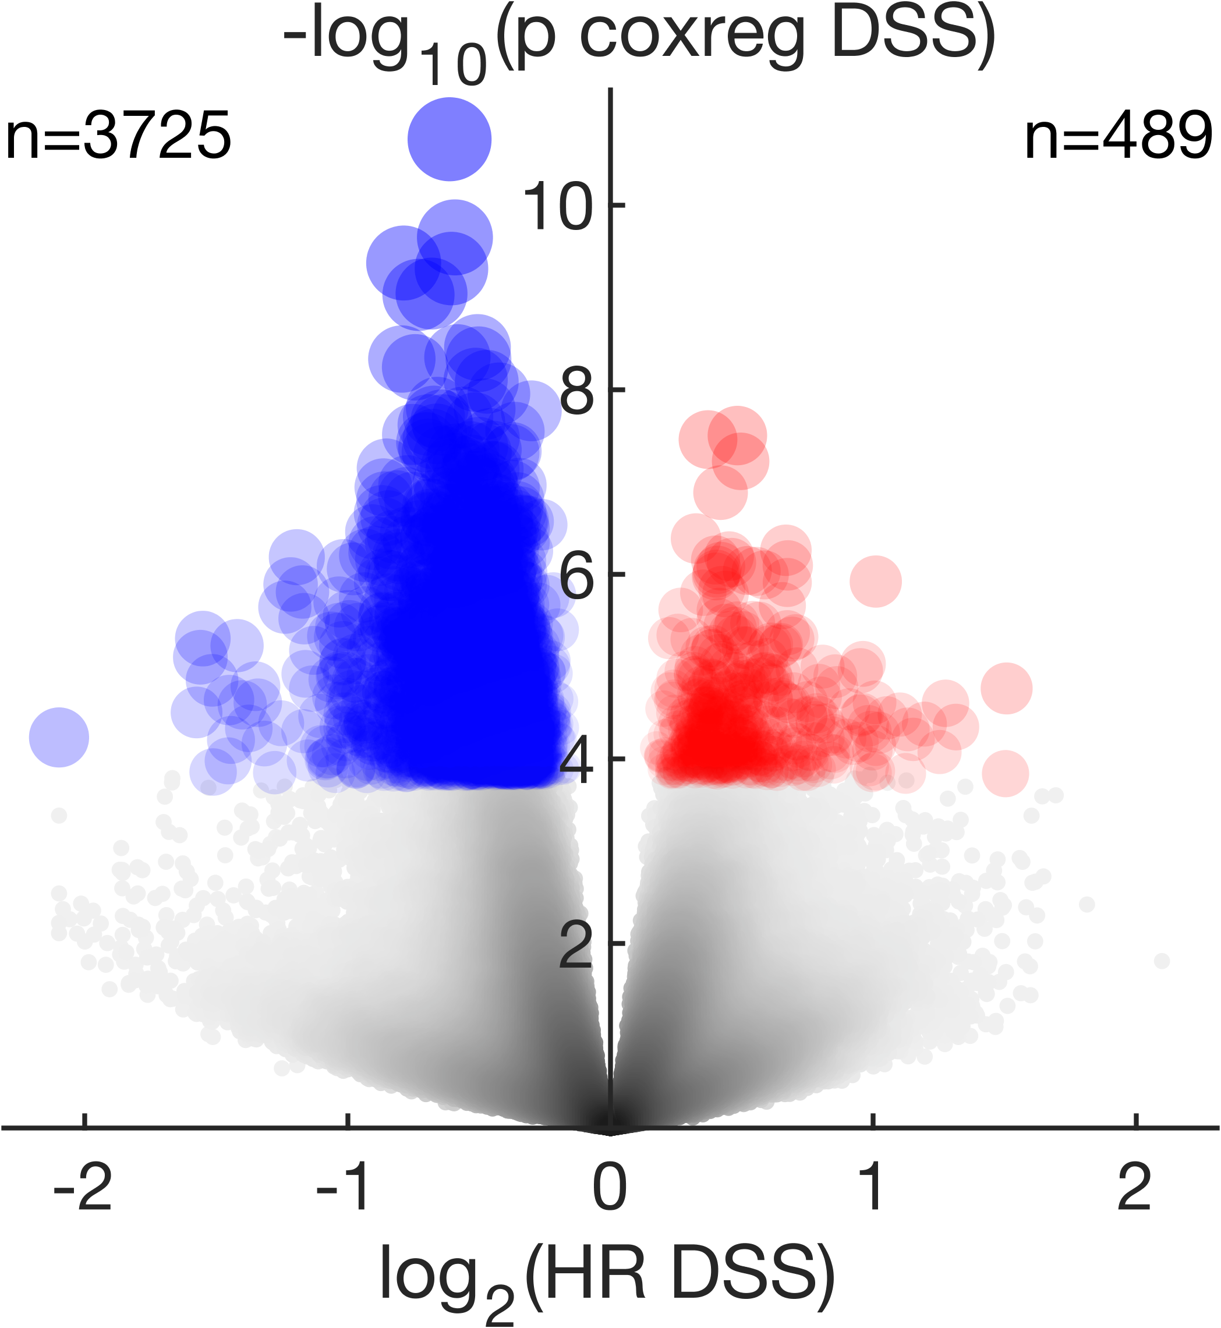
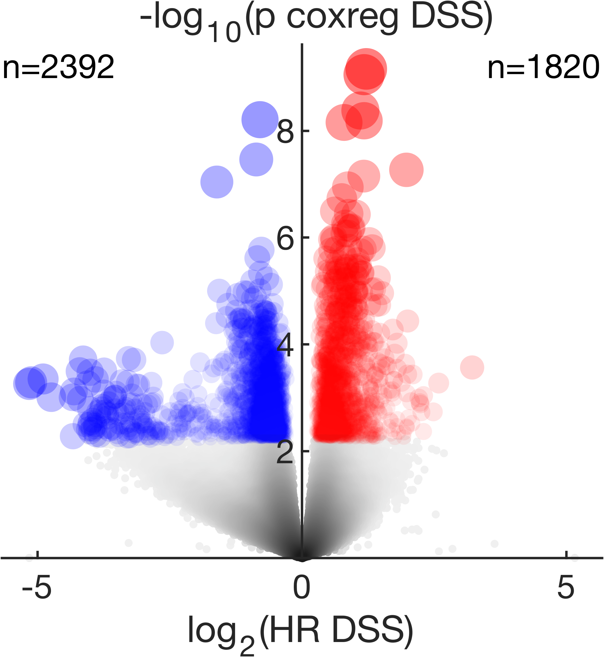
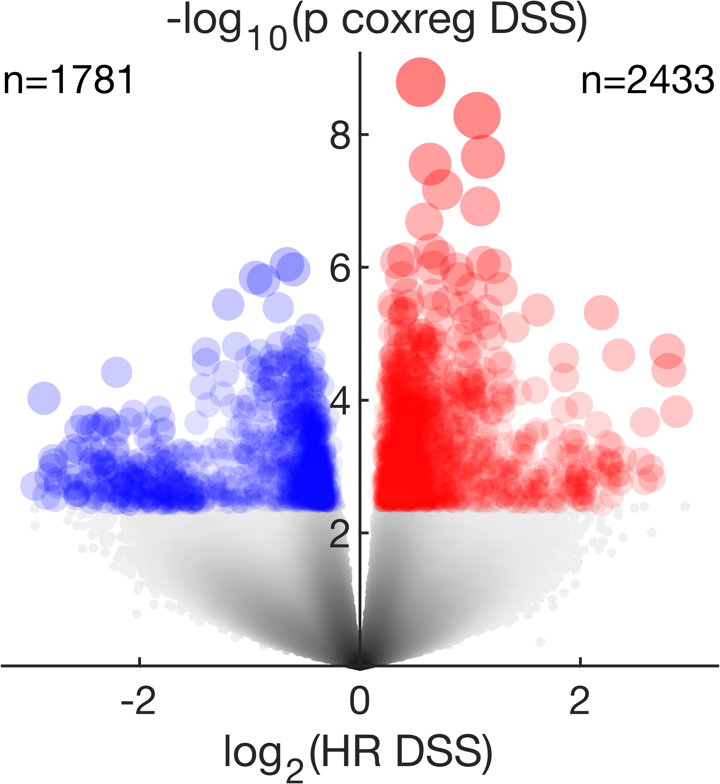
HPV(-)HNSCC
PRAD
SKCM
BRCA
SARC
RT
NoRT
The hyper-methylation trend is not seen in the No RT cohort

Slide 30
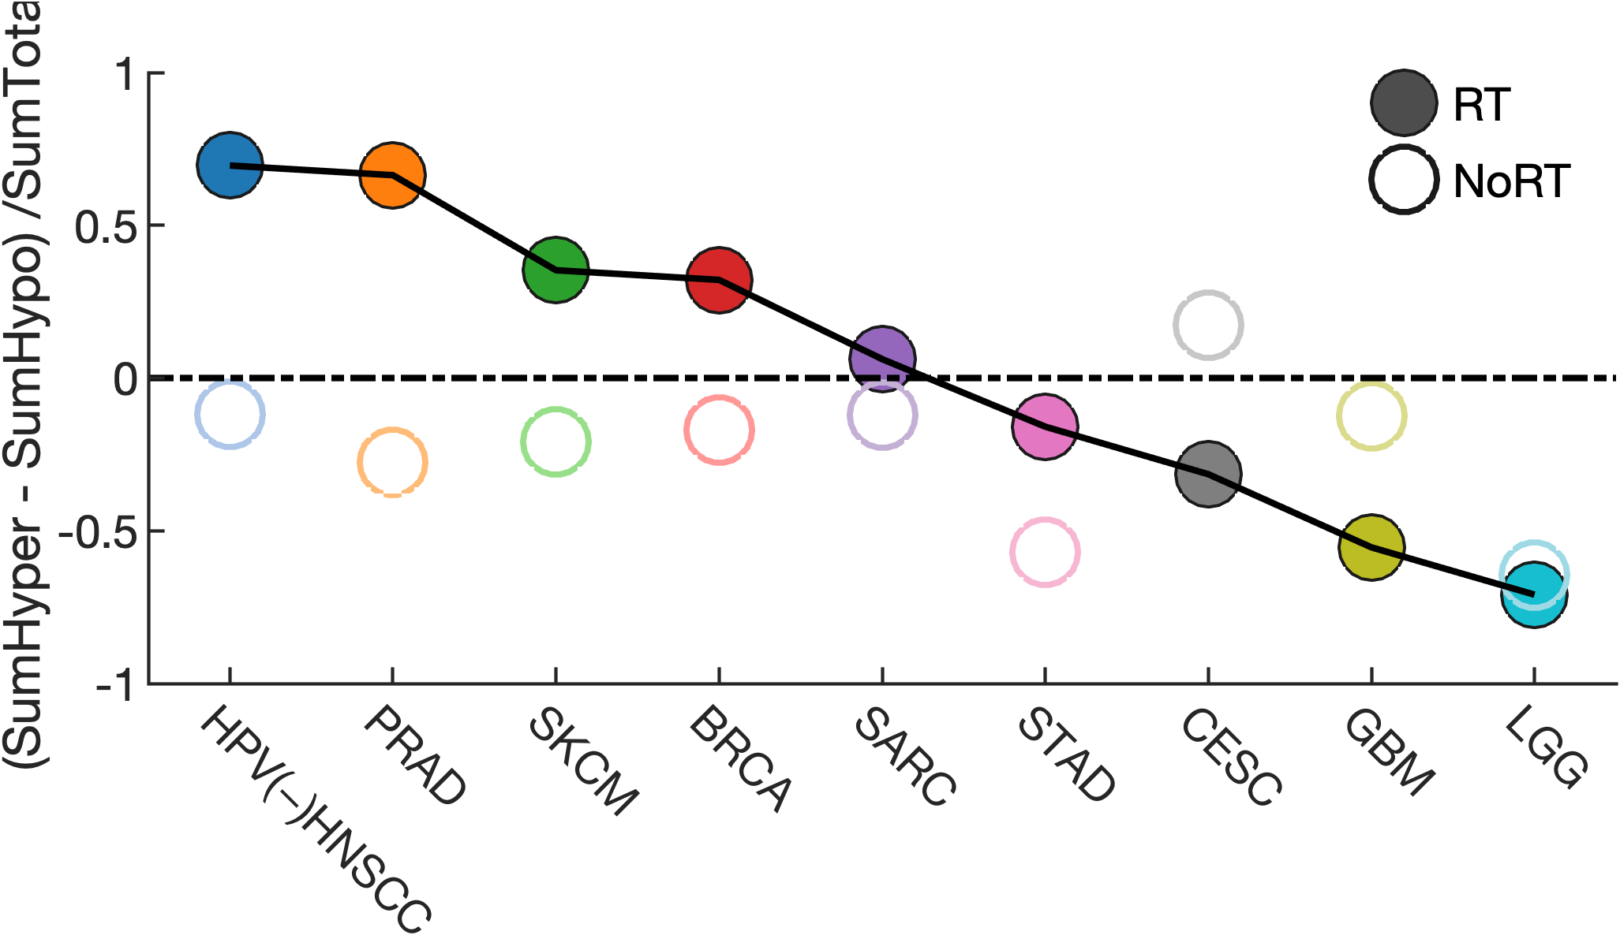
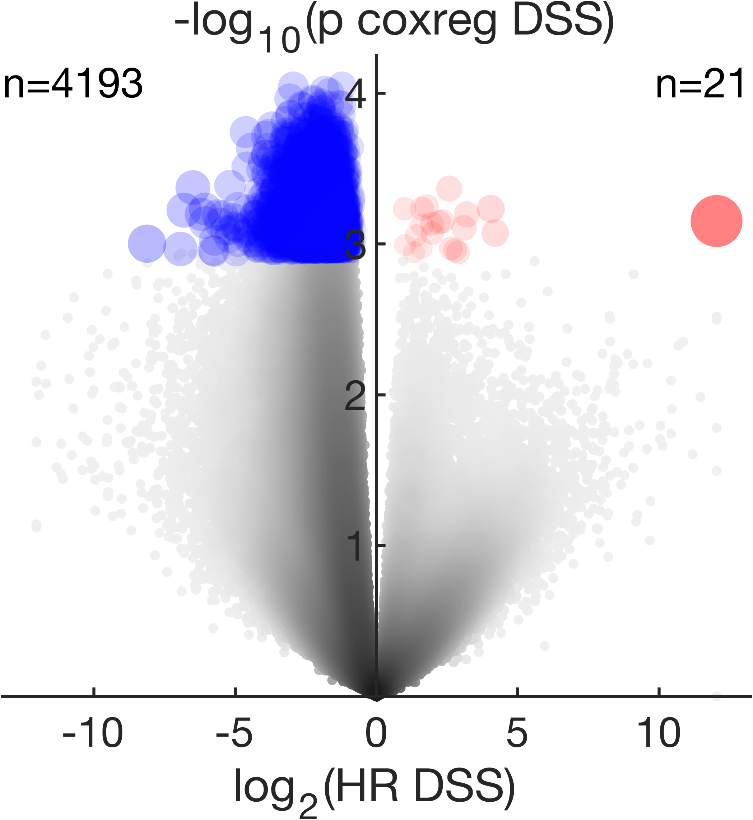
RT HPV(+)HNSCC
(ΣHyper – ΣHypo) / ΣTotal
Interestingly, the association of a hypermethylated epigenome with poor radiation response was not observed in HPV(+)HNSCC
The measure of balance between hyper- and hypo-methylation where zero indicates equal balance

Slide 31
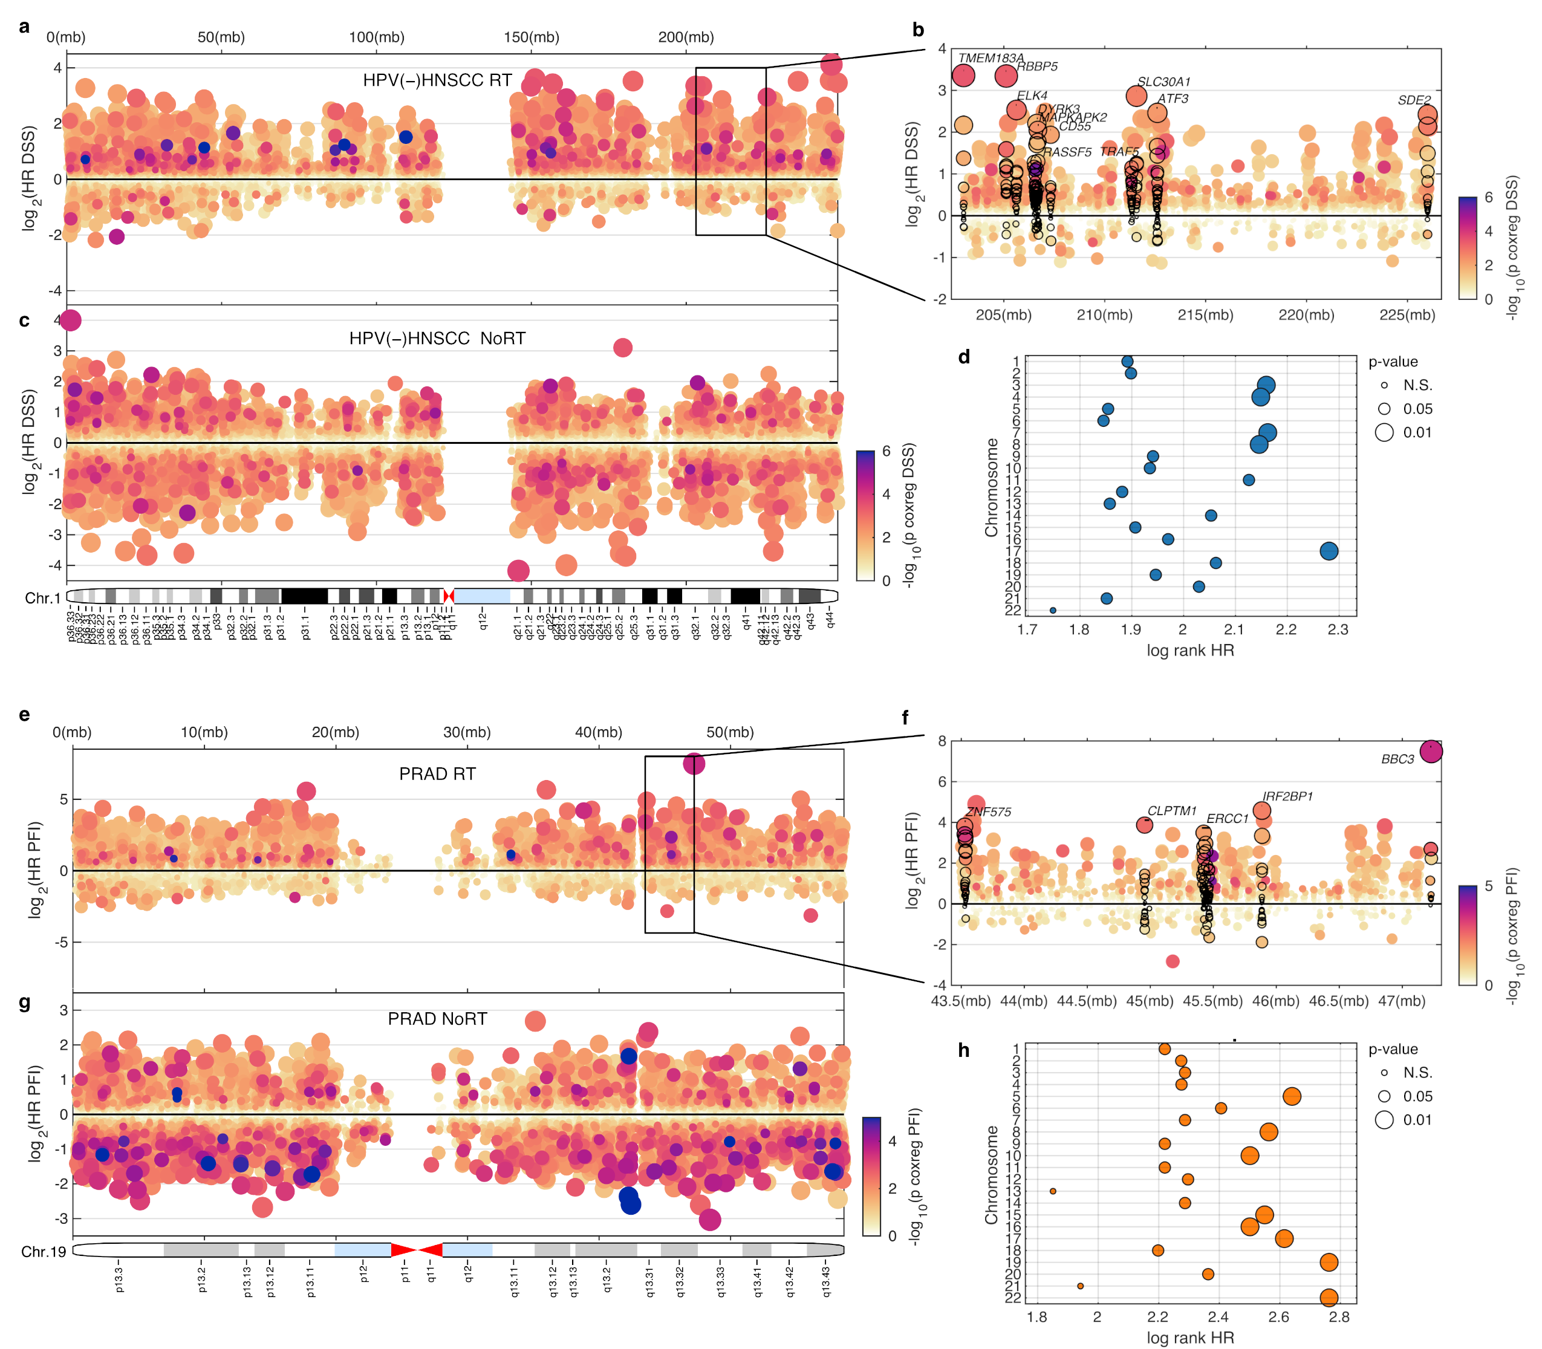
Global hyper-methylation in TCGA HPV(-)HNSCC and PRAD. Manhattan-like plot with log2 HR value on the y-axis and chromosomal position along the x-axis with color based on log10 cox regression p-value and size based on absolute log2 HR value

Slide 32
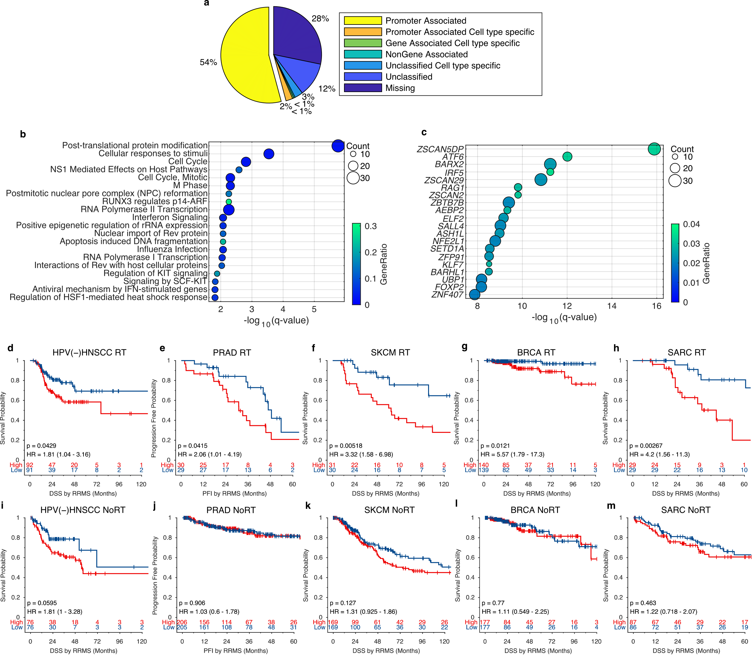

Slide 33
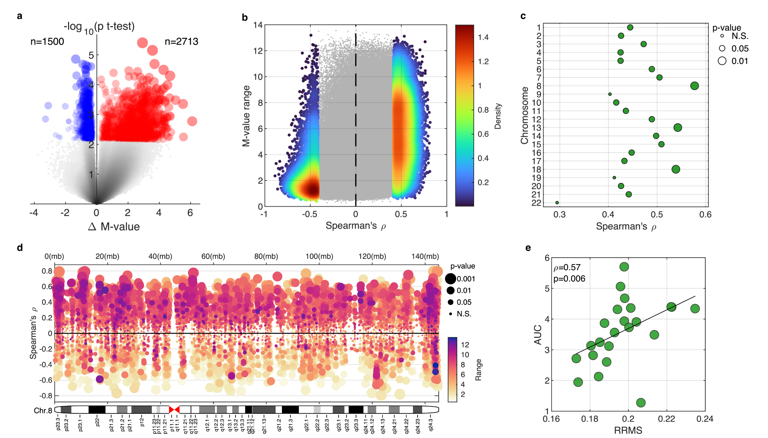

Slide 34
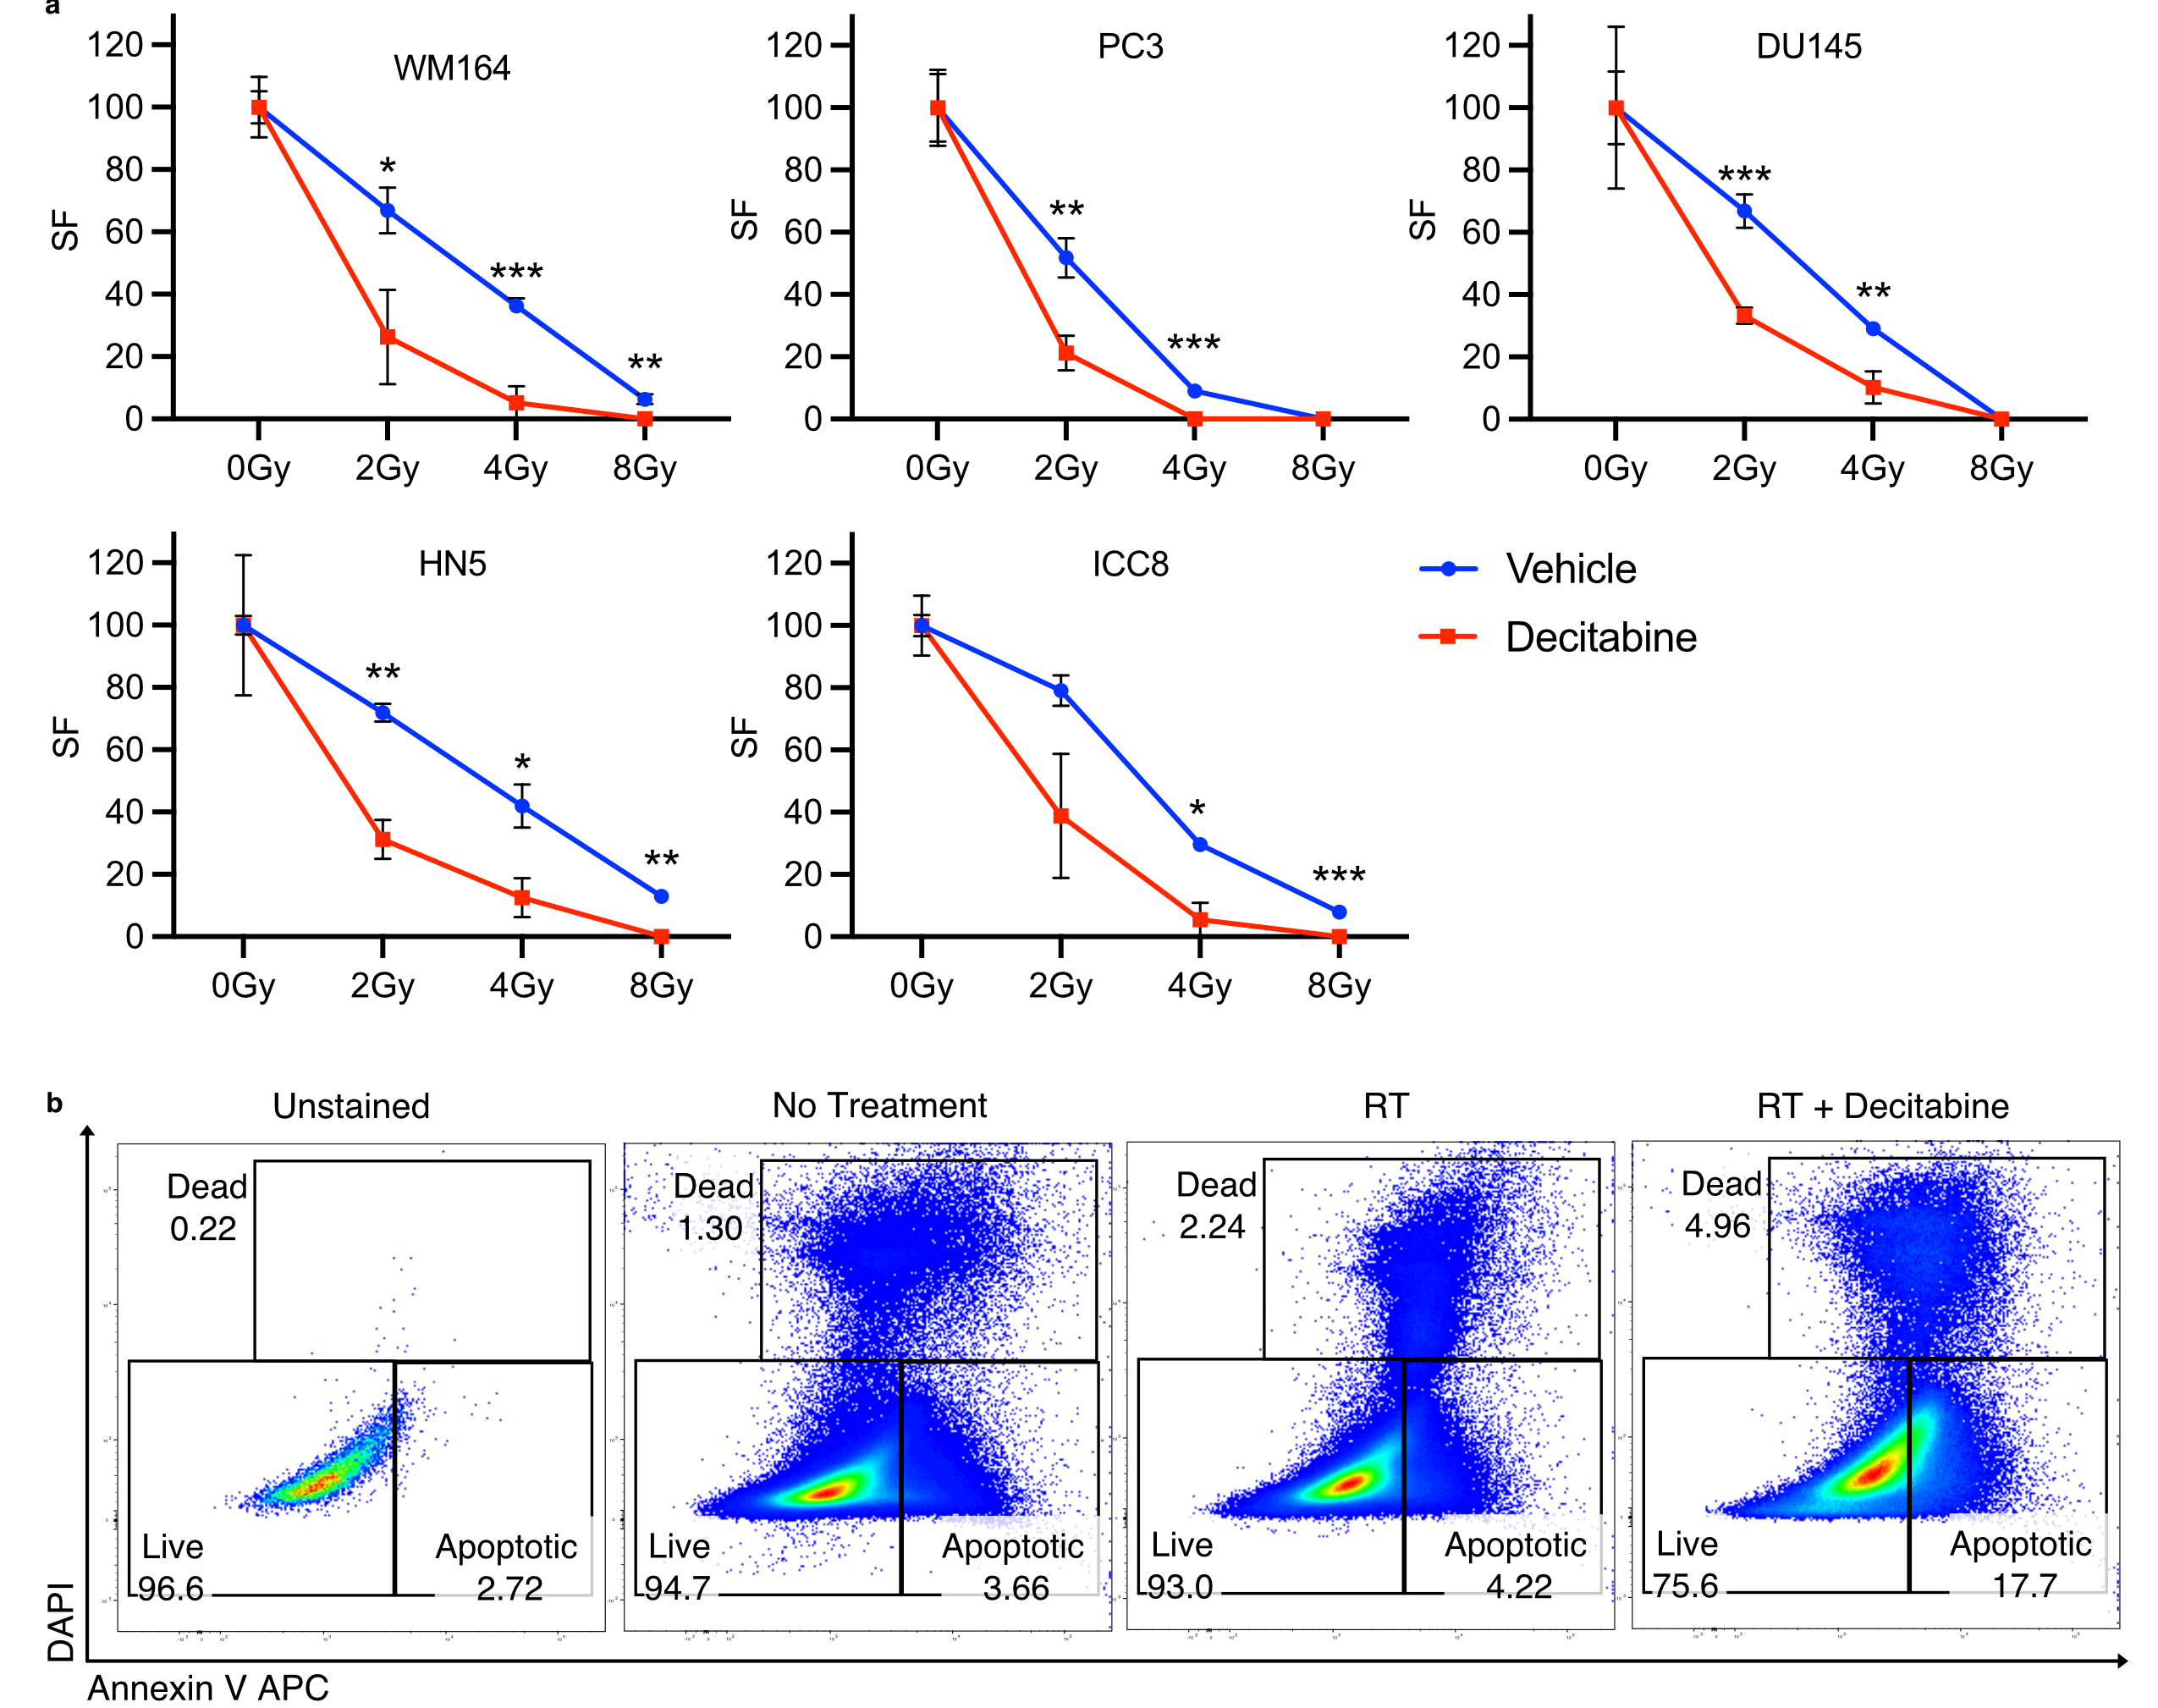
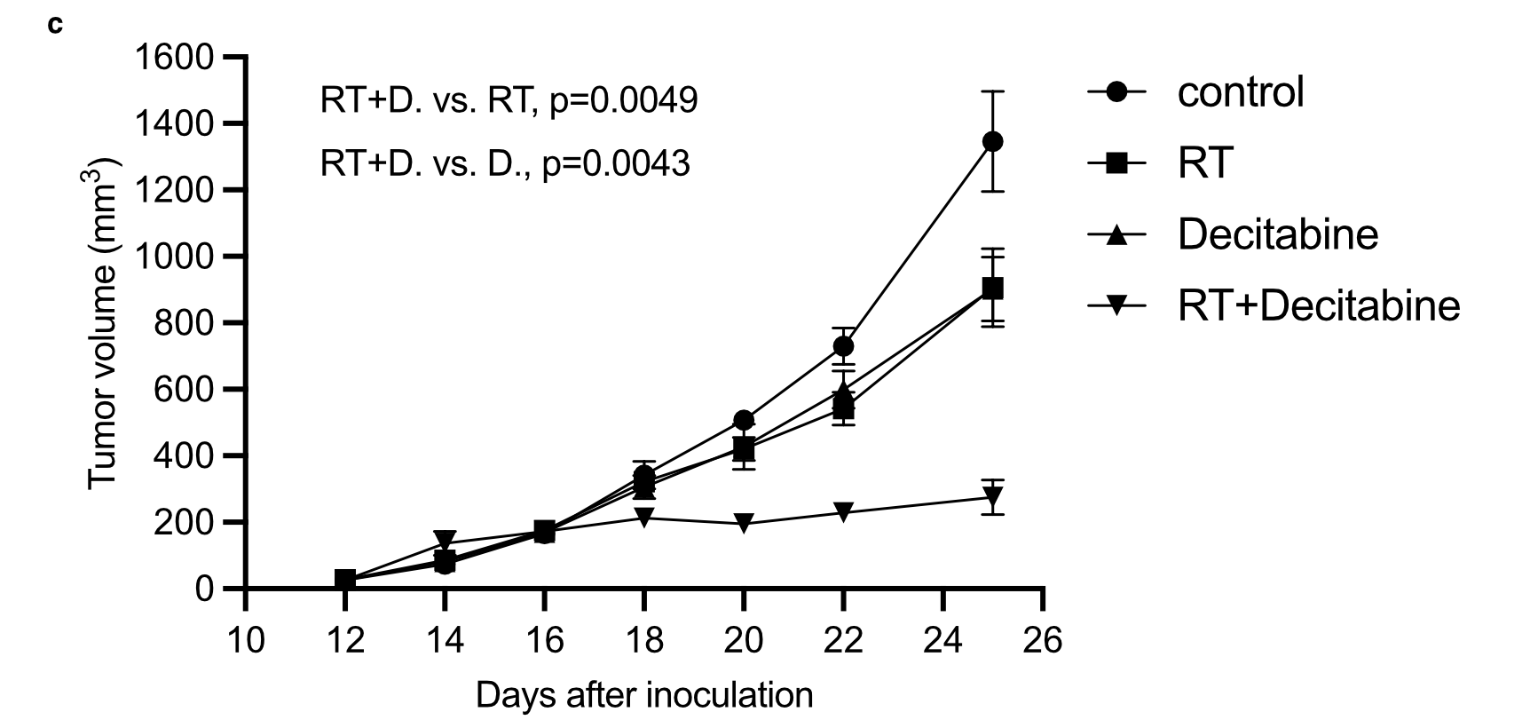
Decitabine, a demethylating agent, radiosensitizes HPV- HNSCC, prostate cancer, and melanoma cell lines
Cell viability of WM164 cells following treatment with radiation alone, decitabine alone, or the combination
Subcutaneous YUMM1.7 tumor growth curves in C57BL/6J mice receiving vehicle, RT alone, Decitabine alone, or the combination RT + Decitabine

Slide 35
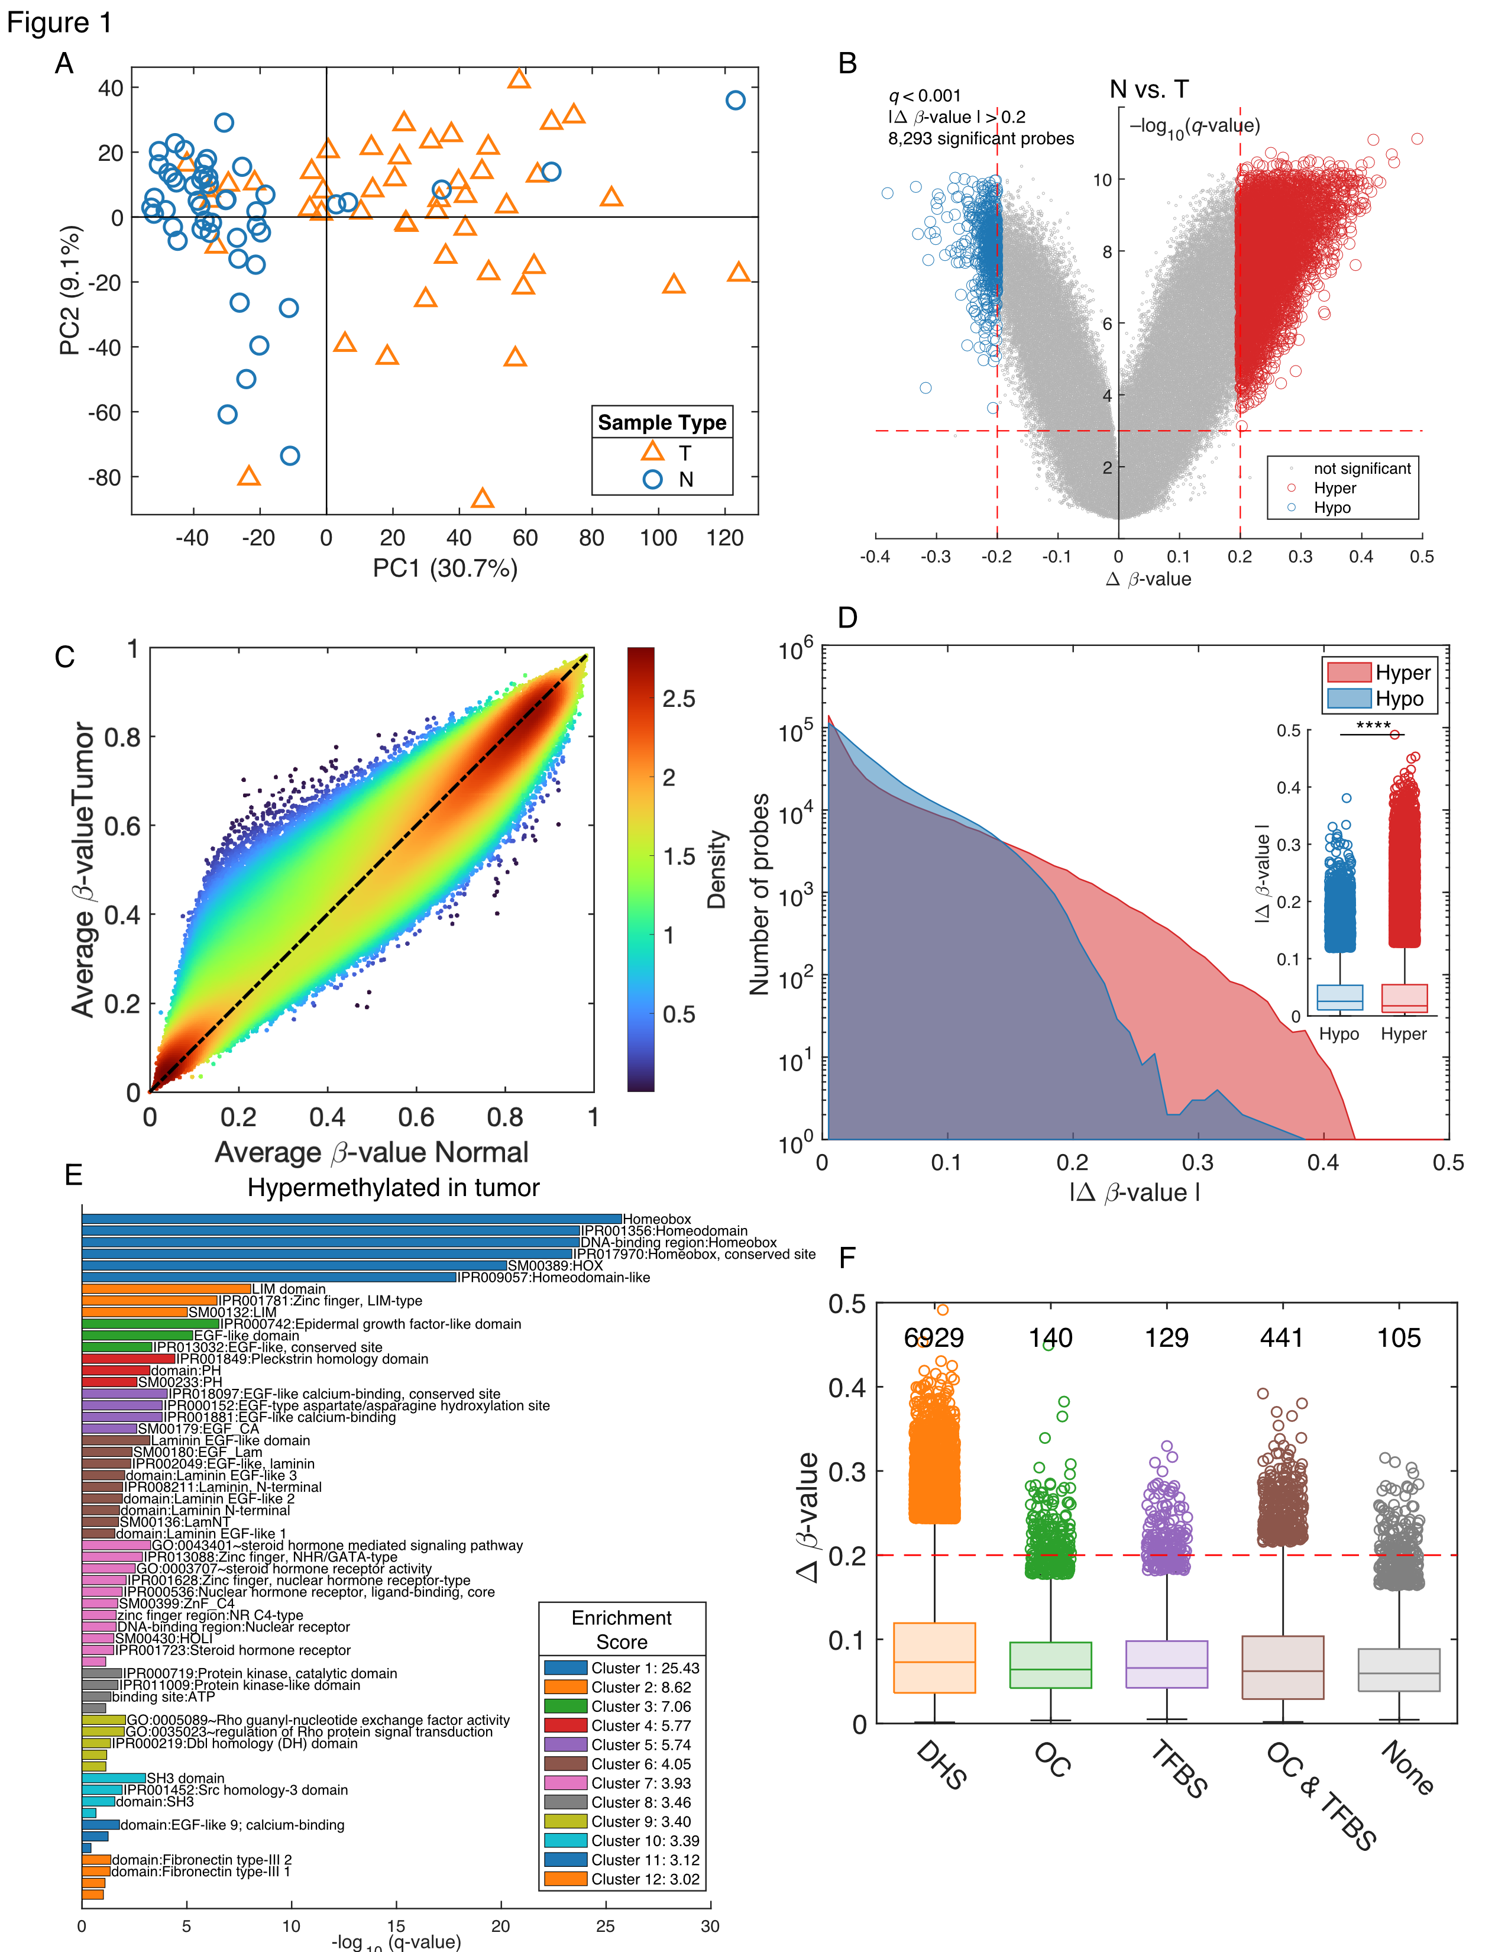
Epigenome-wide studies or Hypothesis-generating studies
There are many ways to analyze the data
Challenges
A limited number of samples
Retrospective cohorts
Additional cell line and mouse work is needed
Potential solutions
Keep it simple, ask specific questions
Use additional public datasets
Examples
Epigenomic characterization of locally advanced anal cancer: a radiation therapy oncology group 98-11 specimen study. [1]
Genome-wide host methylation profiling of anal and cervical carcinoma [2]
Dysregulation of DNA Methylation and Epigenetic Clocks in Prostate Cancer among Puerto Rican Men [3]
Segregation of HPV-positive Vulvar Neoplastic Lesions by Methylation [4]
Epigenome-wide association study of Prostate Cancer in African American Men identified differentially methylated immune genes and dysregulation of epigenetic clocks [5]
Siegel EM, Eschrich S, Winter K, Riggs B, Berglund A, Ajidahun A, et al. Epigenomic characterization of locally advanced anal cancer: a radiation therapy oncology group 98-11 specimen study. Dis Colon Rectum 2014;57:941–57.
Siegel EM, Ajidahun A, Berglund A, Guerrero W, Eschrich S, Putney RM, et al. Genome-wide host methylation profiling of anal and cervical carcinoma. PLoS One 2021;16:e0260857.
Berglund A, Matta J, Encarnación-Medina J, Ortiz-Sanchéz C, Dutil J, Linares R, et al. Dysregulation of DNA Methylation and Epigenetic Clocks in Prostate Cancer among Puerto Rican Men. Biomolecules 2022;12:2.
Ajidahun A, Berglund A, et al. Segregation of HPV-positive Vulvar Neoplastic Lesions by Methylation, Manuscript in preparation
Berglund A, Yamoah K, Ruiz-Deya G, Matta J, Park J. Epigenome-wide association study of Prostate Cancer in African American Men identified differentially methylated immune genes and dysregulation of epigenetic clocks. Submitted.

Slide 36
Data (Dr. Park)
PCa AA
120 Tumors, 121 Normal
Gleason Grade:
5+6 n=26
7 n=72
8+9 n=22
EPIC methylation
Analysis
Are immune-related pathways silenced in AA PCa tumors?
Immune synapse genes
STING/cGAS signaling
What are differently methylated?
Genes and/or global trends
Berglund A, Putney RM, Hamaidi I, Kim S. Epigenetic dysregulation of immune-related pathways in cancer: bioinformatics tools and visualization. Exp Mol Med 2021;53:761–71
Berglund A, Putney RM, Hamaidi I, Kim S. Epigenetic dysregulation of immune-related pathways in cancer: bioinformatics tools and visualization. Exp Mol Med. 2021 May;53(5):761–71.

Slide 37
Can we identify sample from the same person (different timepoints or Tumor/Normal pairs)
There are 59 designed SNP-probes on the EPIC chip
fh=imagesc(squareform(pdist(X','euclidean')))

Slide 38
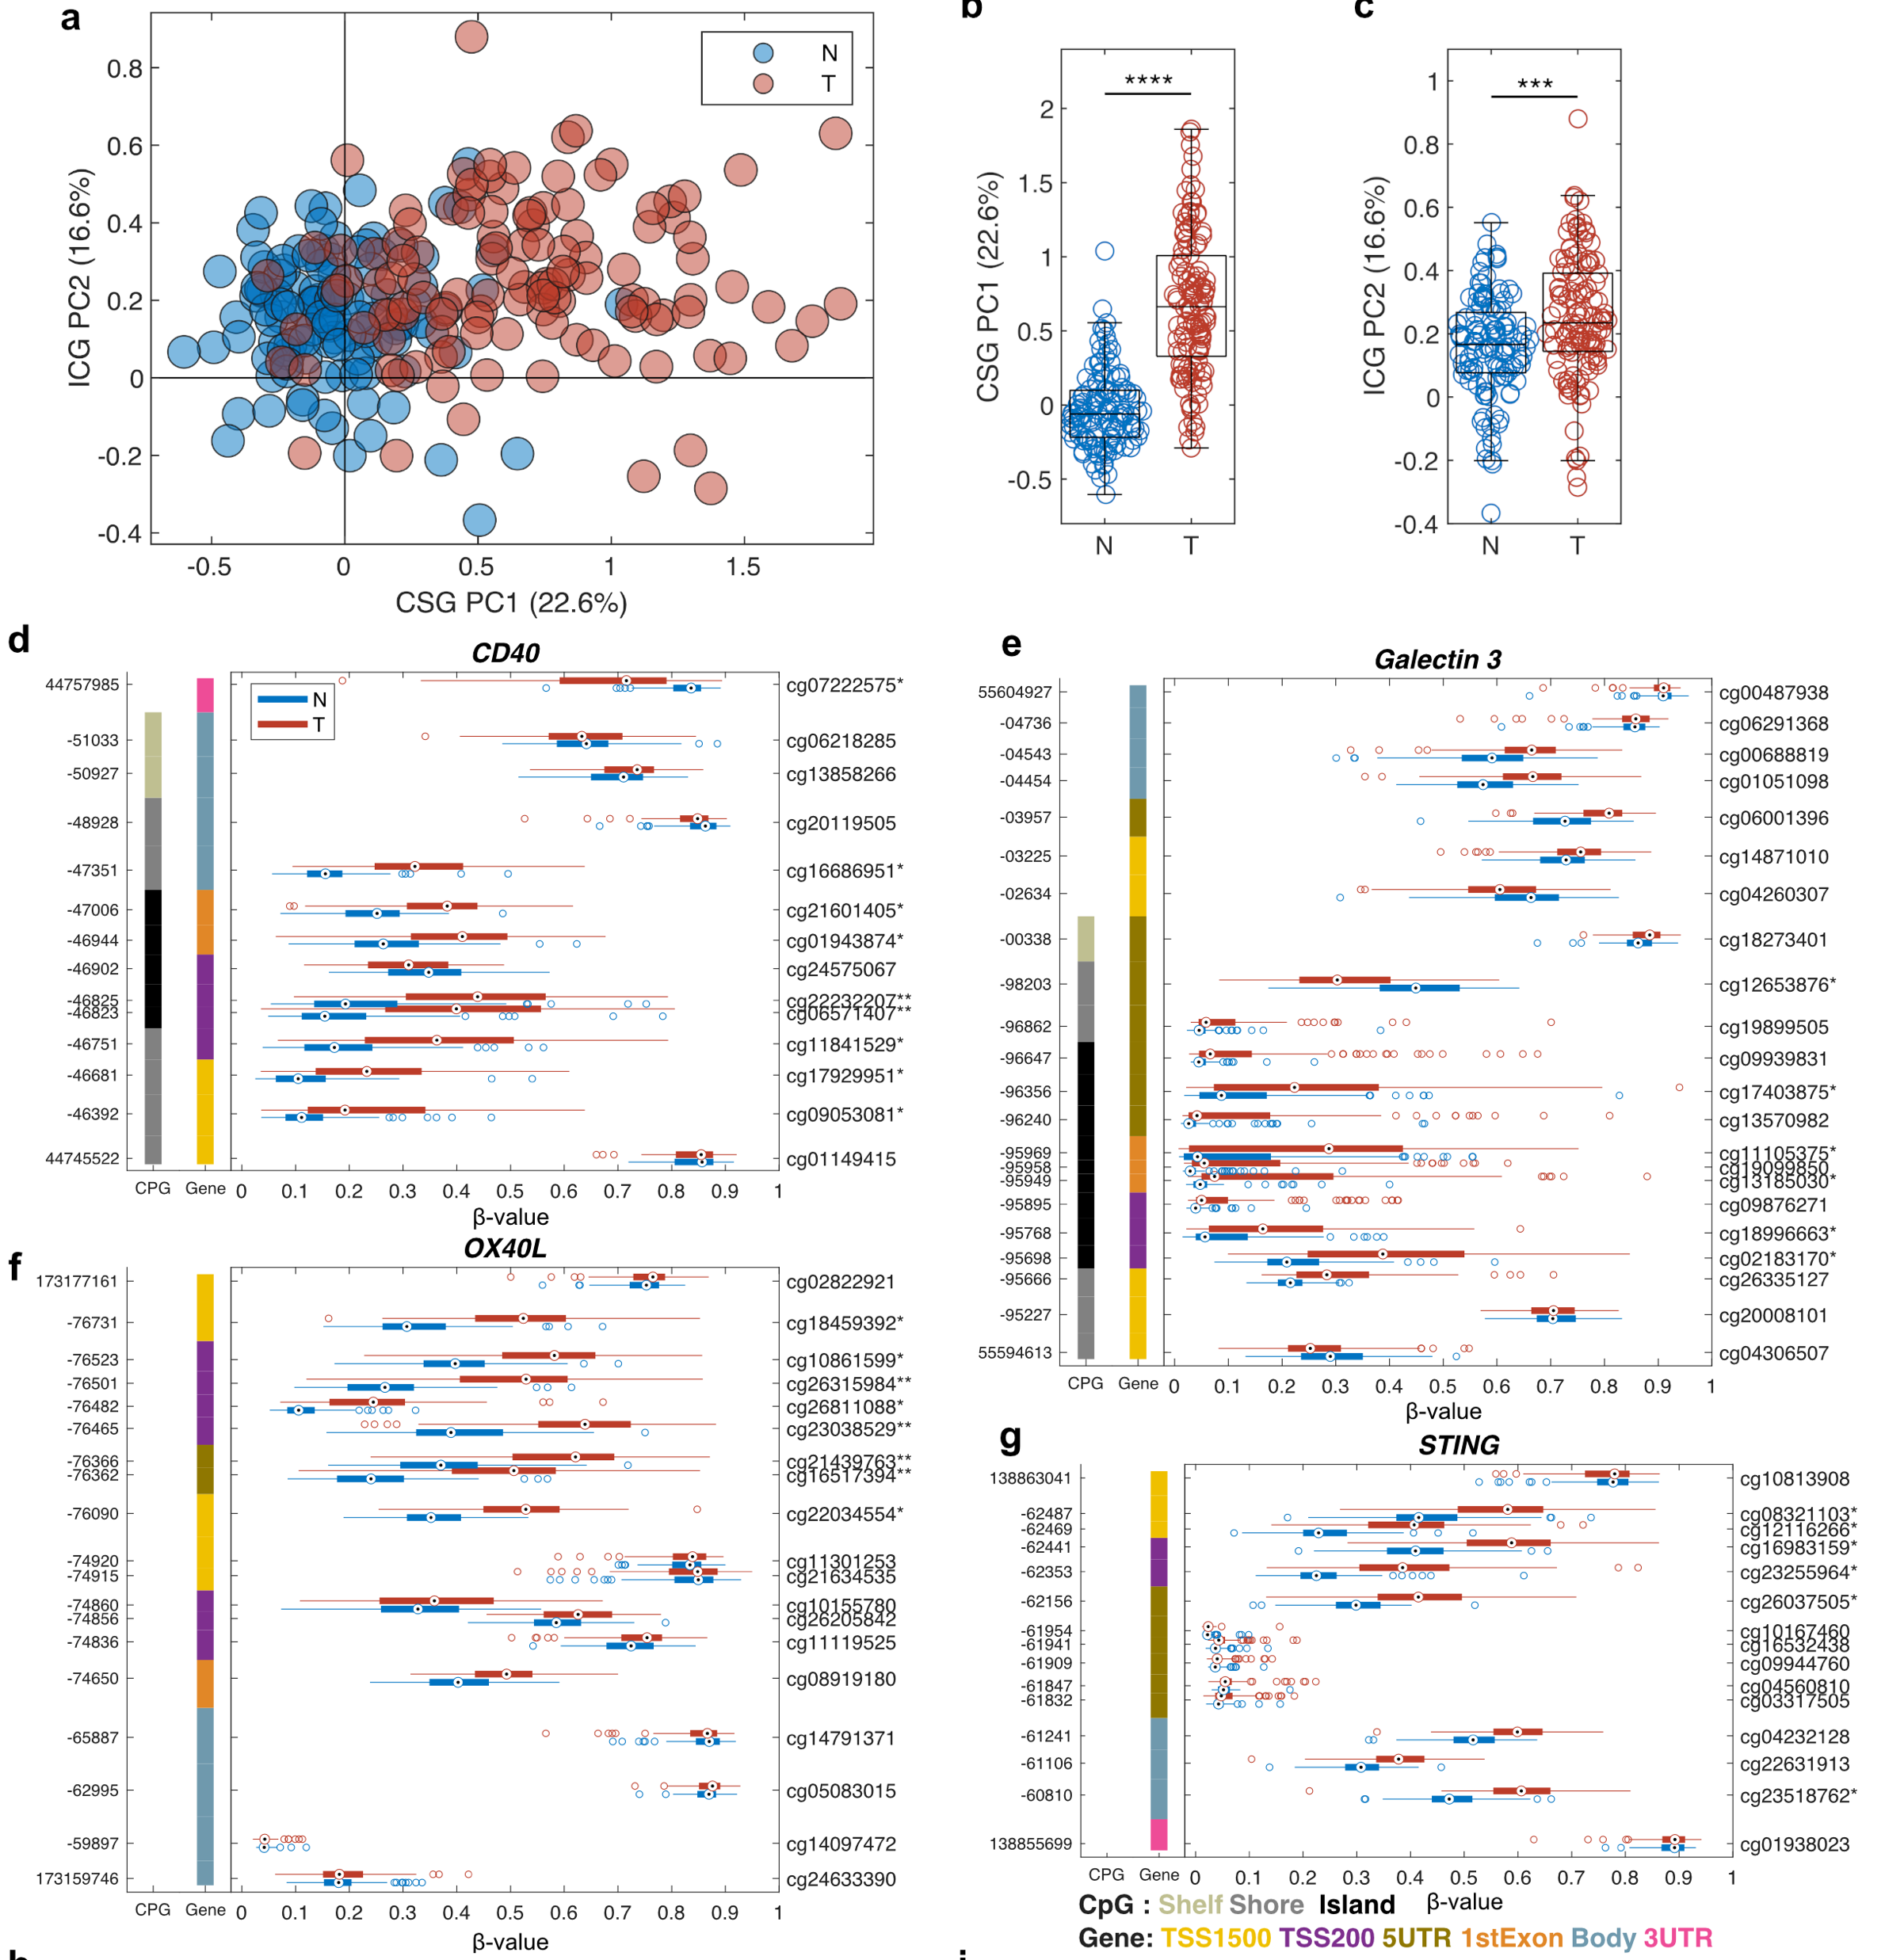
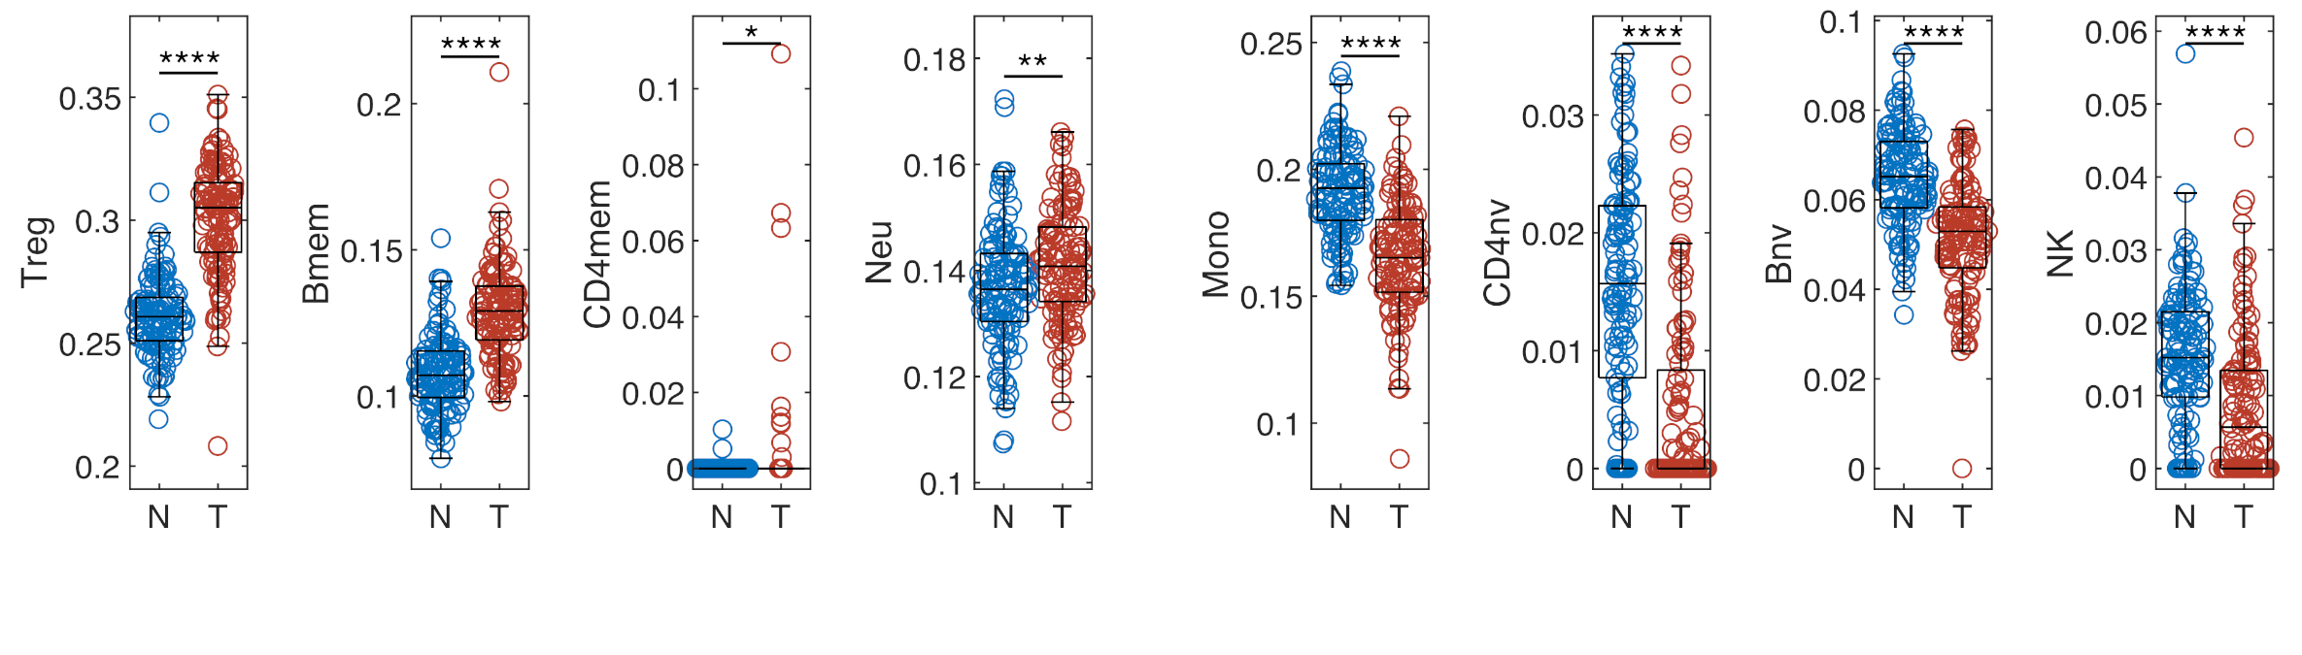
Epigenetic changes in immune genes for AA PCa. (a) Scatter plot of prediction using immune synapse PCA model with adjacent normal tissue in blue and PCa in red. Boxplots of normal and tumor samples for CSG (b) and ICG (c). Several genes show a significant difference in methylation levels for the immune synapse genes
Individual GSM-plots for (d) CD40, (e) Galectin 3, (f) OX40L, and (g) STING.
Boxplots comparing normal vs. tumor for immune cell types with an increased amount in (h) and decreased amount in (i) in tumor compared to normal,

Slide 39
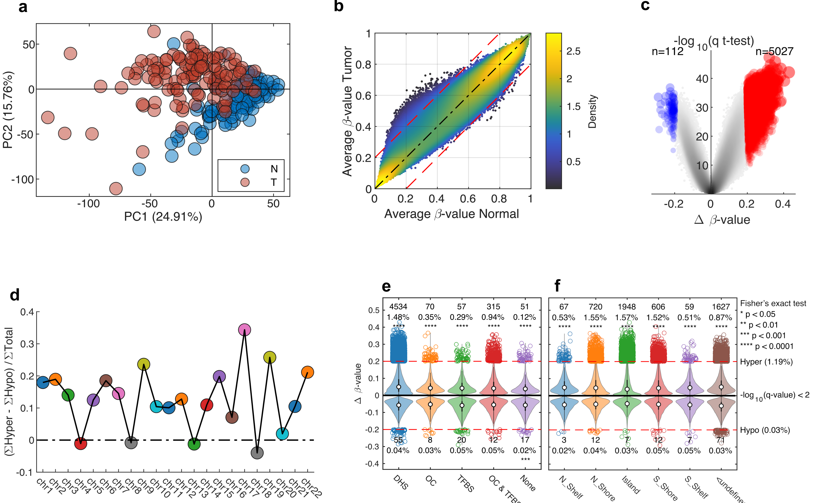
DNase Hypersensitivity CpG-probes (DHS), Open Chromatin probes (OC), Transcription factor binding sites (TFBS).

Slide 40
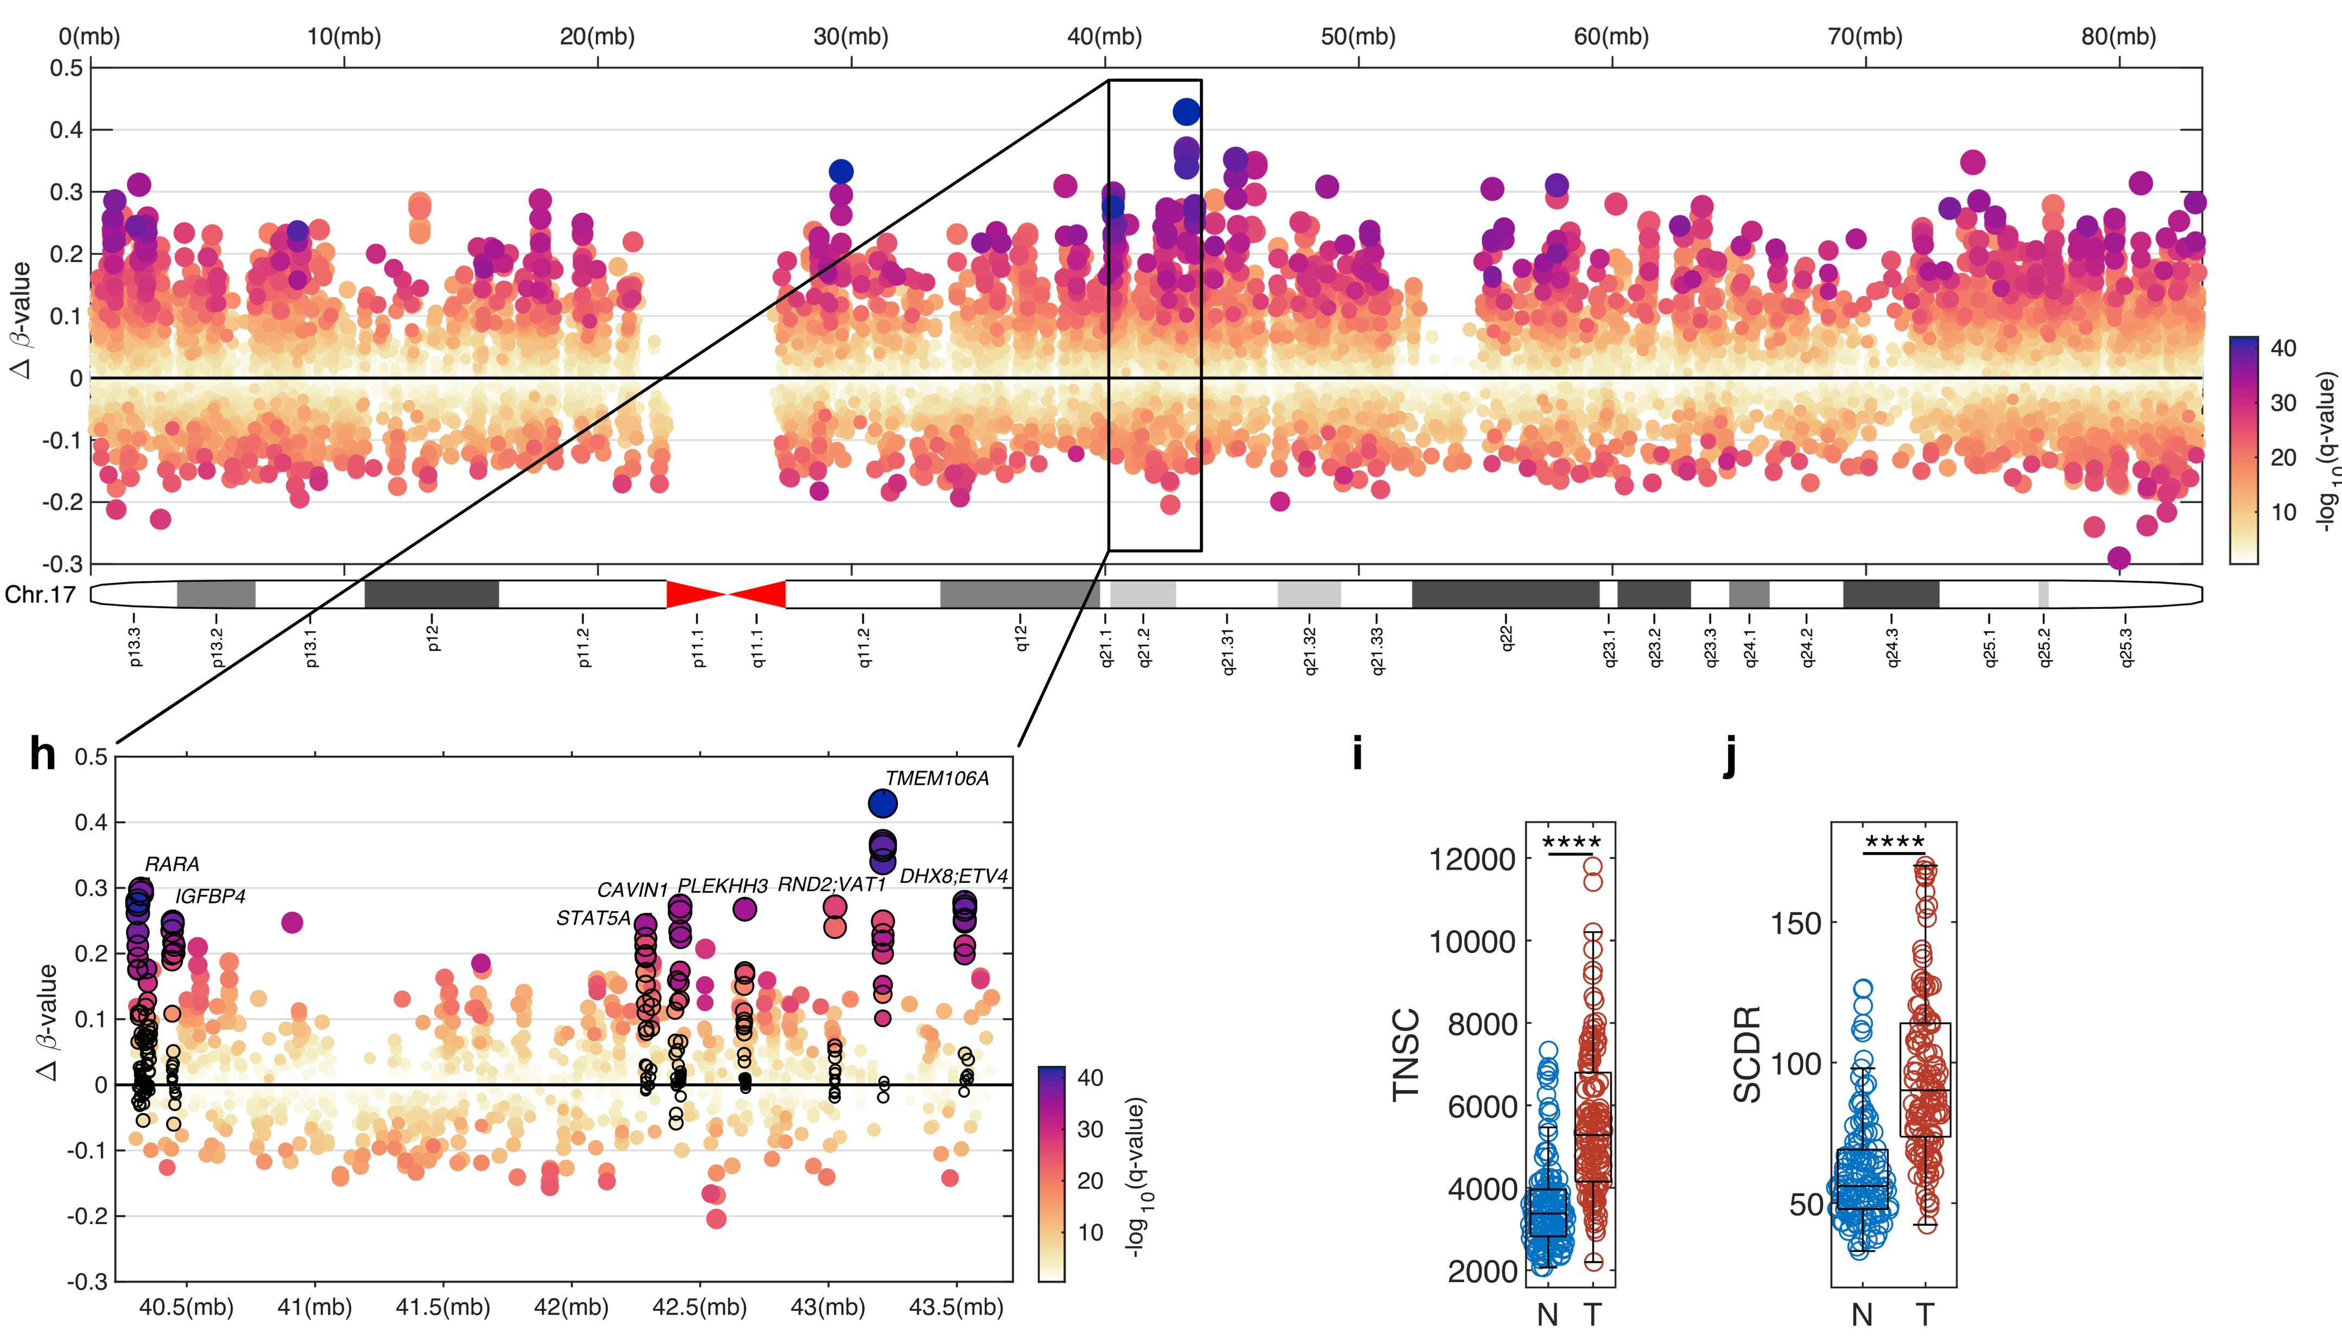

Slide 41
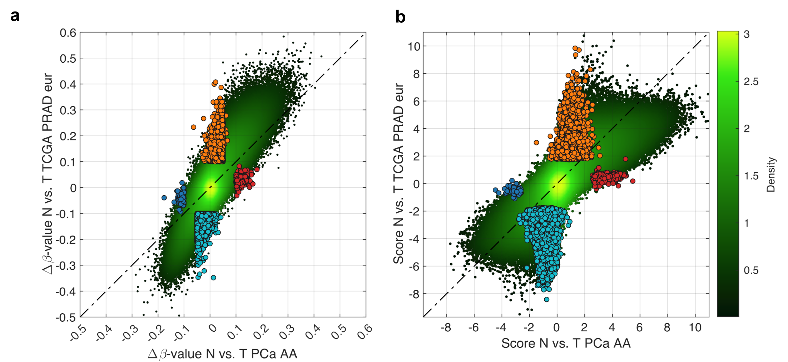
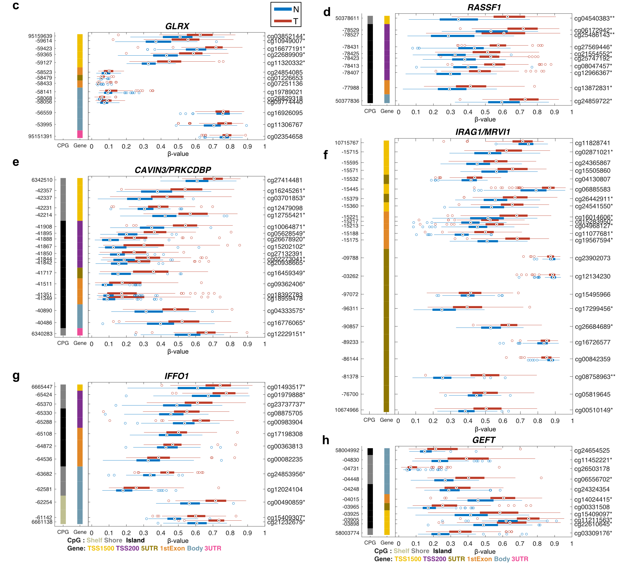
Comparing methylation changes in PCa AA to European cohorts

Slide 42
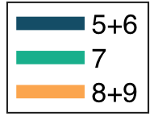
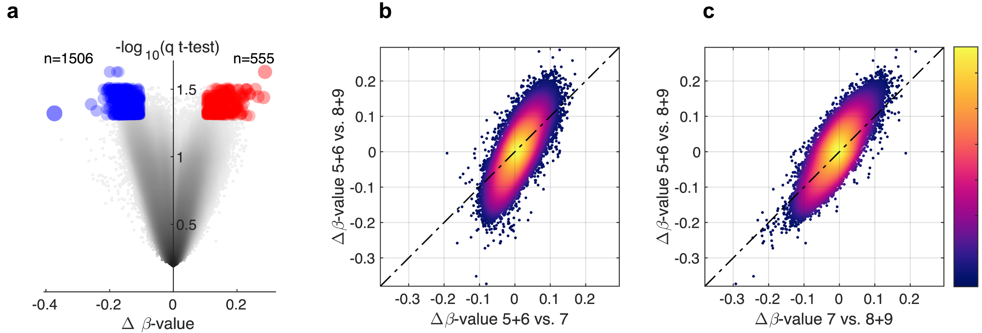
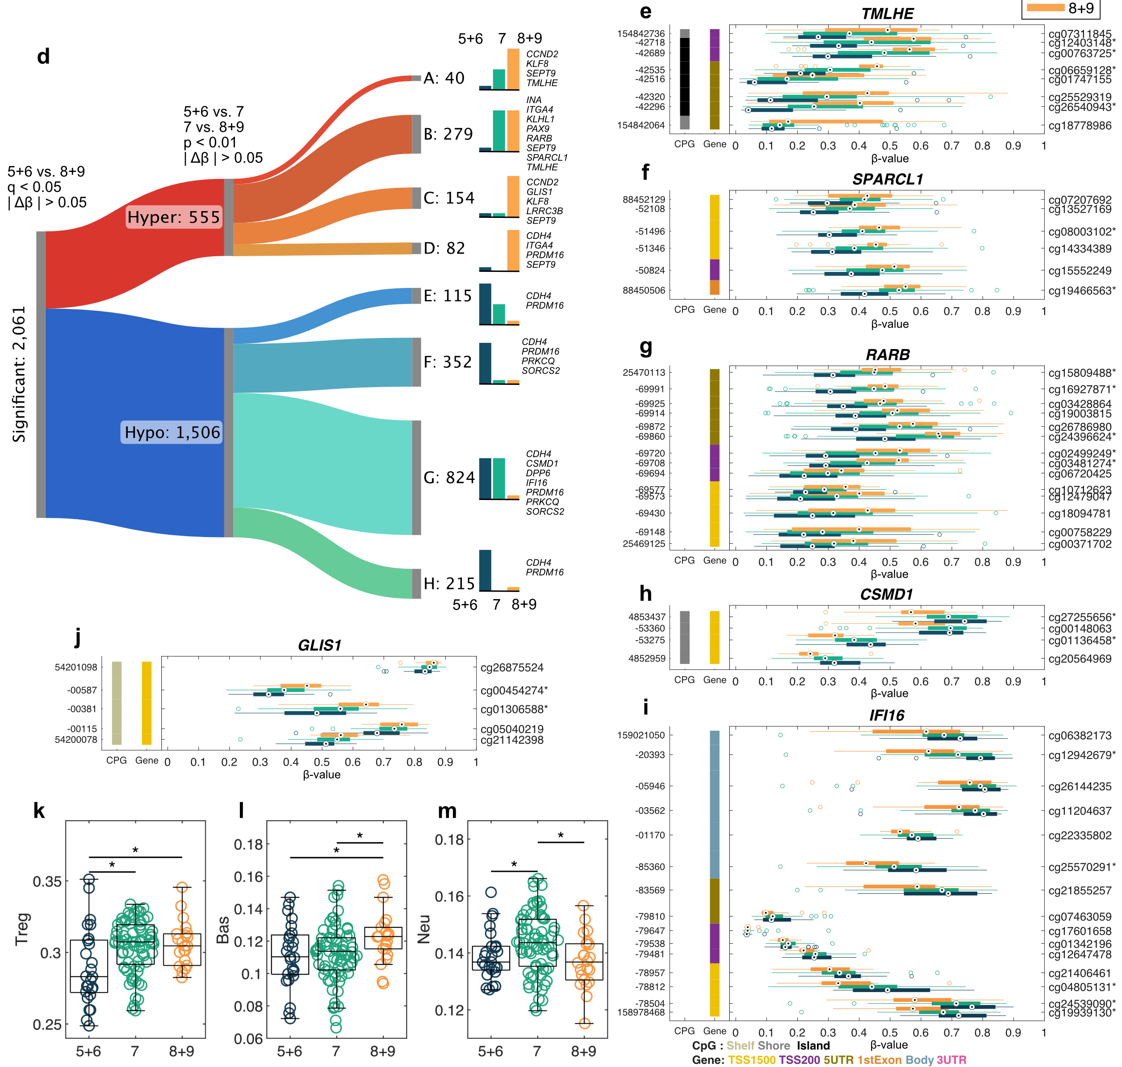
Methylation changes based of Gleason score

Slide 43
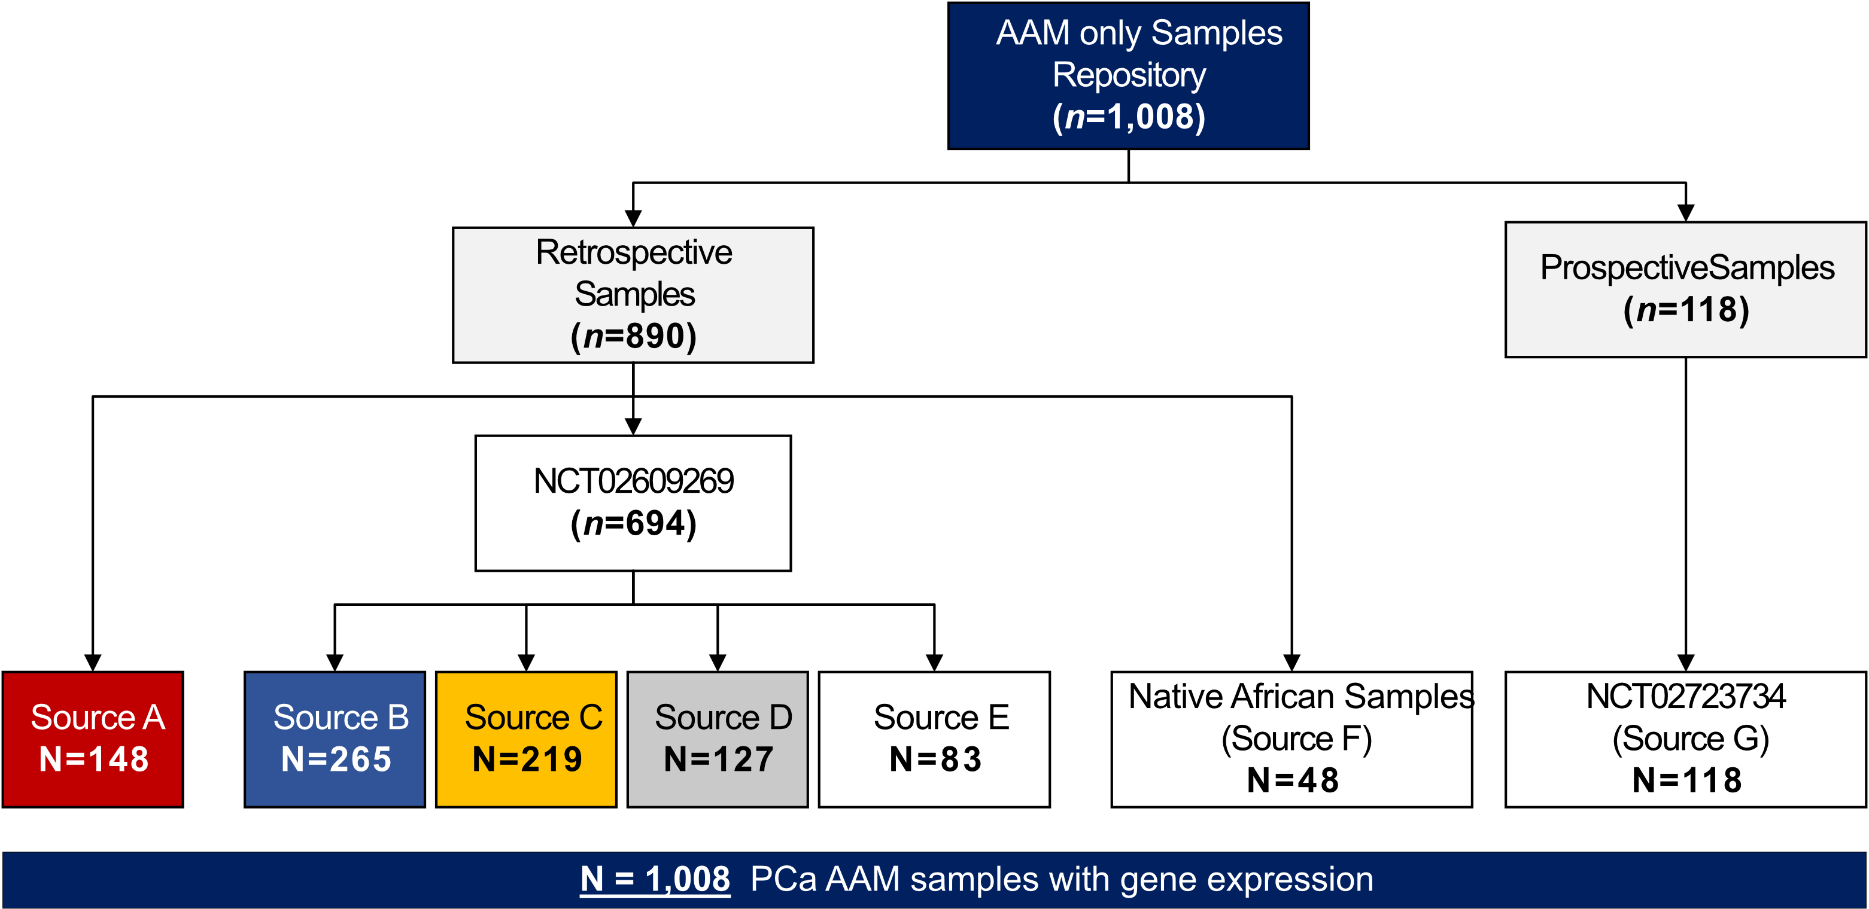
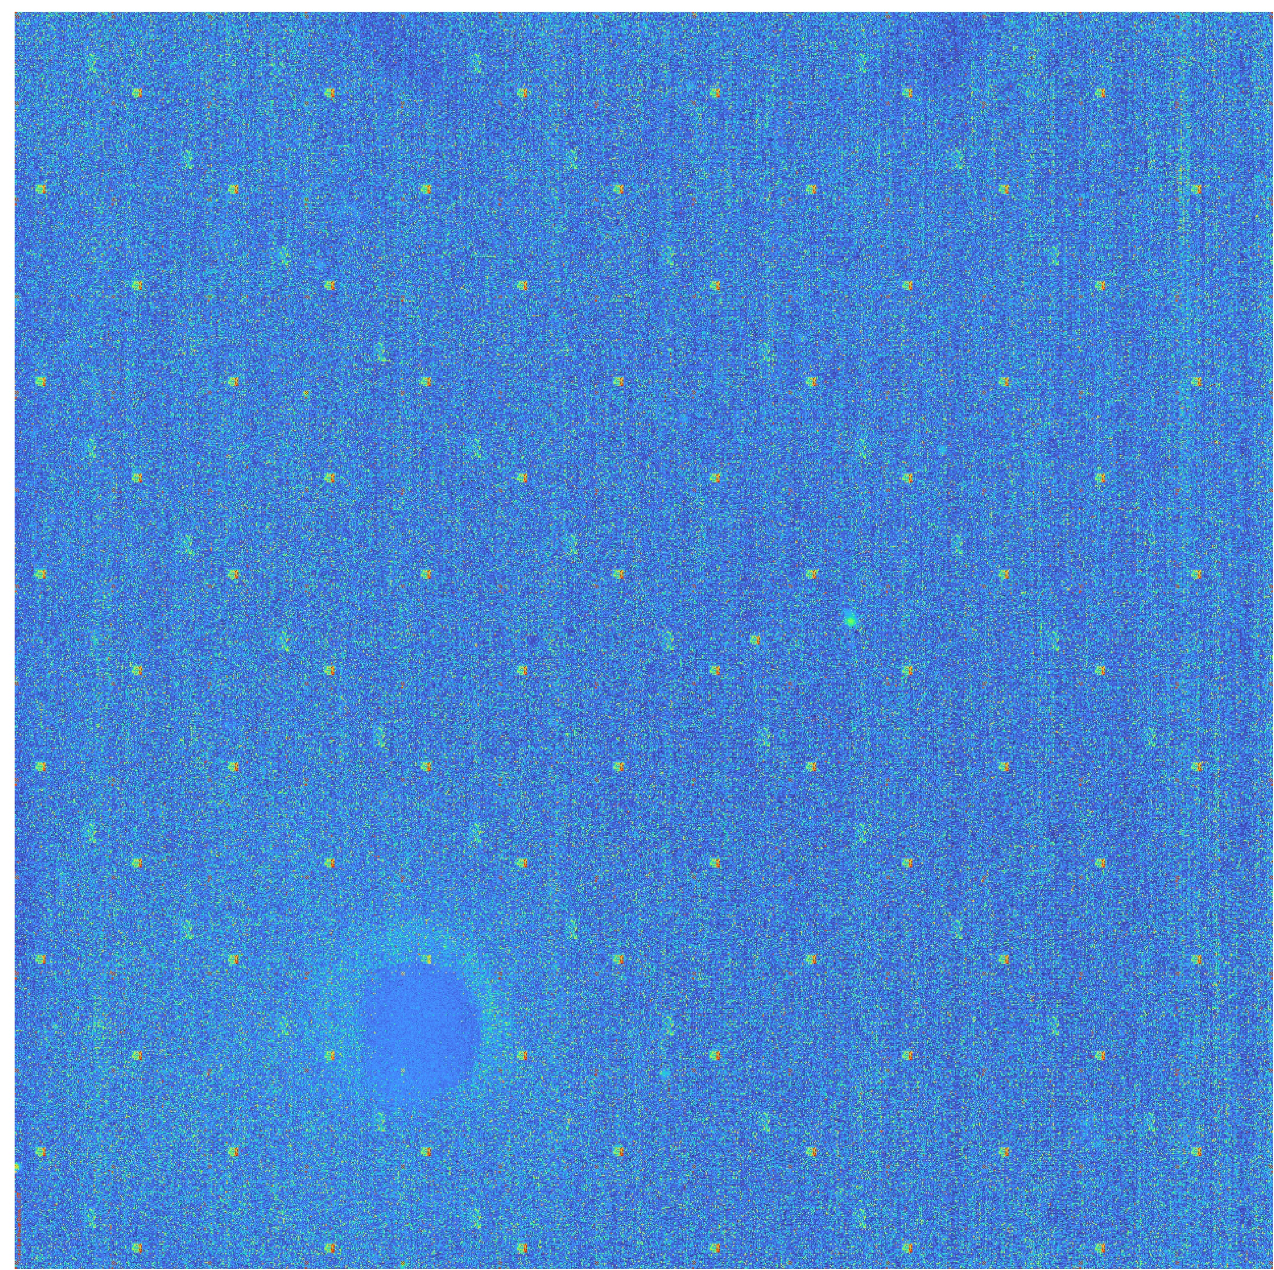
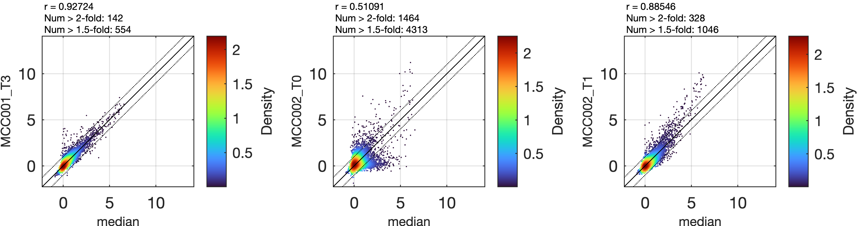
Deconvolute key biological drivers that define subsets of lethal prostate cancer in African American men
DoD Prostate Cancer Research Program (PCRP)
Data Science Grant, Partnering PI with Dr. Yamoah
All samples come from the CLIA approved Decipher test (22 markers) using the Affy HuEx 1.0 ST array
Qin Y, Yi D, Chen X, Guan Y. Deep learning identifies erroneous microarray-based, gene-level conclusions in literature. NAR Genomics and Bioinformatics. 2021 Dec 1;3(4)

Slide 44
Acknowledgment - All my collaborators
Dr. Sungjune Kim
Dr. Brook Fridley
Dr. John Cleveland
Dr. Jim Mulé
Prostate & Health Disparities
Dr. Yong Park
Dr. Kosj Yamoah
GBM
Dr. Arnie Etame
Epigenetic clocks
Dr. Jacob Kresovich
Dr. Anna Giuliano
Dr. Anna Coghill
Kidney
Dr. Brandon Manley
Bladder
Dr. Roger Li
Methylation
Dr. David Shibata
Dr. Erin Siegel
The results shown here are based in part upon data generated by the TCGA Research Network: https://www.cancer.gov/tcga

Slide 45
Backup slides

Slide 46
Berglund A, Mills M, Putney RM, Hamaidi I, Mulé J, Kim S. Methylation of immune synapse genes modulates tumor immunogenicity. J Clin Invest. 2020 Feb 3;130(2):974-980

